Slide 1
FINANCIAL INDEPENDENCE
On a scale of 1-10 what is your desire to become financially independent?
Do you currently have a written plan to get there?
Would you want one if it were free?
HOME INSPECTION
GENERATION TO GENERATION INVESTMENT
Do you want to leave an inheritance to your family?
WITHDRAWAL - RETIREMENT INCOME
Do you have a retirement income strategy?
ACCELERATE MORTGAGE
What age will you be mortgage free?
COLLEGE SAVINGS - 529
Are you saving for your children’s higher education?
RETIREMENT SAVINGS - ACCUMULATION
Do you know your financial independence number?
3-6 MONTH EMERGENCY FUND
How many months of emergency money do you have?
CREDIT CARD DEBT FREE
Do you know your current debt freedom age?
WILL & ESTATE PLAN
Do you have a Will?
CASH FLOW PLAN / SHORTFALL OR SURPLUS
Do you have a budget?
INCOME REPLACEMENT PLAN / TERM LIFE INSURANCE
Do you have enough individual life insurance to replace your income in the event of a premature death?

Slide 2
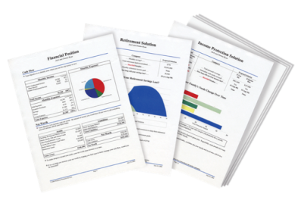
FAMILY FINANCIAL INDEPENDENCE
FINANCIAL NEEDS ANALYSIS
A GPS FOR YOUR MONEY
Goal: Develop a family tradition of financial success & independence
Goal: Never run out of money before you die
Goal: Have no rent or mortgage payment after retirement
Goal: To have well-educated and debt-free kids
Goal: Reach your FIN & be totally financially free
Goal: Protect retirement savings from ever being used for anything other than retirement
Goal: Destroy this “Financial Cancer” as it robs your ability to invest and create wealth
Goal: Avoid probate, name guardians for minors, make Living Will and select Power of Attorney
Goal: Attempt to lower your monthly expenditures
Goal: A plan to replace the income you earn, to protect those you love and depend on you.

Slide 3
10 Areas to Free Up Money to Save
Establish a cash flow plan
Pay yourself first
Avoid the credit trap
Adjust your lifestyle
Adjust your priorities
Check your monthly subscriptions
Check your insurance rates – auto, home, life
Realign your assets - sell something
Adjust your W-4
Earn extra income

