Slide 1

Welcome
Thank You for attending we will begin shortly

Slide 2
What is the New Career Model?

Slide 3

The World is Changing……..Are you Changing?

Slide 4

IBM conducted a survey among 25,000 people to gauge how perspectives about work, transportation, and leisure changed since the outbreak of the coronavirus.
54% of adults want to work remotely most of the time after the pandemic, according to a new study from IBM
Working from home could make workers happier and save employees and employers money.
Of those surveyed, 75% said they would like to continue to work from home in at least a partial capacity, while 40% of respondents said they feel strongly that their employer should give employees the choice to opt-in to remote work.

Slide 5








The Goal is to become a 2% which allows you to live your life on your terms
New Cars
Travel
Education
Hobbies
Family & Friends
New
Homes
Charities
5

Slide 6
How to Become a 2%- Become an Owner
CASH FLOW QUADRANT*
EMPLOYEE
Has a job.
Income based on position, not the person.
BUSINESS
Owns a system. Has others working for him/her.
Unlimited income potential via manufacturing, marketing, etc.
SELF-EMPLOYED
Owns a job.
Dentist, doctor, lawyer, hair stylist, real estate agent, salesperson.
INVESTOR
Has money working for him/her.
Enjoys complete freedom and lives the dream.
*The Cash Flow Quadrant, CASH FLOW Technologies, Inc.; used with permission.
The Cash Flow Quadrant and ESBI are trademarks of CASH FLOW Technologies, Inc. For informational purposes only.

Slide 7
Our Business Model
What if you could find a legitimate professional business that:
80% of North America is in your Market
You can work from home -Totally Online- No Overhead
No Product to Buy, Assemble or Ship
Work when you want and as often as you want

Slide 8
Our Business Model
What if you could find a legitimate professional business that:
Provides a scalable marketing and business system
Utilizes the latest technology
Is an Intangible Product that Requires a Professional License
Has a Multi-Billion Dollar Product Support System

Slide 9


Recap

Slide 10
Our Business…….
Educate North America on Money

Slide 11
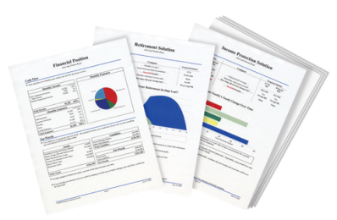


Build Your Financial House
Other Goals and Dreams
College Savings
Retirement
Accelerate Paying Off Debt
On a scale of 1-10,
10 being the highest,
how would you rate your
confidence level that you will become debt free and financially independent?
Budget - Emergency Fund
Protect Your Income / Term Life

Slide 12
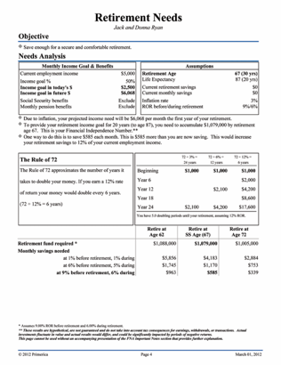
STEP 1: Know Your Financial Independence Number
Everyone’s goal is to have enough money that works,
so they don’t have to. Your FIN defines the amount.
Age 30
Financial Independence Goal is age 60.
Ideal annual income: $100,000
After inflation of 3%, this is $243,000.
The money needs to last for 30 more years. THIS IS A VERY LONG VACATION.
Your FIN is $2,624,000
To get there, invest $1,421 per month for 30 years at 9% = $2,624,400
This hypothetical example assumes 20 years of retirement income needed, at a 6% post-retirement rate of return and 3% inflation. Hypothetical investment rates assume a nominal 9% rate of return, compounded monthly, and are not indicative of any specific investment. Any actual investment may be subject to taxes and fees, which would lower performance. This example shows a constant rate of return, unlike actual investments which may fluctuate in value.

Slide 13
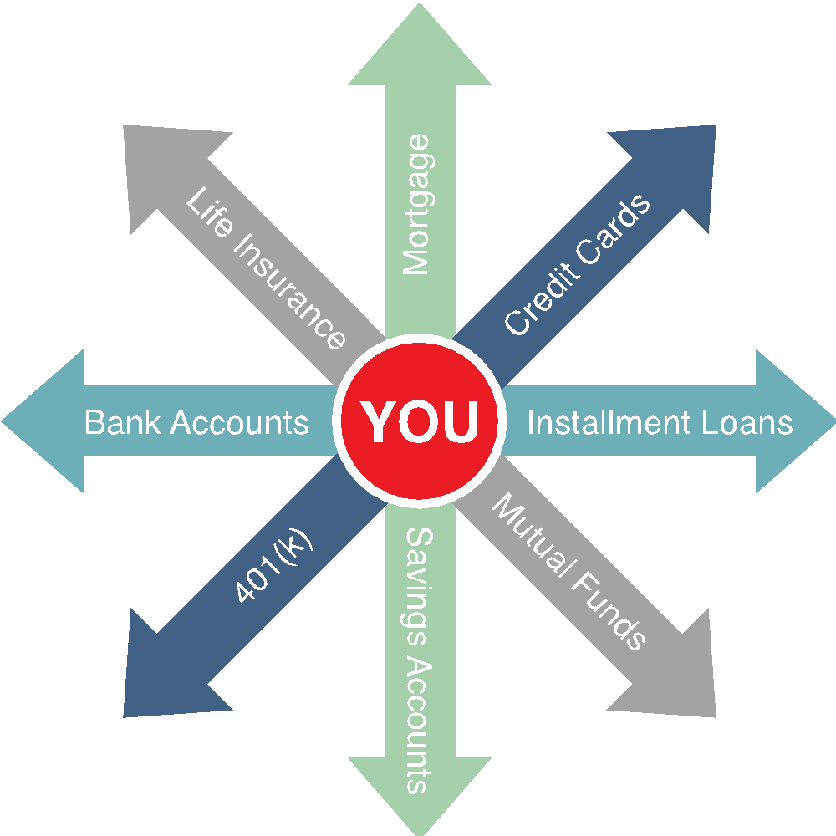
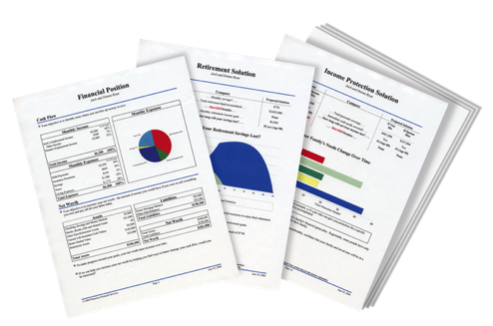

STEP 2: Map Your Route to Get There
The PROBLEM for most people:
No Clear Direction
The SOLUTION:
A cutting-edge digital tool that works like a GPS, but it’s for your money.
We know what we want, but get confused at times on how to get there.
A clear route from wherever you are to where we want to go, so you can worry less about money and enjoy life more!

Slide 14
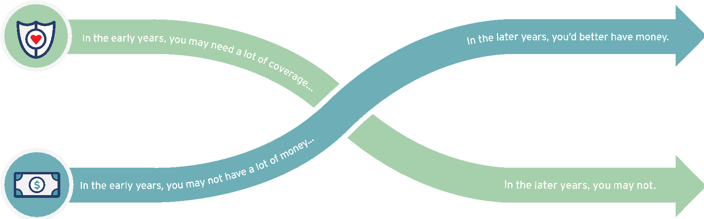


The 2 Issues Everyone Faces with Money
DYING
TOO SOON
LIVING TOO LONG
Today
Young children
High debt
House mortgage
Loss of income would be devastating
At Retirement
Grown children
Lower debt
Mortgage Paid
Retirement income needed
What life insurance company do you know of that
teaches people how to eliminate the need for life insurance?

Slide 15


If you died tomorrow, would you want your family to be…
a little better off, the same, or worse?
5 Biggest Mistakes
Not enough. Can devastate a family.
Wrong kind: Cash Value Life Insurance
Term from a Company selling Cash Value. Unaffordable at renewal, creating future risk.
Procrastination. Putting your family at risk.
GROUP LIFE. May not pay at all.
Notes:
Speaker Notes:
This his how we see life working together.
In the early years we do believe you need a lot of life insurance because you may have some kids, some debt, a house and the loss of your income would be devastating because your saving and investments have not grown yet. Once your savings and investments do grow you now come to what we call the Theory of Decreased Responsibility. So now your kids are grown and out of the house your debt is paid off and your house is paid off so now all you need is money to live off of. At the same time your need for life insurance can go down or ultimately just go away. And we are the only company in the entire financial industry that helps families get the right amount of life insurance the right kind which is level term and we help them get out of there life insurance. And we can do that because we are helping you get out of debt and helping you invest your money for the future. When have you ever heard of a company that helps you get out of the products they provide?

Slide 16
Life Insurance: There Are Two Options
Cash Value Life Insurance
Whole Life, Universal Life, Variable Life
Buy Term and Invest the Difference
30-year Level Term
................
$800,000
$400,000
SAME
$450
SAVINGS
$699,841
......................... ....
$200,000
$200,000
$261 @ 9%
$153,760
.........................
...............
........
$450
$189
Primary
age 35
Spouse
age 35
Monthly
Premium
Cash Value
at age 65
Primary
age 35
Spouse
age 35
Monthly
Premium
Investmentat age 65
Which program would you want?
Monthly premium and accumulated cash value for cash value policies is an average of whole life policies from three major North American life insurance companies for male and female, both age 35 and standard risk. Cash value life insurance can be universal life, whole life, etc., and may contain features in addition to death protection, such as dividends, interest or cash value available for a loan or upon surrender of the policy. Cash value insurance usually has level premiums for the life of the policy. Term insurance provides a death benefit and its premiums increase after initial premium periods and at certain ages. Primerica monthly premium for 30-year Custom Advantage Policy: primary (17CJ0(30)) and spouse rider (17CK0(30)), both age 35, non-tobacco use, underwritten by Primerica Life Insurance Company, Executive Offices: Duluth, GA. The accumulation figure reflects continued investment at the same rate over 30 years at a 9% nominal rate of return compounded monthly and does not take into consideration taxes, fees or other factors, which would lower results. This example uses a constant rate of return, unlike actual investments, which will fluctuate in value. This is hypothetical and does not represent an actual investment.
Not for use in New York.

Slide 17




Learn How to Invest– Become an Owner, Not a Loaner
Traditional Financial Institutions
Your Money
Global Economy
Banks, Credit Unions, Insurance Companies = Historically Low Rates of Return
CDs and savings accounts are generally FDIC insured up to $250,000. Cash value life insurance offers life insurance components in addition to the investment component.

Slide 18
RULE OF 72
THE MOST IMPORTANT RULE OF MONEY
How long it takes to double money
Years
2%
6%
12%
0
$20,000
$20,000
$20,000
How much do most people know about earning
a better return on their 401k’s, IRA’s, etc?
6
$40,000
12
$40,000
$80,000
Do you know how much money you need to get
professional investment advice from most
investment companies?
18
$160,000
24
$80,000
$320,000
$250,000
30
$640,000
36
$40,000
$160,000
$1,280,000
Do you see a problem?
The table serves as a demonstration of how the Rule of 72 works and is only an approximation of accumulations. It is not intended to represent any specific investment, which will fluctuate.
Notes:
----- Meeting Notes (9/8/16 19:29) -----
So, this is a loaded question because unfortunately, we don't learn the Rule of 72 in school, yet it's..

Slide 19




Where to Invest-How Mutual Funds Work
A mutual fund is an opportunity for you, together with many other investors, to pool your money.
How Mutual Funds Work
Individual
Investors
Pooled Assets
Means Professional Money Managers
Global
Economy
Investing entails risk including loss of principal. Shares, when redeemed, may be worth more or less than their original value.
Notes:
Professional money managers invest the “pool” for you, keeping the investments under constant supervision. The money managers use their knowledge of securities and changing market conditions to invest the pooled assets in many different companies within a variety of industries.
19

Slide 20

We help people build and protect wealth regardless of their net worth.
By educating consumers, every Family in North America can achieve Financial Freedom.

Slide 21
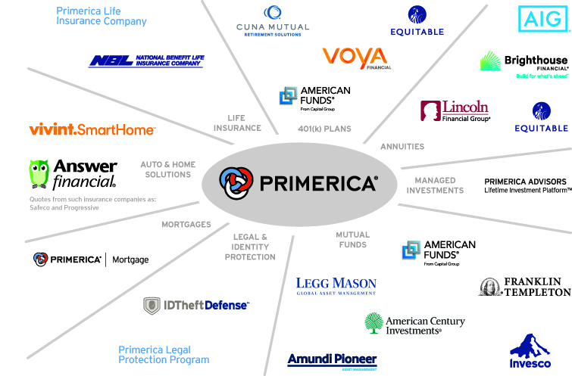
We Represent Products from Major Providers
Not all products and services are available in all states, territories, or the District of Columbia. A representative's ability to offer products from the companies listed is subject to state and federal licensing and certification requirements. Please refer to the Important End Notes for additional details about the contractual arrangements and company affiliations detailed above.

Slide 22
In Summary for Clients
Here’s what makes us different.
1. We can deliver and present Online directly to their home
2. We have all the Financial Products
3. We provide Ongoing Financial Education and Follow Up
Ownership refers to the conditional right of an eligible RVP to transfer his or her code number to another eligible RVP, subject to the consent of Primerica and subject to terms, conditions and regulatory requirements. The Ownership Program Document and policies located on POL control in all respects.

Slide 23
Bottom Line: The Need Is There
Business 101 says find a need and fill it, and Create Opportunities for Others and…
You make money.
Is there a need for what we do?
Are these financial concepts helpful for everyone?
Can you see why our clients love us?
Can you see the Opportunity it creates?

Slide 24
Recap

Slide 25

Plug into “The Marketing and Training System" and Earn Unlimited Income
Monthly Kickoff First Saturday
Sunday Night Training
Monday- Thursday Client Series-Links to Invite
Monday-Thursday Business-System Overview-Links to Invite
Tuesday Marketing Webinar
The Entire System is Online and can be accessed and worked from Anywhere

Slide 26
How the Appointment System Works
Run the System from anywhere and You make Money
Technology drives the Business- Personal Links to Invite Prospects
12 Week Customer Education Series Online
Weekly Join the Team Presentation Online
1-1 Follow Up with Zoom and Online Applications

Slide 27
How the Training Works- Technology drives the Training- Zoom
Online Licensing Training- Life and Securities
Weekly 2 Hour Product Training Online- Zoom
Weekly 1 Hour Marketing Training- Zoom

Slide 28

Earnings Opportunities

Slide 29
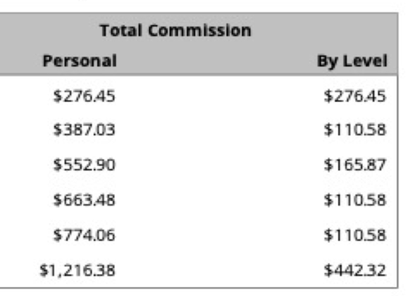
Term Life Insurance Compensation
Age 35
30 Year level premium
$1,000,000 Death Benefit
Monthly Cost $99.29

Slide 30
Term Life Insurance Earnings
Starting at $276.45 Per Transaction to $1,216.38 as an RVP
The Entire Application is done online through Zoom
If you could Earn between $276 and $1,216 Each time you helped a family would that interest you?

Slide 31
Add a Mutual Fund to the Term Insurance
Approximate Monthly Spend Per Client $500-$1,000 Per Month
$99 Per Month Term Policy Pays a One Time Commission of $276-$1.216
$500 Per Month Investment Pays a Recurring Commission of $7-$15 per month
From January 1 through December 31, 2017, Primerica paid cash flow to its North American sales force at an average of $6,030, which includes commissions paid on all lines of business to licensed representatives. Figures include U.S. and Canadian dollars remaining in the local currency earned by the representative, not adjusted for exchange rates.

Slide 32
Term Life and Mutual Fund Compensation
Assumes You Help 1 Client Per Week- Done Online
1-Term Life Policy Per Week - Personal Income Equals $26,000 Annual Income
1- $500 per month Investment Per Week -Personal Income Equals $520 per month in Recurring Income
Total First Year Personal Income $29,000
From January 1 through December 31, 2017, Primerica paid cash flow to its North American sales force at an average of $6,030, which includes commissions paid on all lines of business to licensed representatives. Figures include U.S. and Canadian dollars remaining in the local currency earned by the representative, not adjusted for exchange rates.

Slide 33
Investment Compensation
We Represent The Largest Mutual Fund and Annuity Companies in North America
$68 Trillion Market
Recurring and Repeat Compensation
No Limit to the Size of the Investment
Applications through Zoom and Online Applications

Slide 34
Investment Compensation
What You Earn
Based on a $300,000 Rollover as a Regional Leader
Produce One Rollover Per Month Earn Annual Income $53,550
Does Not Include Residual, Recurring or Repeat Investments
Applications through Zoom and Online Applications

Slide 35

Freedom Comes From Recurring and Residual Income
You gain Freedom when you have both “Time and Money”
Freedom Money is Recurring “Do Nothing Money”
Freedom Comes from “Money Working for You or People Working for You”
Do you have a Plan?

Slide 36
Build Your Own Brokerage Firm
Assumes 10 Producers
10 Term Life Policies Per Week Life -RVP Income Equals $224,640 Annual Income
10 Rollovers Per Month Investment -RVP Income Equals $258,360 Annual Income
Total Income $483,000
Does Not Include Personal Production, Residual, Recurring or Repeat Investments

Slide 37
Recap

Slide 38
99% of Our Reps Started Part Time
We have 3 Career Paths
Spare Time- Help Friends and Family and Learn Themselves
Part Time- They have a Consistent Weekly Income Goal
Full Time- They Want to Change Careers Quickly and Earn $10K Plus Monthly
Plug in to The System

Slide 39
How To Get Started
Complete an Independent Business Application
Submit $99 for Background Check and $25 First Month
Implement Your Financial Plan
Plug in to The System

Slide 40
Your Next Step
Interested
Not Interested
Schedule a follow-up one-on-one Zoom meeting with the person who invited in the next 24-48 hours while this is still fresh in your mind.
Run your complimentary Financial Needs Analysis.
Fill out an Independent Business Application.
Get Started.
Schedule a 1-1 Zoom Follow up and get your complimentary
Financial Needs Analysis.
Become a Client
Attend our Educational Workshops and get Financially Independent

