Slide 1

Fix Your Finances 2020 Quick Review
Class 1-5- Financial Defense

Slide 2

Class #1 Building the Defense

Slide 3
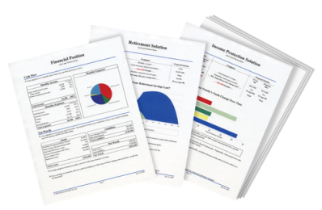

Financial Defense-Build Your Financial House
Offense
Home Ownership
Pay Off Bad Debt
On a scale of 1-10,
10 being the highest,
how would you rate your
confidence level that you will become debt free and financially independent?
Protect Your Income and Liabilities
Budget - Emergency Fund

Slide 4
Class #2 The Cash Flow Plan and Emergency Fund

Slide 5
Did You Know?
“One in four people have almost nothing saved for retirement.”
– Money.CNN.com, March 22, 2019
“More than 80 percent of people making less than $50,000 a year say it is hard to keep up with bills and save for retirement at the same time, and half say it is very hard.”
CBSNews.com, viewed May 25, 2018
“Nearly half of Americans would have trouble finding $400 to pay for an emergency.”
– TheAtlantic.com, May 2019
“Millions of Americans have no savings set aside for a rainy day, leaving them in serious jeopardy if financial calamity strikes…”
– USAToday.com, March 31, 2019

Slide 6

Getting Started
Principle # 1 Where will I get the money to get started?
Problem: Most people have too much month left at the end of the money.
Solution: No matter what your income you can find money to save.

Slide 7


7 Areas to Free Up Money to Save
Pay yourself first
Adjust your lifestyle
Establish a cash flow plan
Adjust your priorities
Earn extra income
Realign your assets-Sell something
Avoid the credit trap

Slide 8
Find Out Where the Money Should Go
Housing and Debt
30%
25% Taxes*
Living Expenses 26%
4% Insurance
15%
Savings and Investments
In an ideal budget,
your monthly income
should be divided up between
five main categories of spending.
8

Slide 9

Keys to Handing your Money
Never lose money
Stop buying stupid things
Only spend money that you have
Have a Big Goal – Save 50% of your income

Slide 10
Budgeting
Tips
Take an honest appraisal of what you spend (budget sheet)
Everything is electronically itemized
Decide what you are going to adjust (not sacrifice) its just an exchange
Keep as many expenses as you can variable
Automatic Millionaire

Slide 11
Gather the Information
You Need to Get Started
Now that you’ve gathered all of the necessary info, it’s time to build a budget! Use this worksheet to help you get started.
Monthly Expense | Amount | Date Due
HOME
Mortgage/Debt | $
Second Mortgage | $
Taxes & Insurance | $
Repairs | $
Homeowner Association Fees | $
UTILITIES
Electric | $
Gas or Oil | $
Water & Sewer | $
Phone (Landline) | $
Phone (Cellular) | $
Cable/Satellite | $
Internet | $
TRANSPORTATION
Car Payment 1 | $
Car Payment 2 | $
Gas | $
Car Insurance | $
Repairs/Maintenance | $
Other (tolls, taxis, parking, subway, bus) | $
INSURANCE
Life Insurance | $
Disability | $
Health Insurance | $
DEBT PAYMENTS (minimums only)
Credit Card 1 | $
Credit Card 2 | $
Credit Card 3 | $
Credit Card 4 | $
Student Loans | $
Other Loans | $
SUBTOTAL: | $
Monthly Expense | Amount | Date Due
SUBTOTAL (from page 1): | $
FOOD
Groceries | $
Dining Out | $
FAMILY PURCHASES
Child Care | $
Child Support | $
Alimony | $
School Tuition Fees | $
PERSONAL CARE
Hair Cuts | $
Prescription Medication | $
Toiletries/Makeup | $
Clothing | $
PETS
Food | $
Care vet bills, grooming, etc. | $
ENTERTAINMENT
Books & Magazines | $
Movies & Concerts | $
Music, Videos & Apps | $
Hobbies | $
Other | $
OTHER
Cleaning Supplies | $
Tithes/Donations | $
Other | $
Other | $
TOTAL: | $
Monthly Expense | Amount | Date Due
HOME
Mortgage/Debt | $
Second Mortgage | $
Taxes & Insurance | $
Repairs | $
Homeowner Association Fees | $
UTILITIES
Electric | $
Gas or Oil | $
Water & Sewer | $
Phone (Landline) | $
Phone (Cellular) | $
Cable/Satellite | $
Internet | $
TRANSPORTATION
Car Payment 1 | $
Car Payment 2 | $
Gas | $
Car Insurance | $
Repairs/Maintenance | $
Other (tolls, taxis, parking, subway, bus) | $
INSURANCE
Life Insurance | $
Disability | $
Health Insurance | $
DEBT PAYMENTS (minimums only)
Credit Card 1 | $
Credit Card 2 | $
Credit Card 3 | $
Credit Card 4 | $
Student Loans | $
Other Loans | $
SUBTOTAL: | $
Monthly Expense | Amount | Date Due
SUBTOTAL (from page 1): | $
FOOD
Groceries | $
Dining Out | $
FAMILY PURCHASES
Child Care | $
Child Support | $
Alimony | $
School Tuition Fees | $
PERSONAL CARE
Hair Cuts | $
Prescription Medication | $
Toiletries/Makeup | $
Clothing | $
PETS
Food | $
Care vet bills, grooming, etc. | $
ENTERTAINMENT
Books & Magazines | $
Movies & Concerts | $
Music, Videos & Apps | $
Hobbies | $
Other | $
OTHER
Cleaning Supplies | $
Tithes/Donations | $
Other | $
Other | $
TOTAL: | $
11

Slide 12
Accounts that Need to be Opened
Emergency Fund- Savings or Money Market
Draft Account- Checking
Personal Weekly Spending Account- Checking

Slide 13

Account Descriptions
Draft Account- This is a checking account where your total household income comes in. If you are married, we recommend both incomes go into this account. If your company provides a retirement plan and group health insurance, then this would be the income after those costs. All recurring bills including long term investments are set on automation as well as money is set aside for future purchases
Emergency Fund- This account should have an automatic transfer from the draft account each month until it is fully funded 3-6 months of expenses. If you have Bad Debt you can transfer from this account periodically to finish off any debts while maintaining a comfortable amount of emergency cash.

Slide 14
Account Descriptions
Weekly Spending Account- This is a checking account that is used to cover any weekly miscellaneous expenses. Each spouse should have an individual account based on typical weekly expenses. You should have a debit card. If you need cash, then you can get the cash from the ATM.
Each day have the bank text or email you the balance in the account. Sunday night transfer from the draft account to the weekly spending account

Slide 15

Steps to Setting Up the Cash Flow Plan
Use the Budget worksheet to account for all previous income and expenses
All Income deposited in your Draft Account
Drafts to Investments
Money is set aside for cars,vacations,maintanance, Christmas,etc. This money will be allocated and withdrawn as needed.
Drafts and bill pay to pay recurring expenses
Make any cuts that will allow for a positive real outcome.

Slide 16
Class #2 The Emergency Fund

Slide 17



The Three Accounts You Need to Budget
To have a complete savings program,
most people need three types of basic accounts.
Emergency Fund
Short-Term Savings
Long-Term Savings or Investments
Investing entails risk including loss of principal. Shares, when redeemed, may be worth more or less than original value.

Slide 18
Benefits of an Emergency Fund
Keeps you from Borrowing and going deeper in debt
Provides security and reduces stress and worry
Allows you to cut insurance cost by raising deductibles
It is part of the foundation of your financial house

Slide 19
How Much should you have in an Emergency Fund?
Short Term Goal of $1,000 or 1 month of expenses
Long Term Goal 3-6 months of expenses
Use a money market account or savings account

Slide 20

Recap

Slide 21
Fix Your Finances 2020
Class 3- How to Determine Your FIN Number

Slide 22
Step 1- Would you like to know your Financial Independence Number?
Your FIN is the amount of money you’ll need to accumulate, so that someday you can live off that money for the rest of your life and never have to go back to work.
Example: You want to retire in 30 years, with $100,000 a year in todays dollars
30 years from now, after 3% inflation… $243,000 spends like $100,000 does today.
Your FIN is $2,624,000
To get there, invest $1,421 per month for 30 years at 9% = $2,624,400
Lets Find Out What Your FIN Number Is…..
This hypothetical example assumes 20 years of retirement income needed, at a 6% post-retirement rate of return and 3% inflation. Hypothetical investment rates assume a nominal 9% rate of return, compounded monthly, and are not indicative of any specific investment. Any actual investment may be subject to taxes and fees, which would lower performance. This example shows a constant rate of return, unlike actual investments which may fluctuate in value.

Slide 23


The seeds you sow today will be your Harvest tomorrow…
Fix Your Finances 2020

Slide 24
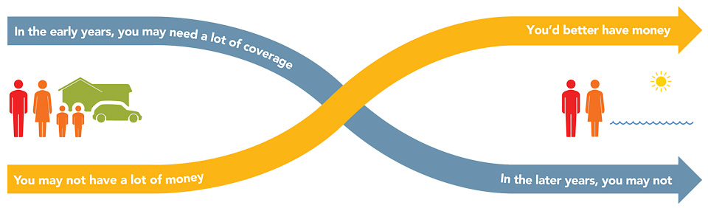
The Theory of Decreasing Responsibility
F I N #
Age 65
Age 30
Today
1. Young children
2. High debt
3. House mortgage
Loss of income
would be devastating
At Retirement
1. Grown children
2. Lower debt
3. Mortgage paid
Retirement income needed
Age 85
Fix Your Finances 2020
Notes:
According to the Theory of Decreasing Responsibility, your need for life insurance peaks along with your family responsibilities. When you’re young, you buy low-cost death protection, term insurance, enough to protect the loss of your earning power, and put the maximum amount you can afford into a promising investment program. When you’re older, you may have much less need for insurance coverage. If you’ve saved and invested wisely you should have a significant amount of accumulated cash. You’ve become “self-insured” and eliminated your need for life insurance.

Slide 25
Inflation
$155,550
$12,962/mo
$94,928
$7,910/mo
Withdrawal
AGE 85
Inflation = 2.5%
AGE 65
Income = $40,000
($3,333/mo)
Accumulation
FIN #
Financial
Independence #
Age 30
Fix Your Finances 2020
Notes:
According to the Theory of Decreasing Responsibility, your need for life insurance peaks along with your family responsibilities. When you’re young, you buy low-cost death protection, term insurance, enough to protect the loss of your earning power, and put the maximum amount you can afford into a promising investment program. When you’re older, you may have much less need for insurance coverage. If you’ve saved and invested wisely you should have a significant amount of accumulated cash. You’ve become “self-insured” and eliminated your need for life insurance.

Slide 26
Setting Your FIN#
$155,550
$12,962/mo
$94,928
$7,910/mo
Withdrawl
AGE 85
Inflation = 2.5%
AGE 65
Income = $40,000
($3,333/mo)
Accumulation
$1,239,137
7%
Financial
Independence #
Age 30
Fix Your Finances 2020
Notes:
According to the Theory of Decreasing Responsibility, your need for life insurance peaks along with your family responsibilities. When you’re young, you buy low-cost death protection, term insurance, enough to protect the loss of your earning power, and put the maximum amount you can afford into a promising investment program. When you’re older, you may have much less need for insurance coverage. If you’ve saved and invested wisely you should have a significant amount of accumulated cash. You’ve become “self-insured” and eliminated your need for life insurance.

Slide 27
You need three things to become
Financially independent…….
1. Time. If you have Lots of time!
2.Money. You need A little money!
3.Rate of return. Small Rate of return!
Shortage of time!
A lot of Money!
Highy rate of return
These are the facts of life!

Slide 28
Accumulating Your FIN#
AGE 65
$1,239,137
Accumulation
Financial
Independence #
Age 30
Add no more Money
For 35 Years
3 %
6 %
9 %
$28,138
$76,860
$204,140
$10,000
$1,669/mo
$ 869/mo
$400/mo
Additional $/mo needed to reach FIN#
Fix Your Finances 2020
Notes:
According to the Theory of Decreasing Responsibility, your need for life insurance peaks along with your family responsibilities. When you’re young, you buy low-cost death protection, term insurance, enough to protect the loss of your earning power, and put the maximum amount you can afford into a promising investment program. When you’re older, you may have much less need for insurance coverage. If you’ve saved and invested wisely you should have a significant amount of accumulated cash. You’ve become “self-insured” and eliminated your need for life insurance.

Slide 29
Spending Phase
9 %
In 20 yrs = $1,854,000
$1,239,137
7 %
In 20 yrs = $757,757
5 %
In 20 yrs = $64,808
$94,928
$7,910/mo
For Illustrative Purposes Only!!!...No Inflation Factored into above Numbers
Fix Your Finances 2020
Notes:
According to the Theory of Decreasing Responsibility, your need for life insurance peaks along with your family responsibilities. When you’re young, you buy low-cost death protection, term insurance, enough to protect the loss of your earning power, and put the maximum amount you can afford into a promising investment program. When you’re older, you may have much less need for insurance coverage. If you’ve saved and invested wisely you should have a significant amount of accumulated cash. You’ve become “self-insured” and eliminated your need for life insurance.

Slide 30
Ask Your Rep for a Complimentary Financial Needs Analysis
A Financial Plan that is Personalized to You
Free of Charge
Calculate your Net Worth
Find out your FIN Number
Debt Elimination Plan
Calculate Insurance Needs
And More…….

Slide 31
Fix Your Finances 2020
Class 4- Buy the Right Insurance

Slide 32
2 Types of Insurance
Income Protection
Asset Protection

Slide 33

Insurance for Income Protection
Life Insurance provides a lump sum that can be converted into an income stream to replace the income your family would have received from your work efforts. Employers generally provide 1 year of income as a benefit, so you purchase your own individual policy.
Disability Insurance provides a monthly income along with Social Security Disability to replace your income due to a particular disability or accident. Most disability insurance is purchased though an individual policy.

Slide 34

Asset or Liability Protection Insurance
Health Insurance provides reimbursements for medical expenses that you as an individual will incur from any type of illness or accident. You as an individual are responsible for these costs. You trade a premium in return for the insurance company to take on a portion of that liability.
Long Term Care Insurance provides reimbursements to you directly should you be confined in a nursing home or certain other care facilities. You as an individual are responsible for these costs. You trade a premium in return for the insurance company to take on a portion of that reimbursement.

Slide 35
Asset or Liability Protection Insurance
Auto Insurance provides reimbursements for damage to your car or a claim against you should someone be hurt by your car. You as an individual are responsible for these costs. You trade a premium in return for the insurance company to take on a portion of that reimbursement or liability.
Homeowners or Renters Insurance provides reimbursements for damage to your residence or a claim against you should someone be hurt at your residence. You as an individual are responsible for these costs. You trade a premium in return for the insurance company to take on a portion of that reimbursement or liability.

Slide 36


Income Protection

Slide 37
Two Problems- Dying too Soon and Living too Long
DYING
TOO SOON
LIVING TOO LONG
Today
Young children
High debt
House mortgage
Loss of income would be devastating
At Retirement
Grown children
Lower debt
Mortgage Paid
Retirement income needed

Slide 38
What is Life Insurance For?
Life Insurance is the Foundation of your Financial Plan
Life Insurance is income protection
Your income provides for expenses of your family
Life Insurance provides a lump sum to replace the future earnings that someone would earn
The goal is to one day be self insured with savings and investments at which time you can drop your coverage

Slide 39
Should You have Life Insurance Outside of Work?
Employer Sponsored Group Life Insurance generally will provide 1- 2 years of earnings and in many cases only $20,000 as a final expenses plan
Group Life Insurance does not transfer with you if you change jobs and puts you at risk of being uninsurable based on your health conditions
50% of families are either without life insurance or are under insured
Level Term insurance which is protection only provides the most affordable coverage

Slide 40
2 Types of Life Insurance
Term
Level Premium up to 35 Years
Low Cost Protection Only
No Cash Build Up
Age 35
$1,000,000 Death Benefit
$99 Per Month
Cash Value
Level Premium to Age 100
Builds Up Cash Value
High Cost
Age 35
$1,000,000 Death Benefit
$1,125 Per Month

Slide 41
Term vs. Cash Value
Cash Value Life Insurance
Whole Life, Universal Life, Variable Life
Buy Term and Invest the Difference
30-year Level Term
................
$800,000
$400,000
SAME
$450
SAVINGS
$699,841
......................... ....
$200,000
$200,000
$261 @ 9%
$153,760
.........................
...............
........
$450
$189
Primary
age 35
Spouse
age 35
Monthly
Premium
Cash Value
at age 65
Primary
age 35
Spouse
age 35
Monthly
Premium
Investmentat age 65
Which program would you want?
Monthly premium and accumulated cash value for cash value policies is an average of whole life policies from three major North American life insurance companies for male and female, both age 35 and standard risk. Cash value life insurance can be universal life, whole life, etc., and may contain features in addition to death protection, such as dividends, interest or cash value available for a loan or upon surrender of the policy. Cash value insurance usually has level premiums for the life of the policy. Term insurance provides a death benefit and its premiums increase after initial premium periods and at certain ages. Primerica monthly premium for 30-year Custom Advantage Policy: primary (17CJ0(30)) and spouse rider (17CK0(30)), both age 35, non-tobacco use, underwritten by Primerica Life Insurance Company, Executive Offices: Duluth, GA. The accumulation figure reflects continued investment at the same rate over 30 years at a 9% nominal rate of return compounded monthly and does not take into consideration taxes, fees or other factors, which would lower results. This example uses a constant rate of return, unlike actual investments, which will fluctuate in value. This is hypothetical and does not represent an actual investment.
Not for use in New York.

Slide 42
How Much Coverage Do I Need?
Age 35
Primary earning $5,000 per month
Spouse earning $3,300 per month
Over the next 30 years without a raise:
Primary will earn $1,800,000
Spouse will earn $1,200,000

Slide 43
How Much Coverage Do I Need?
Total Family Income $3,000,000
If something happened to either of the earners how much of the income do you think they would want to have for their family?

Slide 44
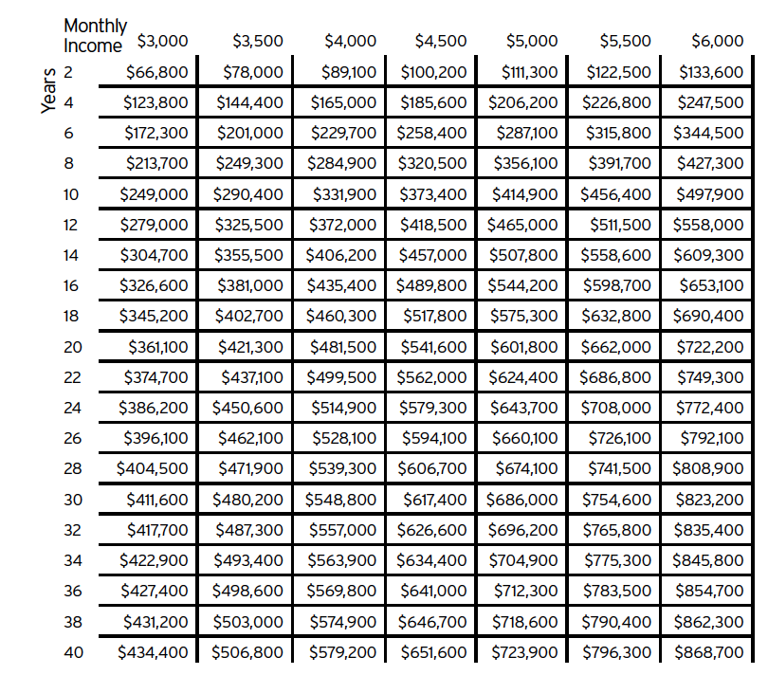
Coverage Needed Invested at 8% for 30 Years
$5,000 Per Month
Coverage Needed $686,000
$3,300 Per Month
Coverage Needed $314,000
Total Premium $112 per month

Slide 45
How much does Term Life Income Protection Cost?
Total Premium $112 per month
Represents 1.3% of Total monthly Income
Insures 100% of the $3,000,000 in future earnings
Doesn’t it make sense to set aside 1.3% of your monthly income to insure 100% of your Lifetime Earnings?

Slide 46
Smart Tips on Buying Insurance
Become more Self-Insured as your Assets Grow by raising your deductibles. You can raise deductibles on Home, Auto, Health Insurance and Increase the waiting period on Long Term care and Disability Income Payments
Buy Term Life Insurance enough to replace your income and you can drop the Term Insurance once you reach your FIN
Always have enough personal liability coverage to protect you against potential lawsuits. A personal Umbrella Policy is a cheap way to have an insurance company's law firm protect you

Slide 47
Recap

Slide 48
Fix Your Finances 2020
Class 5- Debt Elimination

Slide 49
High Consumer Debt- Bad Debt
Problem: Consumer Debt is robbing America's financial security
Solution: Implement systematic plans to permanently eliminate debt, freeing up money to save & invest.

Slide 50
The Bad News About Compounding- Lets Fix It
Did you know if you made a one-time $3,000 credit card purchase with an 18% interest rate with no new purchases and made only the minimum payments, it would take at least 10 years to pay off and you would end up paying more than $2,002 in interest charges?
$3,000 + $2,002 = $5,002!
Purchase Interest
Assumes 18% APR and a minimum payment of 3.5% of the balance or $20 if more.
Notes:
Compound interest is one of the most powerful financial forces around. When you are building savings, its power works in your favor. However, when you have debt, the power of compound interest works against you! When you pay just the minimum balance on your credit cards, interest charges are added each month to the remaining principal. Each month, your new balance is the principal PLUS the interest … and that amount gets compounded again and again. It’s easy to see how small debts grow large with compound interest.

Slide 51

What is Bad Debt
You can’t afford the payment easily
The underlying thing the debt is tied to depreciates cars, credit cards etc.
Rule never finance things that depreciate

Slide 52

What is Good Debt?
You can easily afford the payment
You are financing an appreciating asset such as a home, rental property, business or some type of asset

Slide 53
Getting Started Eliminating Bad Debt

Slide 54
Fix The Foundation
Get Mad about being Broke and Make a Decision to Fix it
Have a Working Budget and Stop Spending More than You Make
Fire all Expenses and Rehire only the ones that are totally necessary
Food, Shelter, Insurance and Transportation
Create a Plan

Slide 55
Solution #1:Implement Debt Stacking
Save $1,000
Stop using existing credit and don’t establish new credit
Get Started
Minimum Payments to all Debts
Apply all additional monies to smallest balance, until paid off.
Continue minimum payments to remaining debts and all additional monies to smallest balances until all debt is paid. Requires Discipline.
Best plan is to auto-pay set amount to each bill until it is paid off with a larger portion going to the smallest debts
Once one bill is payed off apply that money automatically to the remaining bills

Slide 56
Revolving Debt vs. Fixed Debt
Look at how revolving debt can erode your financial security:
Revolving Debt
$17,000 @ 18%
$595/month*
$12,500 in interest paid
17 years and 2 months to pay off
Fixed Debt
$17,000 @ 18%
$595/month fixed**
$5,370 in interest paid
3 years and 2 months to pay off
*Assumes revolving payment (minimum) is 3.5% of the remaining balance or $20, whichever is greater. First month’s payment is shown and term assumes continued payment of minimum amount with no additional amounts paid. No additional debt incurred.
**Assumes payment of 3.5% of initial loan amount, no additional debt incurred and payment amount remains fixed throughout term of loan.
Notes:
Credit card debt is what is known as “revolving” debt. The interest compounds daily instead of monthly which means you can pay much more in interest. Because there is no fixed amount that you pay each month, your debt can go on forever. Additionally, your interest rate could change at almost any time and there is little a consumer can do beyond paying off the entire balance at once.

Slide 57
The Debt Stacking Concept*
As each debt is paid off, you apply the amount you were paying for that debt to the payment that are making on the next target account.
Retail Card 1: $220
Credit Card 2: $353
Car Loan: $551
Credit Card 1: $303
Mortgage: $1,293
Total: $2,720
$353
$551
$303
$1,293
$2,720
$551
$303
$1,293
$2,720
$303
$1,293
$2,720
$1,293
$2,720
$220
+ $220
$573
+ $573
$1,124
+ $1,124
$1,427
+ $1,427
$2,720
Target Account
Extra Debt Payment Amount
*The above example is for illustrative purposes only. The Debt Stacking concept assumes that: (1) you make consistent payments on all of your debts; (2) when you pay off the first debt in your plan, you add the payment you were making toward that debt to your existing payment on the next debt in your plan (therefore you make the same total monthly payment each month toward your debts); (3) you continue this process until you have paid off all of the debts in your plan. In the example above, when Retail Card 1 is paid off, the $220 payment applied to Retail Card 1 is applied to Credit Card 2, accelerating its payment to $573. After Credit Card 2 is paid off, the $573 payment applied to Credit Card 2 is applied to Car Loan for a total payment of $1,124. The process is then continued until all debts are paid off. Note that the total payment per month remains constant.
Notes:
If the idea of paying off your debt seems overwhelming, consider debt stacking. They say you can eat an elephant – one bite at a time. Well, the same concept works with paying off your debt! By taking into account the interest rate and amount of debt, debt stacking identifies an ideal order for you to pay off your debts.
You begin by making consistent payments on all of your debts.
When you pay off your first debt account, you roll that payment into the payment that you were making on the next account. These extra dollars help you reduce the effect of compound interest working against you. As each debt is paid off, you apply the amount you were paying to that debt to the payment that you were making on the next account.
57

Slide 58
The Debt Stacking Concept
Category | Without Debt Stacking | With Debt Stacking
Payoff | 23 Years | 9 Years 14 Years Sooner
Interest Avoided | $0 | $130,643
Interest Paid | $214,442 | $83,799
Monthly Payments | $2,720 | $2,720
Debt Stacking assumes that you add no additional debt and make the same monthly payment each month using the Debt Stacking method. Debt Stacking assumes that when you pay off the first target account, you then apply the amount of money you were paying toward the first target account to the next target account and continue with this process until you have paid off all the debts you have targeted.
Notes:
Debt stacking allows you to make the same total monthly payment each month toward all of your debt and works best when you do not accrue any new debts.
You continue this process until you have paid off all of your debts. When you finish paying off your debts, you can apply the amount you were paying towards your debt toward creating wealth and financial independence!
58

Slide 59
Solution #2 Debt Consolidation
Establish a written budget
Establish an equity line of credit or refinance your existing first mortgage if you can cut interest costs
Consider a 15-year mortgage- should be a lower rate
Borrow enough if possible, to pay off all debts and establish a small emergency fund
Make a decision to never get back in the situation ever again

Slide 60
Avoid These Common Credit Mistakes
Not valuing your credit
Raising credit card limits
Not monitoring your credit history
Not monitoring your credit score
Not knowing your interest rate and fees
Notes:
60

Slide 61
Recap

Slide 62
Next Week Begins “Creating the Offense”
Rule of 72
Time and Consistency
Become and Owner not a loaner
How Mutual Funds Work
Investment Spectrum
Investment choices- Allocation
Target Date and Company Retirement Plans
Retirement Planning Options
College Plan Options

Slide 63
Thank You for Attending
If you need help with anything that we covered tonight or if you have questions be sure and reach out to the person that invited, you through the private link. Text or email and they will follow up with you. Take Action for Your Family
Do you have a friend or family member that would benefit from this information? Forward your private link that you received and encourage them to register for next week.

Slide 64

Do you need a work from home solution to earn extra Income?
54% of adults want to work remotely most of the time after the pandemic, according to a new study from IBM
IBM conducted a survey among 25,000 people to gauge how perspectives about work, transportation, and leisure changed since the outbreak of the coronavirus.
Working from home could make workers happier and save employees and employers money.
Of those surveyed, 75% said they would like to continue to work from home in at least a partial capacity, while 40% of respondents said they feel strongly that their employer should give employees the choice to opt-in to remote work.
Ask the person who invited you to send you a link to our upcoming “Join Our Team Webinar”

