Slide 1

The World is Changing

Slide 2


CHANGING TECHNOLOGY

Slide 3



CHANGING INNOVATION
100 year old Company
Industry Leader 90%
to bankruptcy
THEY DIDN’T CHANGE

Slide 4


CHANGING DISTRIBUTION
THEY DIDN’T CHANGE
Speed and convenience

Slide 6
… Nearly 9,100 store
closures have been
announced in 2019,
55% higher than total
closures in 2018,
according to a recent
report from global
marketing research firm
Coresight Research.
THE WORLD IS CHANGING

Slide 7
JUST A FEW
THEY DIDN’T CHANGE
Payless Shoe: 2,589 Gymboree749 Dressbarn: 649
Fred's 129 Charlotte Russe: 494 Shopko: 371 Charming Charlie: 261
Avenue: 222 Kitchen Collection: 160
Henri Bendel: 23
Barneys New York: 22 Topshop: 11

Slide 8

The World is Changing……..Are you Changing?

Slide 9

  Do You have a Changing Financial Plan?
  The Consumer is Facing today:
Their Financial Challenges

Slide 10
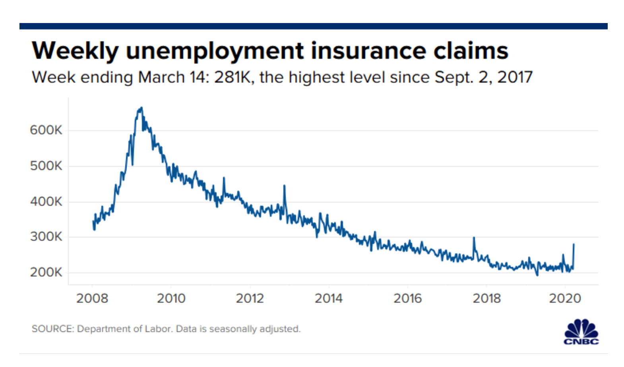
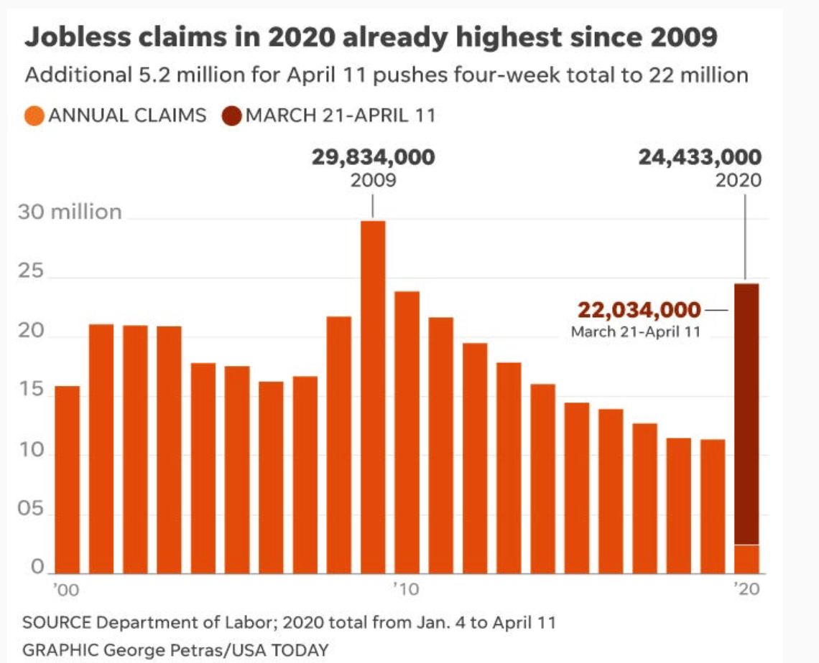
  Do You Have a Changing Income Plan?
  Job Worries working are Facing today:
Job Insecurity - Layoffs

Slide 11


Financial Challenges Have Worsened With Corona
78% of full-time workers live paycheck to paycheck.
CNNMoney.com, “How to Save for Retirement On a Tight Budget,” October 13, 2017
More than half of Americans have less than $1,000 in savings.
CNBC.com, “Here’s How Much Money Americans Have in Their Savings Accounts,” September 13, 2017
U.S. households with debt carry an average credit card balance of $15,654.
NBCNews.com, “Americans Have More Credit Cards – and More Debt, Says CFPB,” December 28, 2017
Nearly half (48%) of U.S. households don’t have enough life insurance.
USAToday.com, “Impending Death of the Life Insurance Medical Exam,” August 6, 2017
More than half of all workers have less than $25,000 in savings and investments for retirement.
Employee Benefit Research Institute 2015 Retirement Confidence Survey

Slide 12
Why Are People Having So Many Financial Challenges?
Most People Today
Don’t Earn Enough Income - Less than 6 Figures
Don’t Have a Work from Home Income Plan
Don’t have a Financial Plan or Coach.
We have Solutions to all of these Challenges

Slide 13








Being a 2% Allows you to live your life on your terms
New Cars
Travel
Education
Hobbies
Family & Friends
New
Homes
Charities
13

Slide 14
How to Become a 2%- Become an Owner
CASH FLOW QUADRANT*
EMPLOYEE
Has a job.
Income based on position, not the person.
BUSINESS
Owns a system. Has others working for him/her.
Unlimited income potential via manufacturing, marketing, etc.
SELF-EMPLOYED
Owns a job.
Dentist, doctor, lawyer, hair stylist, real estate agent, salesperson.
INVESTOR
Has money working for him/her.
Enjoys complete freedom and lives the dream.
*The Cash Flow Quadrant, CASH FLOW Technologies, Inc.; used with permission.
The Cash Flow Quadrant and ESBI are trademarks of CASH FLOW Technologies, Inc. For informational purposes only.

Slide 15
Our Business Model
What if you could find a legitimate professional business that:
80% of North America is in your Market
You can work from home -Totally Online- No Overhead
No Product to Buy, Assemble or Ship
Work when you want and as often as you want

Slide 16
Our Business Model
What if you could find a legitimate professional business that:
Provides a scalable marketing and business system
Utilizes the latest technology
An Intangible Product that Requires a Professional License
Be a part of a Multi-Billion Dollar Product Support System

Slide 17






We are launching a Professional, 100% Virtual, Work From Anywhere Business
That Makes a Huge Difference in People’s Lives Financially.

Slide 18



Our MISSION is to help 100,000,000
Families in North America...
… live life with less worry about money,
so they are more excited about their future,
and feel confident about today.
When an impact is made on person’s financial life,
there’s a ripple effect like no other.

Slide 19
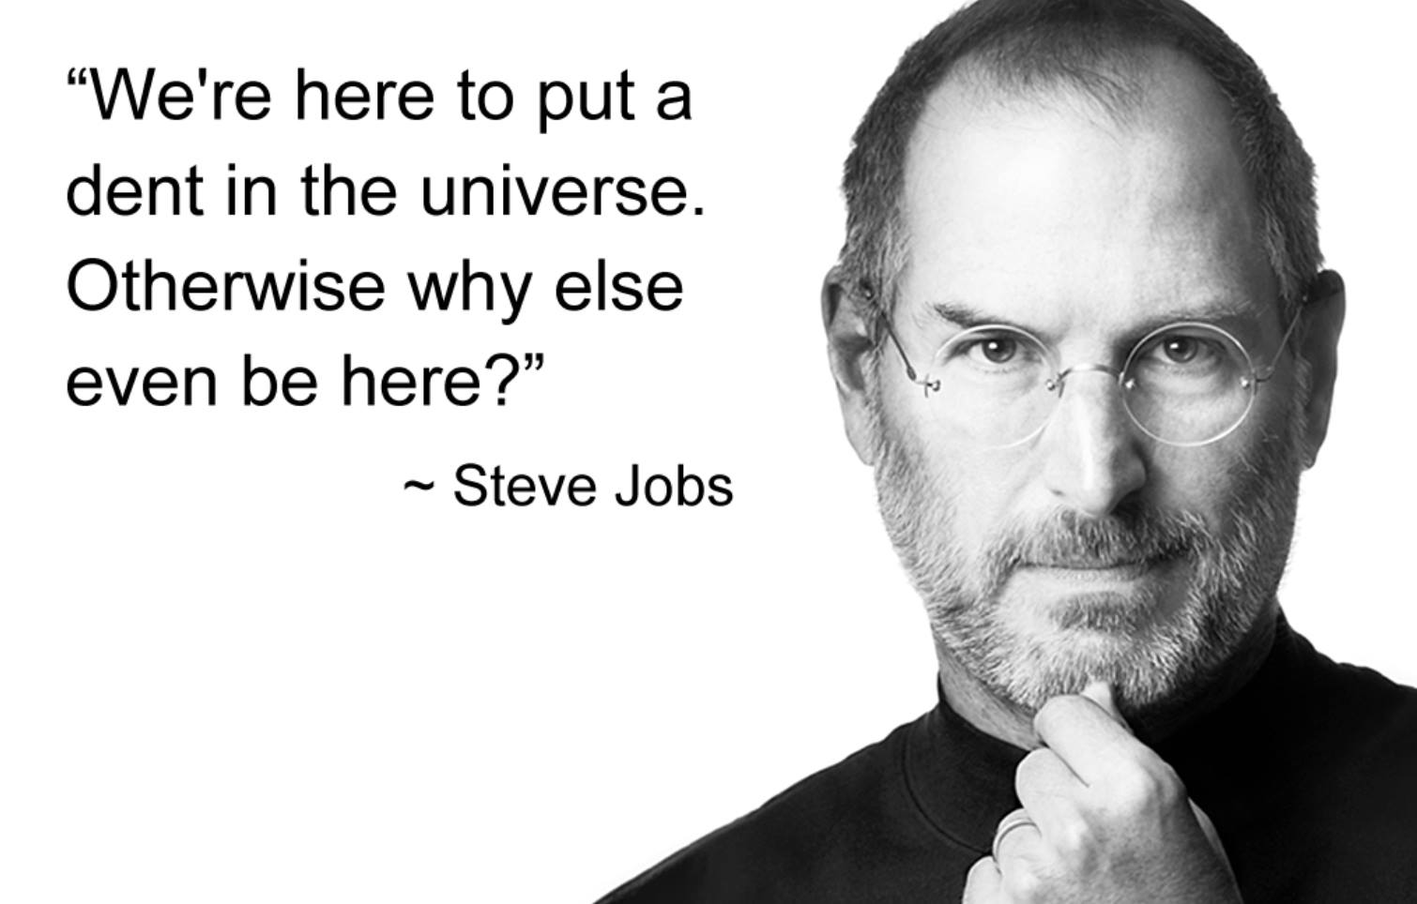

The Next Dent in the Universe

Slide 20





The Next Dent in the Universe
TECHNOLOGY
RETAIL
FINANCIAL

Slide 21


$20,000 / Month PASSIVE
AGENTS
UNDER MANAGEMENT
ASSETS
UNDER MANAGEMENT
+
5 or more leaders consistently producing 10 or more new clients per month personally and/or as a team.
Mutual funds, annuities, managed accounts.
PAC’s, Trails, Additional Rollovers / Investments
Example: Personal 10M AUM/100k PAC’s + Base Shop 20M AUM/300k PAC’s

Slide 22
The Business…….
Educate North America on Money
Friends do not standby and watch friends get taken advantage of financially.
Friends help their friends set up a financial success plan.

Slide 23
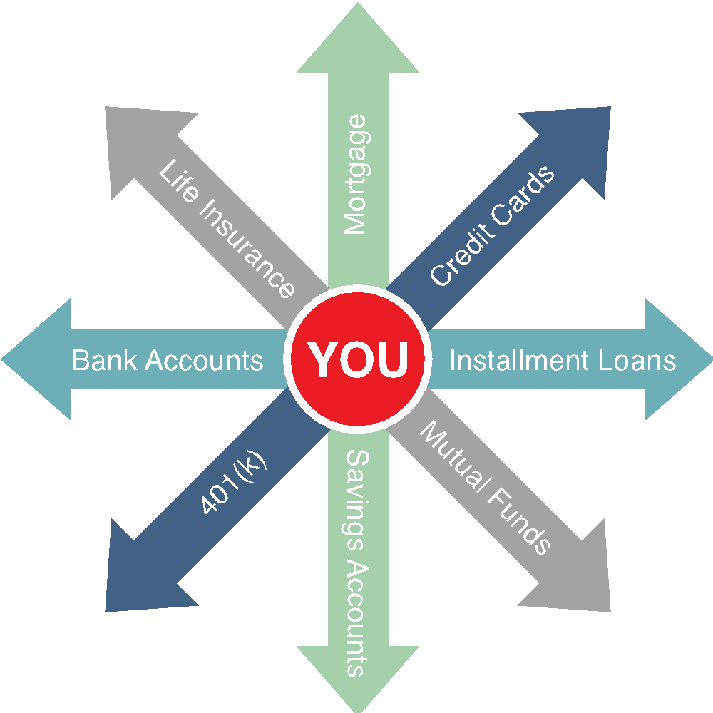
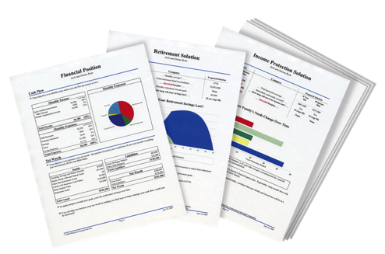

We Provide Financial Education
The Problem:
Traditional financial institutions sell you products. They don’t provide you with a total solution.
The Solution:
A Financial Needs Analysis. A customized, confidential and complimentary program that helps you achieve your goals and dreams.
A Financial GPS: It helps you find answers to important questions.

Slide 24
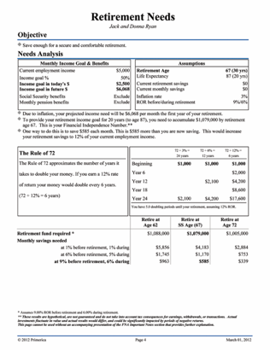
Do You Know Your Financial Independence Number?
Your FIN is the amount of money you’ll need to accumulate, so that someday you can live off that money for the rest of your life and never have to go back to work.
You want to retire in 30 years, with $100,000 a year in todays dollars
30 years from now, after 3% inflation… $243,000 spends like $100,000 does today.
Your FIN is $2,624,000
To get there, invest $1,421 per month for 30 years at 9% = $2,624,400
How important is it to know your Financial Independence Number?
This hypothetical example assumes 20 years of retirement income needed, at a 6% post-retirement rate of return and 3% inflation. Hypothetical investment rates assume a nominal 9% rate of return, compounded monthly, and are not indicative of any specific investment. Any actual investment may be subject to taxes and fees, which would lower performance. This example shows a constant rate of return, unlike actual investments which may fluctuate in value.

Slide 25
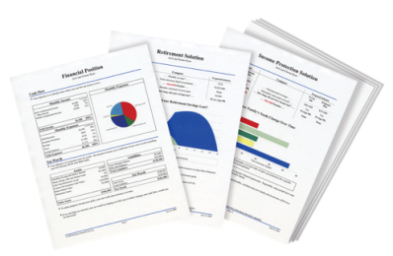


Solution: Build Your Financial House
Other Goals and Dreams
College Savings
Retirement
Accelerate Paying Off Debt
On a scale of 1-10,
10 being the highest,
how would you rate your
confidence level that you will become debt free and financially independent?
Budget - Emergency Fund
Protect Your Income / Term Life

Slide 26
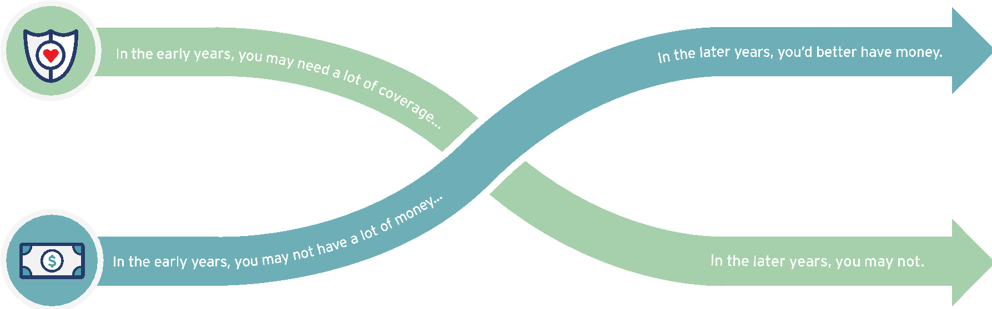


The Theory of Decreasing Responsibility
DYING
TOO SOON
LIVING TOO LONG
Today
Young children
High debt
House mortgage
Loss of income would be devastating
At Retirement
Grown children
Lower debt
Mortgage Paid
Retirement income needed
What life insurance company do you know of that
teaches people how to eliminate the need for life insurance?

Slide 27
Life Insurance: There Are Two Options
Cash Value Life Insurance
Whole Life, Universal Life, Variable Life
Buy Term and Invest the Difference
30-year Level Term
................
$800,000
$400,000
SAME
$450
SAVINGS
$699,841
......................... ....
$200,000
$200,000
$261 @ 9%
$153,760
.........................
...............
........
$450
$189
Primary
age 35
Spouse
age 35
Monthly
Premium
Cash Value
at age 65
Primary
age 35
Spouse
age 35
Monthly
Premium
Investmentat age 65
Which program would you want?
Monthly premium and accumulated cash value for cash value policies is an average of whole life policies from three major North American life insurance companies for male and female, both age 35 and standard risk. Cash value life insurance can be universal life, whole life, etc., and may contain features in addition to death protection, such as dividends, interest or cash value available for a loan or upon surrender of the policy. Cash value insurance usually has level premiums for the life of the policy. Term insurance provides a death benefit and its premiums increase after initial premium periods and at certain ages. Primerica monthly premium for 30-year Custom Advantage Policy: primary (17CJ0(30)) and spouse rider (17CK0(30)), both age 35, non-tobacco use, underwritten by Primerica Life Insurance Company, Executive Offices: Duluth, GA. The accumulation figure reflects continued investment at the same rate over 30 years at a 9% nominal rate of return compounded monthly and does not take into consideration taxes, fees or other factors, which would lower results. This example uses a constant rate of return, unlike actual investments, which will fluctuate in value. This is hypothetical and does not represent an actual investment.
Not for use in New York.

Slide 28

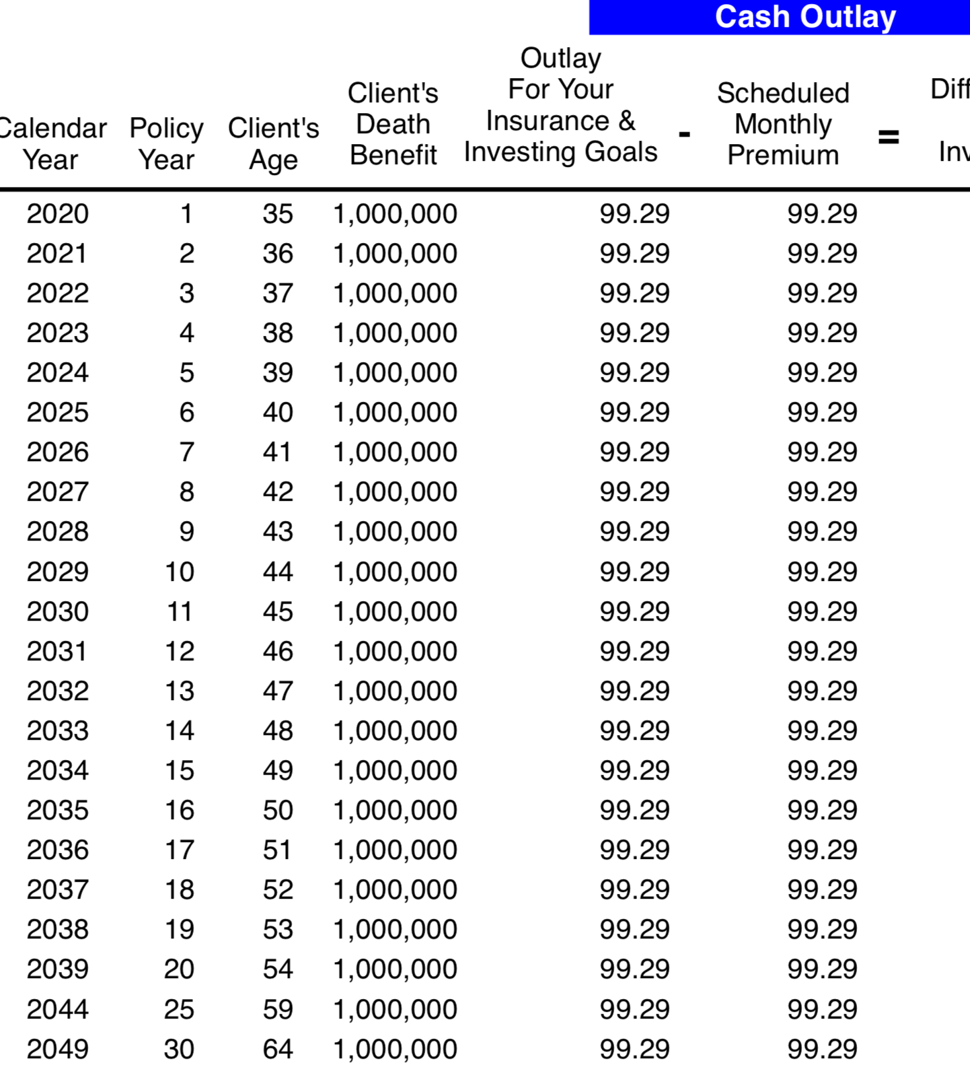
Term Life Insurance is Income Protection
Age 35
30 Year level premium
$1,000,000 Death Benefit
Monthly Cost $99.29

Slide 29
Investing Education -The Rule of 72
Divide your interest rate into 72 to find the approximate number of years it takes for money to double.
Years
3%
6%
12%
0
$10,000
$10,000
$10,000
6
12
18
24
30
36
42
48
$20,000
$20,000
$40,000
$80,000
$20,000
$40,000
$160,000
$320,000
$80,000
$640,000
$1,280,000
$40,000
$160,000
$2,560,000
This table serves as a demonstration of how the Rule of 72 concept works from a mathematical standpoint. It is not intended to represent an investment. The chart uses constant rates of return, unlike actual investments which will fluctuate in value. It does not include fees or taxes, which would lower performance. It is unlikely that an investment would grow 10% or greater on a consistent basis, given current market conditions.

Slide 30
Investing Education-Pay Yourself First
When you don’t, there’s a high cost of waiting.
$1,000 Monthly Savings at 9% for 40 Years (Age 25-65)
25
$4,716,400
Wait 1 Year
($12,000)
26
$4,300,400
(-$416,000)
Wait 5 Years
($60,000)
30
$2,963,800
(-$1,752,600)
Wait 15 Years
($180,000)
40
$1,129,500
(-$3,586,900)
Rates of return are constant and nominal rates, compounded monthly. Contributions are assumed to be made at the beginning of the month. The chart above is not indicative
of any particular investment or savings vehicle where rates of return fluctuate. It does not take into consideration taxes or other applicable deductions, which would lower results.

Slide 31




Investing Education – Become an Owner, Not a Loaner
Traditional Financial Institutions
Your Money
Global Economy
Banks, Credit Unions, Insurance Companies = Historically Low Rates of Return
CDs and savings accounts are generally FDIC insured up to $250,000. Cash value life insurance offers life insurance components in addition to the investment component.

Slide 32




Investing Education- Mutual Funds
A mutual fund is an opportunity for you, together with many other investors, to pool your money.
How Mutual Funds Work
Individual
Investors
Pooled Assets
Means Professional Money Managers
Global
Economy
Investing entails risk including loss of principal. Shares, when redeemed, may be worth more or less than their original value.
Notes:
Professional money managers invest the “pool” for you, keeping the investments under constant supervision. The money managers use their knowledge of securities and changing market conditions to invest the pooled assets in many different companies within a variety of industries.
32

Slide 33
Accumulating a FIN#
Why Banks & Insurance companies are rich and we are not!
AGE 65
$1,239,137
Accumulation
Financial
Independence #
Age 30
Add no more Money
For 35 Years
3 %
6 %
9 %
$28,138
$76,860
$204,140
$10,000
$1,669/mo
$ 869/mo
$400/mo
Additional $/mo needed to reach FIN#
Fix Your Finances 2020
Notes:
According to the Theory of Decreasing Responsibility, your need for life insurance peaks along with your family responsibilities. When you’re young, you buy low-cost death protection, term insurance, enough to protect the loss of your earning power, and put the maximum amount you can afford into a promising investment program. When you’re older, you may have much less need for insurance coverage. If you’ve saved and invested wisely you should have a significant amount of accumulated cash. You’ve become “self-insured” and eliminated your need for life insurance.

Slide 34
We move the wealth back into the hands of the people!
By educating consumers, every Family in North America can achieve Financial Freedom.

Slide 35
Bottom Line: The Need Is There
Business 101 says find a need and fill it, and if you do, what happens?
You make money.
Is there a need for what we do?
Are these financial concepts helpful for everyone?
Can you see why our clients love us?
Can you see the Opportunity it creates?

Slide 36

How the Business System Works

Slide 37
How the Appointment System Works
Run the System from anywhere and You make Money
Technology drives the Business- Personal Links to Invite Prospects
12 Week Customer Education Series Online
Weekly Join the Team Presentation Online
1-1 Follow Up with Zoom and Online Applications

Slide 38
How the Training Works- Technology drives the Training- Zoom
Online Licensing Training- Life and Securities
Weekly 2 Hour Product Training Online- Zoom
Weekly 1 Hour Marketing Training- Zoom

Slide 39

Earnings Opportunities

Slide 40
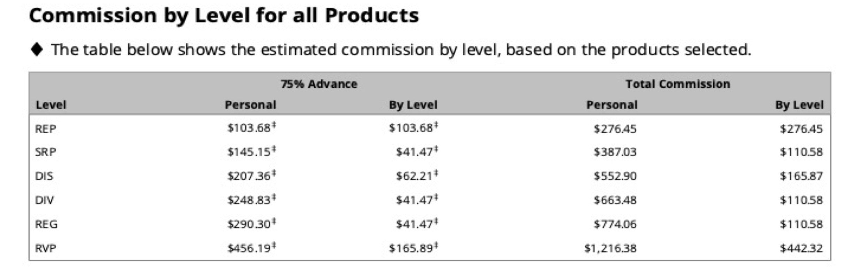
Term Life Insurance Earnings- Starting at $276.45 Per Transaction to Maximum $1,216.38

Slide 41
Term Life Insurance and Investing in Mutual Funds
Approximate Monthly Spend Per Client $500-$1,000 Per Month
$86 Per Month Term Policy Pays a One Time Commission of $276-$1.216
$500 Per Month Investment Pays a Recurring Commission of $7-$15 per month

Slide 42
Term Life and Mutual Fund Compensation
Assumes 1 Client Per Week- Done Online
1-Term Life Policy Per Week - Personal Income Equals $26,000 Annual Income
1- $500 per month Investment Per Week -Personal Income Equals $520 per month in Recurring Income
Total First Year Personal Income $29,000

Slide 43

The Rollover Market-Nov 2019

Slide 44
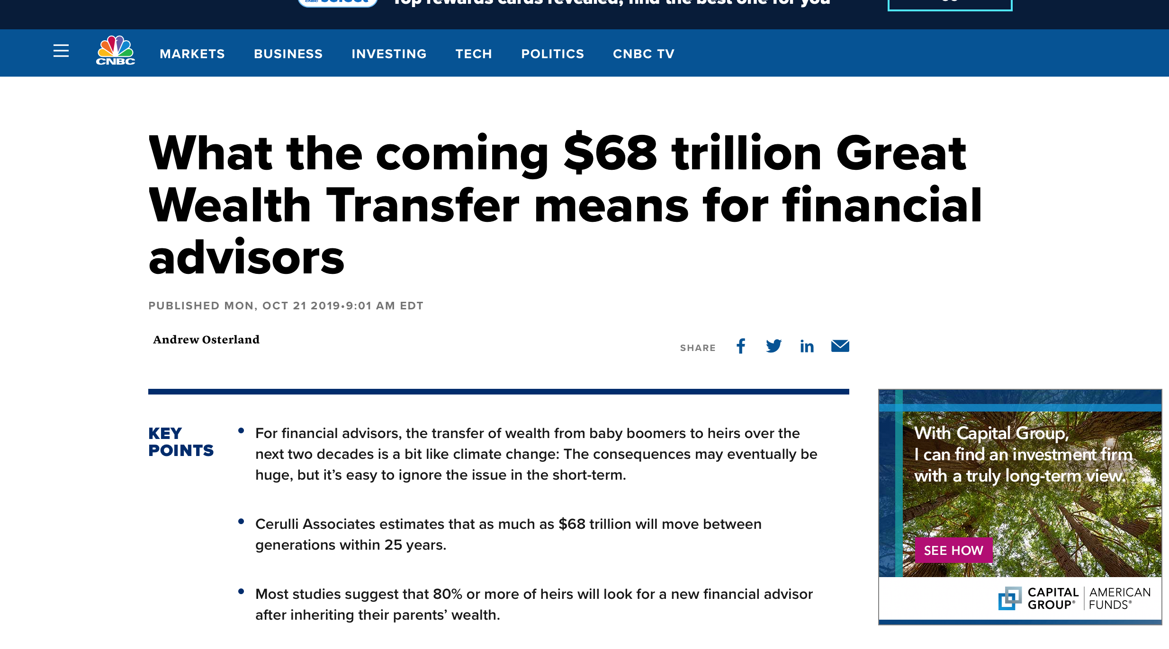
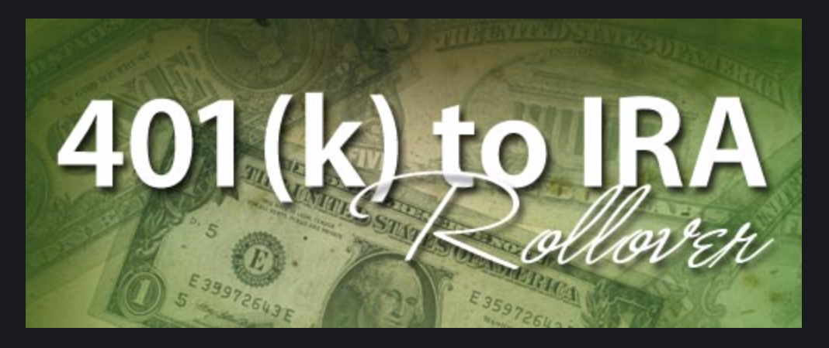
Investment Compensation

Slide 45
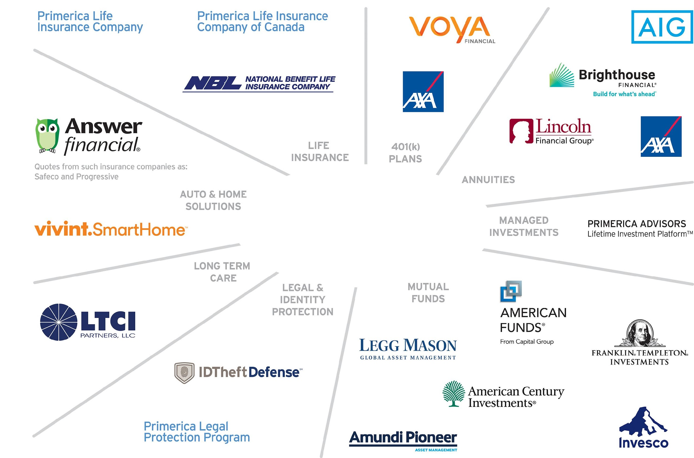
One Stop
Financial Solutions
Not all products and services are available in all states, territories, or the District of Columbia. A representative's ability to offer products from the companies listed is subject to state and federal licensing and certification requirements. Please refer to the Important End Notes for additional details about the contractual arrangements and company affiliations detailed above.

Slide 46
$300,000 Rollover Compensation
Representing the Largest Mutual Fund and Annuity Companies in North America
Regional Leader Produces One Rollover Per Month Annual Income $53,550
Does Not Include Residual, Recurring or Repeat Investments

Slide 47
Build a Team and Have Unlimited Override Earnings
Assumes 10 Producers
10 Term Life Policies Per Week Life -Override Income Equals $224,640 Annual Income
10 Rollovers Per Month Investment -Override Income Equals $258,360 Annual Income
Total Override Income $483,000
Does Not Include Personal Production, Residual, Recurring or Repeat Investments

Slide 48
In Summary for Clients
Here’s what makes us different.
1. We can deliver and present Online directly to their home
2. We have all the Financial Products
3. We provide Ongoing Financial Education and Follow Up
Ownership refers to the conditional right of an eligible RVP to transfer his or her code number to another eligible RVP, subject to the consent of Primerica and subject to terms, conditions and regulatory requirements. The Ownership Program Document and policies located on POL control in all respects.

Slide 49
In Summary for Reps
Here’s what makes us different.
1. The Spare -Time Online Opportunity
2. The Low Cost of Going into Business for Yourself
3. The Unlimited Referral System
4. Licensed – Regulated – Professional
5. Technology that Supports your entire business
Ownership refers to the conditional right of an eligible RVP to transfer his or her code number to another eligible RVP, subject to the consent of Primerica and subject to terms, conditions and regulatory requirements. The Ownership Program Document and policies located on POL control in all respects.

Slide 50
What You’ll Get
An Opportunity to:
Receive an education on personal finance
Have flexibility to earn additional spare-time income
Build a spare-time business as a Plan B or bridge to a full-time business

Slide 51

How to Get Started

Slide 52



Independent Business Application (IBA)
$99
The Ultimate Business Support System
$25
ONE TIME
MONTH
  Life and Securities License Includes:
  All Study Materials
  State Application
  Exam Fee
  Processing Fees
  Appointment Fee
  Fingerprint
  Typical Cost to Become Life Licensed: $399
  Typical Cost to Become Securities Licensed $900*
Technology Support Package Value Includes:
Cell phone discount: up to 25%/yr.
Your own website and business reports: $50/mo.
Live and on-demand video training: $55/mo.
Total Value: $105+/month
*Costs vary by state. Average licensing costs are $193. Average costs for pre-licensing education are $206 for life only and $248 for life and health.

Slide 53
Your Next Step
Interested
Not Interested
Schedule a follow-up one-on-one Zoom meeting with the person who invited in the next 24-48 hours while this is still fresh in your mind.
Run your complimentary Financial Needs Analysis.
Fill out an Independent Business Application.
Get Started.
Schedule a 1-1 Zoom Follow up and get your complimentary
Financial Needs Analysis.
Become a Client
Attend our Educational Workshops and get Financially Independent
*See company brochure for details.

