Slide 1
A New Business Model

Slide 2

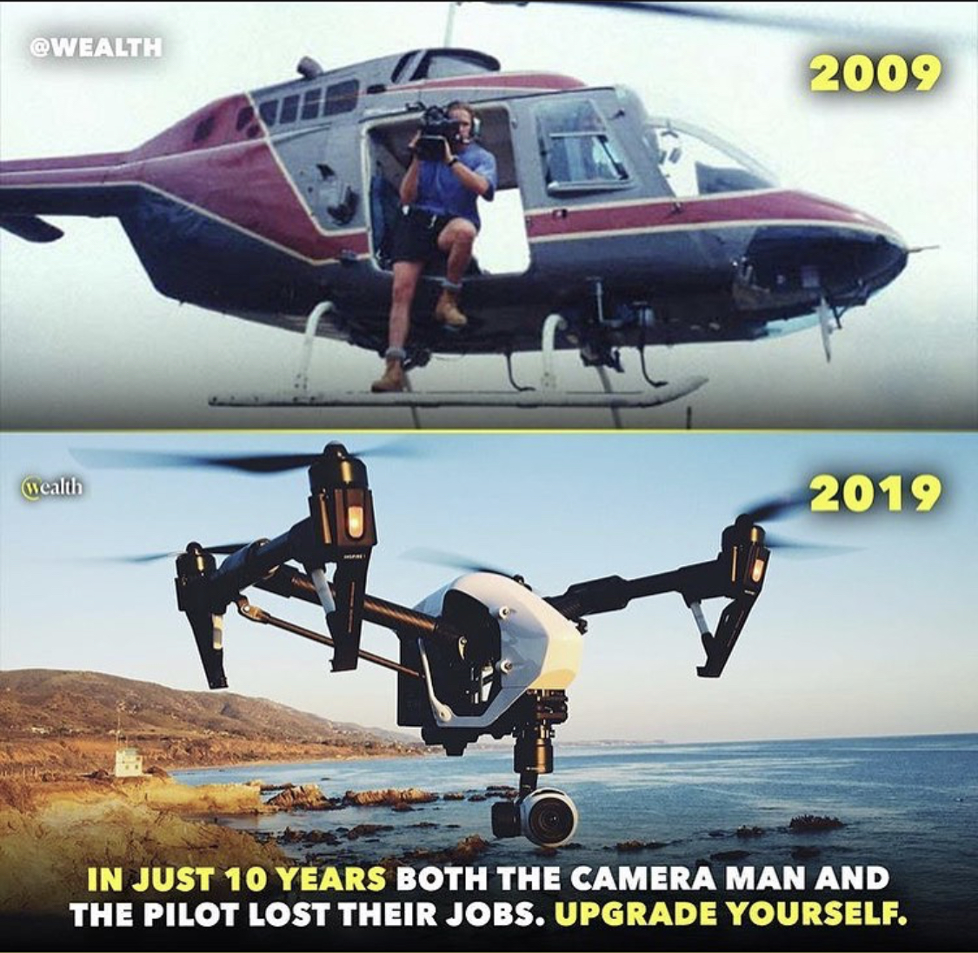
CHANGING TECHNOLOGY

Slide 3



CHANGING INNOVATION
100 year old Company
Industry Leader 90%
to bankruptcy
THEY DIDN’T CHANGE

Slide 4


CHANGING DISTRIBUTION
THEY DIDN’T CHANGE
Speed and convenience

Slide 6
… Nearly 9,100 store
closures have been
announced in 2019,
55% higher than total
closures in 2018,
according to a recent
report from global
marketing research firm
Coresight Research.
THE WORLD IS CHANGING

Slide 7
JUST A FEW
THEY DIDN’T CHANGE
Payless Shoe: 2,589 Gymboree749 Dressbarn: 649
Fred's 129 Charlotte Russe: 494 Shopko: 371Charming Charlie: 261
Avenue: 222Kitchen Collection: 160
Henri Bendel: 23
Barneys New York: 22 Topshop: 11

Slide 8

The World is Changing……..Are you Changing?

Slide 9

  Is your financial plan changing?
  The Consumer is Facing today:
Their Financial Challenges

Slide 10
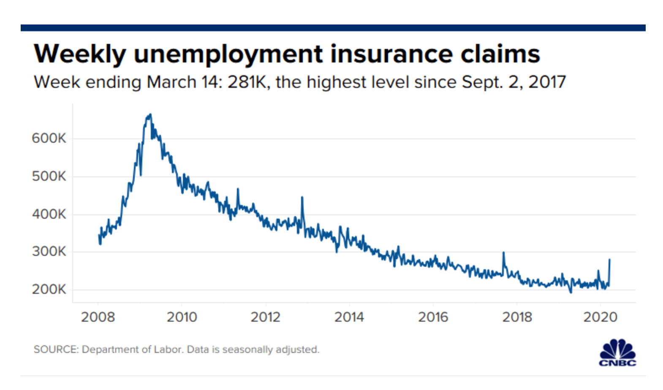
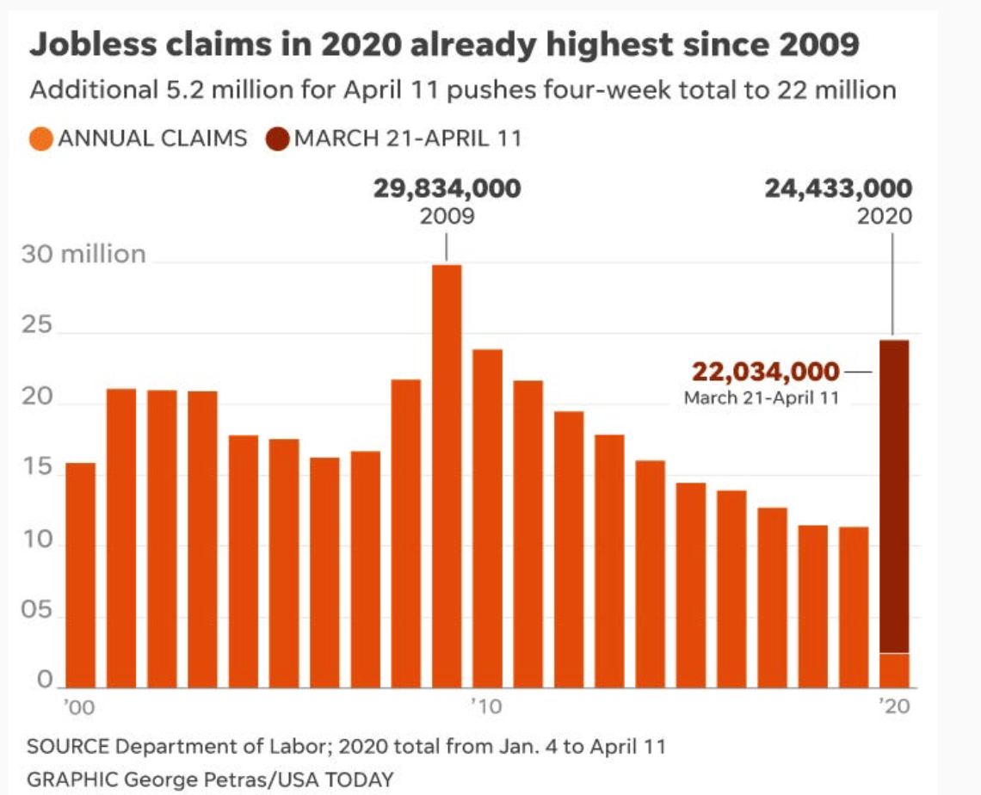
  Is your financial plan changing?
  Job Worries working are Facing today:
Job Insecurity - Layoffs

Slide 11


Financial Challenges Have Worsened With Corona
78% of full-time workers live paycheck to paycheck.
CNNMoney.com, “How to Save for Retirement On a Tight Budget,” October 13, 2017
More than half of Americans have less than $1,000 in savings.
CNBC.com, “Here’s How Much Money Americans Have in Their Savings Accounts,” September 13, 2017
U.S. households with debt carry an average credit card balance of $15,654.
NBCNews.com, “Americans Have More Credit Cards – and More Debt, Says CFPB,” December 28, 2017
Nearly half (48%) of U.S. households don’t have enough life insurance.
USAToday.com, “Impending Death of the Life Insurance Medical Exam,” August 6, 2017
More than half of all workers have less than $25,000 in savings and investments for retirement.
Employee Benefit Research Institute 2015 Retirement Confidence Survey

Slide 12
Why Are People Having So Many Financial Challenges?
Most People Today
Don’t Earn Enough Income - Less than 6 Figures
Don’t Have a Work from Home Income Plan
Don’t have a Financial Plan or Coach.
We have Solutions to all of these Challenges

Slide 13








The Goal is to become a 2% which allows you to live your life on your terms
New Cars
Travel
Education
Hobbies
Family & Friends
New
Homes
Charities
13

Slide 14
How to Become a 2%- Become an Owner
CASH FLOW QUADRANT*
EMPLOYEE
Has a job.
Income based on position, not the person.
BUSINESS
Owns a system. Has others working for him/her.
Unlimited income potential via manufacturing, marketing, etc.
SELF-EMPLOYED
Owns a job.
Dentist, doctor, lawyer, hair stylist, real estate agent, salesperson.
INVESTOR
Has money working for him/her.
Enjoys complete freedom and lives the dream.
*The Cash Flow Quadrant, CASH FLOW Technologies, Inc.; used with permission.
The Cash Flow Quadrant and ESBI are trademarks of CASH FLOW Technologies, Inc. For informational purposes only.

Slide 15
Our Business Model
What if you could find a legitimate professional business that:
80% of North America is in your Market
You can work from home -Totally Online- No Overhead
No Product to Buy, Assemble or Ship
Work when you want and as often as you want

Slide 16
Our Business Model
What if you could find a legitimate professional business that:
Provides a scalable marketing and business system
Utilizes the latest technology
Is an Intangible Product that Requires a Professional License
Has a Multi-Billion Dollar Product Support System

Slide 17






A Professional, 100% Virtual, Work From Anywhere Business
That Changes People’s Lives Financially.

Slide 18
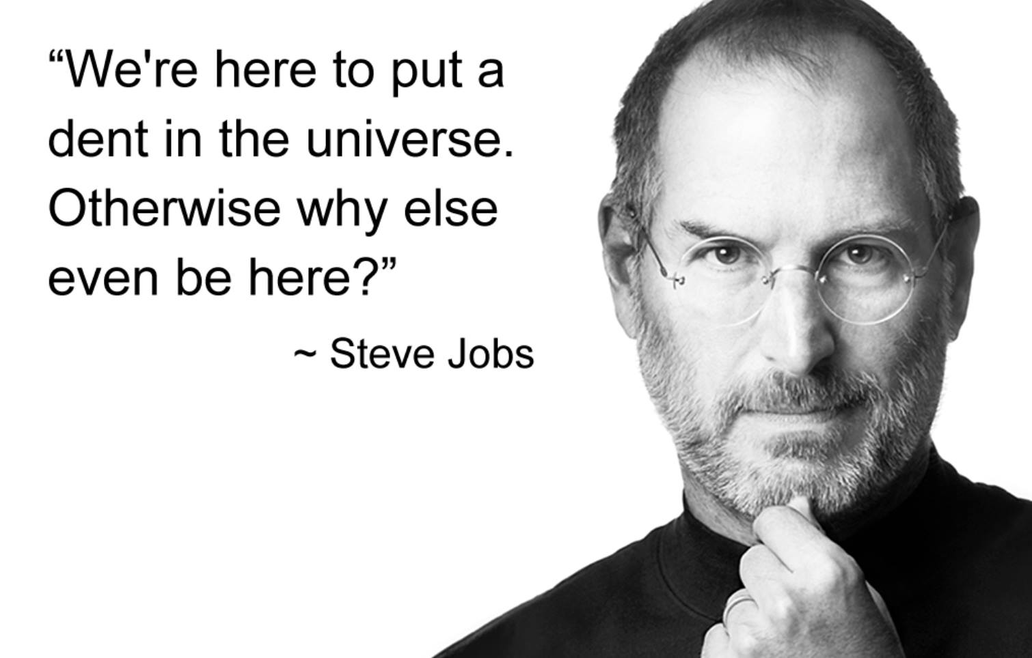

Slide 19




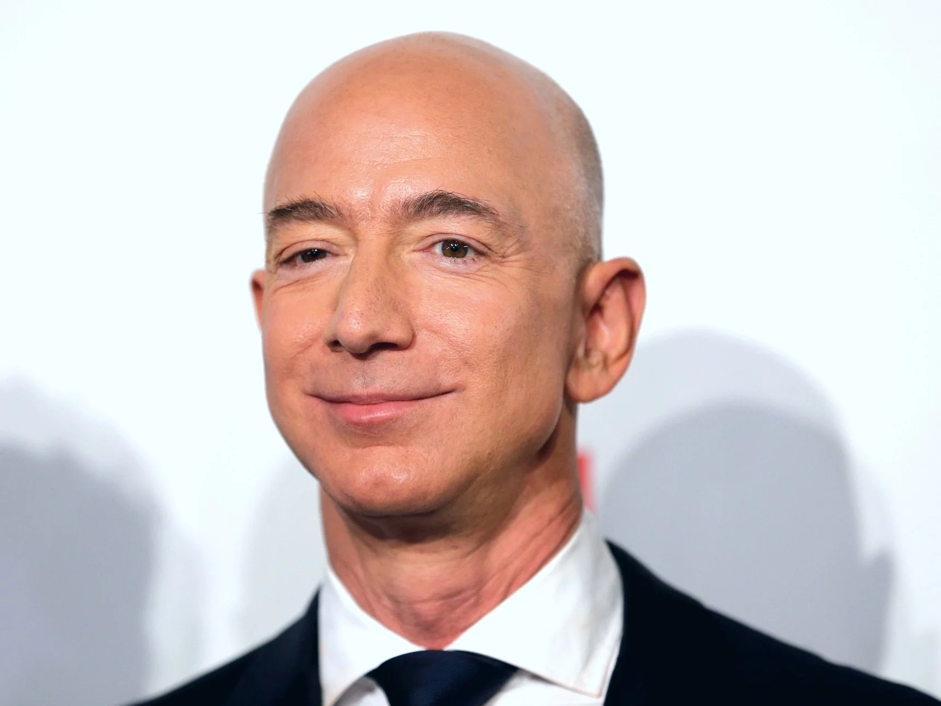
The Next Dent in the Universe
TECHNOLOGY
RETAIL
FINANCIAL

Slide 20
Our Business…….
Educate North America on Money

Slide 21
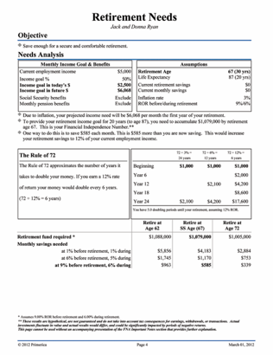
STEP 1: Know Your Financial Independence Number
Everyone’s goal is to have enough money that works,
so they don’t have to. Your FIN defines the amount.
Age 30
Financial Independence Goal is age 60.
Ideal annual income: $100,000
After inflation of 3%, this is $243,000.
The money needs to last for 30 more years. THIS IS A VERY LONG VACATION.
Your FIN is $2,624,000
To get there, invest $1,421 per month for 30 years at 9% = $2,624,400
This hypothetical example assumes 20 years of retirement income needed, at a 6% post-retirement rate of return and 3% inflation. Hypothetical investment rates assume a nominal 9% rate of return, compounded monthly, and are not indicative of any specific investment. Any actual investment may be subject to taxes and fees, which would lower performance. This example shows a constant rate of return, unlike actual investments which may fluctuate in value.

Slide 22
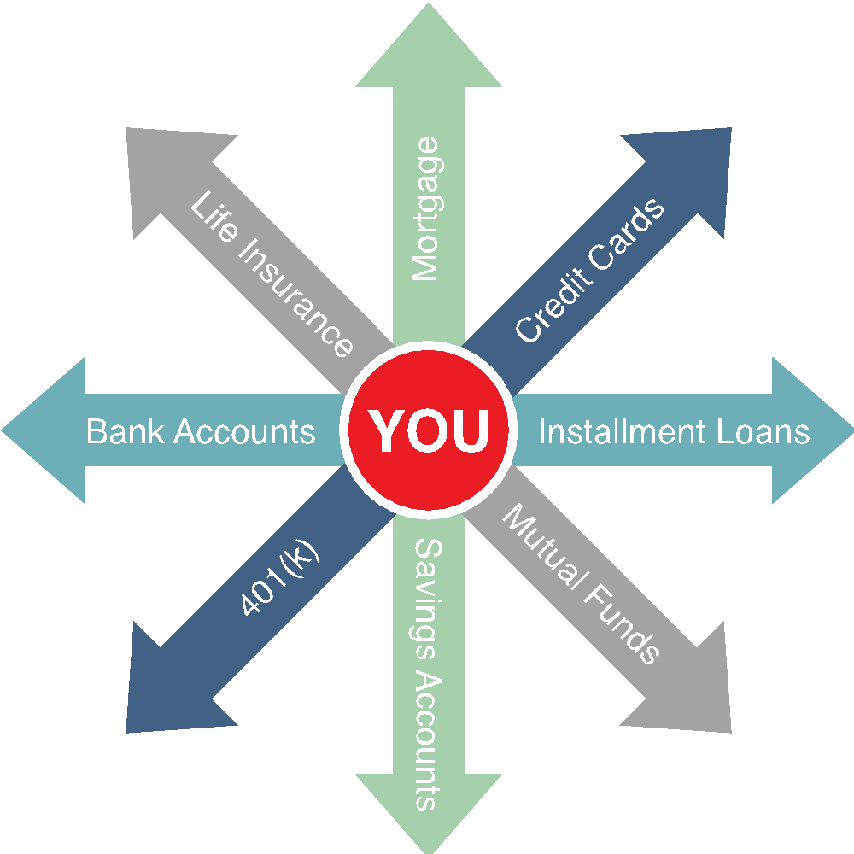
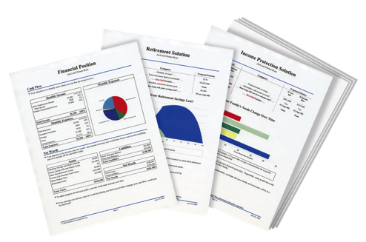

STEP 2: Map Your Route to Get There
The PROBLEM for most people:
No Clear Direction
The SOLUTION:
A cutting-edge digital tool that works like a GPS, but it’s for your money.
We know what we want, but get confused at times on how to get there.
A clear route from wherever you are to where we want to go, so you can worry less about money and enjoy life more!

Slide 23
STEP 2: Map Your Route to Get There
The Problem:
Traditional financial institutions sell you products. They don’t provide you with a total solution.
The Solution:
A Financial Needs Analysis. A customized, confidential and complimentary program that helps you achieve your goals and dreams.
A Financial GPS: It helps you find answers to important questions.

Slide 24
RULE OF 72
THE MOST IMPORTANT RULE OF MONEY
How long it takes to double money
Years
2%
6%
12%
0
$20,000
$20,000
$20,000
How much do most people know about earning
a better return on their 401k’s, IRA’s, etc?
6
$40,000
12
$40,000
$80,000
Do you know how much money you need to get
professional investment advice from most
investment companies?
18
$160,000
24
$80,000
$320,000
$250,000
30
$640,000
36
$40,000
$160,000
$1,280,000
Do you see a problem?
The table serves as a demonstration of how the Rule of 72 works and is only an approximation of accumulations. It is not intended to represent any specific investment, which will fluctuate.
Notes:
----- Meeting Notes (9/8/16 19:29) -----
So, this is a loaded question because unfortunately, we don't learn the Rule of 72 in school, yet it's..

Slide 25
What if you could earn about $30,000-$50,000 over time for every client you helped like this? 100 Clients = $3,000,000-$5,000,000
How Much Do Most People Waste Per Day or Per Week?
What if we could re-route that money towards our future?
$500 per month earning 9% and increased each year by 3%. At Age 65.
25
$3,243,606
Wait 1 Year
($6,000)
26
$2,947,185
(-$296,421)
Wait 5 Years
($31,854)
30
$1,999,566
(-$1,244,040)
Wait 15 Years
($111,588)
40
$722,293
(-$2,521,313)
How important is it to make consistent investing a priority?
Rates of return are constant and nominal rates, compounded monthly. Contributions are assumed to be made at the beginning of the month. The chart above is not indicative
of any particular investment or savings vehicle where rates of return fluctuate. It does not take into consideration taxes or other applicable deductions, which would lower results.

Slide 26
Turn Debt Payments into Wealth
Retail Card 1
Credit Card 2
Car Loan
Credit Card 1
Mortgage
Total
$220
$353
$551
$303
$1,293
$2,720
$353
$551
$303
$1,293
$2,720
$551
$303
$1,293
$2,720
+ $220
$573
+ $573
$303
$1,293
$2,720
$1,124
+ $1,124
$1,293
$2,720
$1,427
+ $1,427
$2,720
23 years to pay off debt and $214,442 in interest paid
Paid off in 8 years, Age 43 (15 years sooner) Interest saved $130,643
(Age 44, invest $2,720 each month at 9%) @ Retirement … Age 65 = $2 million
The above example is for illustrative purposes only. The Debt Stacking concept assumes that: (1) you make consistent payments on all of your debts, (2) when you pay off the first debt in your plan, you add the payment you were making toward that debt to your existing payment on the next debt in your plan (therefore you make the same total monthly payment each month toward your debts) (3) you continue this process until you have eliminated all of the debts in your plan. In the example above, when the retail card is paid off, the $220 is applied to credit card 2, accelerating its payment to $573. After credit card 2 is paid off, the $573 is applied to the car loan for
a total payment of $1,124. The process is then continued until all debts are paid off. Note that the total payment per month remains constant.
The hypothetical assumes a constant nominal 9% rate of return compounded monthly, unlike actual investments which will fluctuate in value,
and does not include taxes or fees, which would reduce returns. Investing begins once debts have been paid off (at age 44).
Notes:
26

Slide 27

Protect Your Family’s Financial Independence
What’s the worst thing that can happen to a family financially?
PROBLEM: We know as much about life insurance as we do investing.

Slide 28



Income Protection
$4,000
$4,000
Mortgage
Cars
Insurance
Credit Cards
Utilities
Groceries
Child Care
$8,000
MONTHLY NEEDS
MONTHLY INCOME
MONTHLY INCOME
What happens to your family when an income stops
and the bills keep coming? Financial Disaster.
There are there 2 deaths: The Person and The Income

Slide 29


If you died tomorrow, would you want your family to be…
a little better off, the same, or worse?
5 Biggest Mistakes
Not enough. Can devastate a family.
Wrong kind: Cash Value Life Insurance
Term from a Company selling Cash Value. Unaffordable at renewal, creating future risk.
Procrastination. Putting your family at risk.
GROUP LIFE. May not pay at all.
Notes:
Speaker Notes:
This his how we see life working together.
In the early years we do believe you need a lot of life insurance because you may have some kids, some debt, a house and the loss of your income would be devastating because your saving and investments have not grown yet. Once your savings and investments do grow you now come to what we call the Theory of Decreased Responsibility. So now your kids are grown and out of the house your debt is paid off and your house is paid off so now all you need is money to live off of. At the same time your need for life insurance can go down or ultimately just go away. And we are the only company in the entire financial industry that helps families get the right amount of life insurance the right kind which is level term and we help them get out of there life insurance. And we can do that because we are helping you get out of debt and helping you invest your money for the future. When have you ever heard of a company that helps you get out of the products they provide?

Slide 30
Life Insurance: There Are Two Options
Cash Value Life Insurance
Whole Life, Universal Life, Variable Life
Buy Term and Invest the Difference
30-year Level Term
................
$800,000
$400,000
SAME
$450
SAVINGS
$699,841
......................... ....
$200,000
$200,000
$261 @ 9%
$153,760
.........................
...............
........
$450
$189
Primary
age 35
Spouse
age 35
Monthly
Premium
Cash Value
at age 65
Primary
age 35
Spouse
age 35
Monthly
Premium
Investmentat age 65
Which program would you want?
Monthly premium and accumulated cash value for cash value policies is an average of whole life policies from three major North American life insurance companies for male and female, both age 35 and standard risk. Cash value life insurance can be universal life, whole life, etc., and may contain features in addition to death protection, such as dividends, interest or cash value available for a loan or upon surrender of the policy. Cash value insurance usually has level premiums for the life of the policy. Term insurance provides a death benefit and its premiums increase after initial premium periods and at certain ages. Primerica monthly premium for 30-year Custom Advantage Policy: primary (17CJ0(30)) and spouse rider (17CK0(30)), both age 35, non-tobacco use, underwritten by Primerica Life Insurance Company, Executive Offices: Duluth, GA. The accumulation figure reflects continued investment at the same rate over 30 years at a 9% nominal rate of return compounded monthly and does not take into consideration taxes, fees or other factors, which would lower results. This example uses a constant rate of return, unlike actual investments, which will fluctuate in value. This is hypothetical and does not represent an actual investment.
Not for use in New York.

Slide 31


Imagine you had a ‘magic’ toaster that popped up $4000 a month…
Would you insure your toaster?
How soon?
How much would you insure it for?
$600,000
@8% = $48,000 a year
To your kids and/or your spouse, you are the toaster!
What is the moral of this story?
The primary purpose of life insurance is to replace the loss of income.

Slide 32
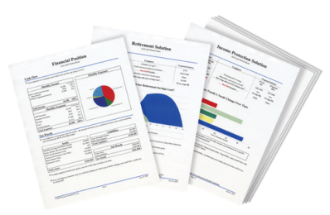


Solution: Build Your Financial House
Other Goals and Dreams
College Savings
Retirement
Accelerate Paying Off Debt
On a scale of 1-10,
10 being the highest,
how would you rate your
confidence level that you will become debt free and financially independent?
Budget - Emergency Fund
Protect Your Income / Term Life

Slide 33
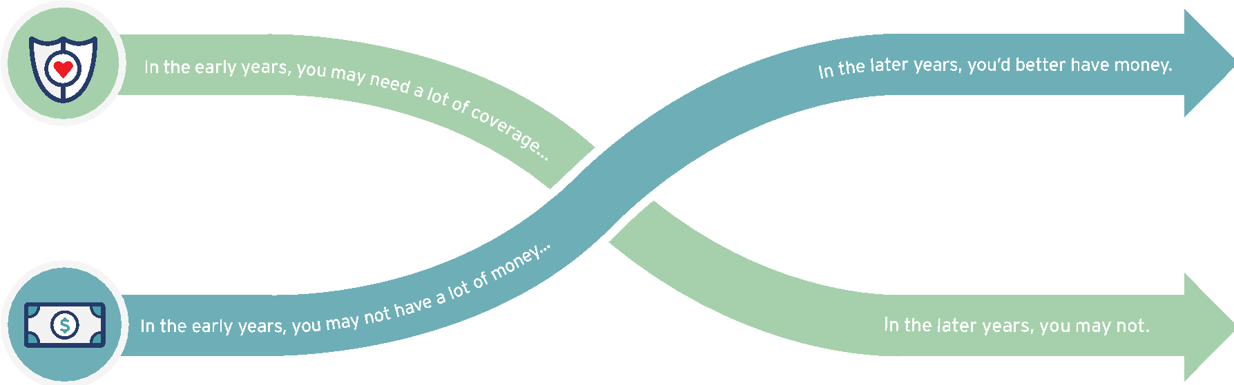


The 2 Issues Everyone Faces with Money
DYING
TOO SOON
LIVING TOO LONG
Today
Young children
High debt
House mortgage
Loss of income would be devastating
At Retirement
Grown children
Lower debt
Mortgage Paid
Retirement income needed
What life insurance company do you know of that
teaches people how to eliminate the need for life insurance?

Slide 34
Investing Education -The Rule of 72
Divide your interest rate into 72 to find the approximate number of years it takes for money to double.
Years
3%
6%
12%
0
$10,000
$10,000
$10,000
6
12
18
24
30
36
42
48
$20,000
$20,000
$40,000
$80,000
$20,000
$40,000
$160,000
$320,000
$80,000
$640,000
$1,280,000
$40,000
$160,000
$2,560,000
This table serves as a demonstration of how the Rule of 72 concept works from a mathematical standpoint. It is not intended to represent an investment. The chart uses constant rates of return, unlike actual investments which will fluctuate in value. It does not include fees or taxes, which would lower performance. It is unlikely that an investment would grow 10% or greater on a consistent basis, given current market conditions.

Slide 35
Investing Education-Pay Yourself First
When you don’t, there’s a high cost of waiting.
$1,000 Monthly Savings at 9% for 40 Years (Age 25-65)
25
$4,716,400
Wait 1 Year
($12,000)
26
$4,300,400
(-$416,000)
Wait 5 Years
($60,000)
30
$2,963,800
(-$1,752,600)
Wait 15 Years
($180,000)
40
$1,129,500
(-$3,586,900)
Rates of return are constant and nominal rates, compounded monthly. Contributions are assumed to be made at the beginning of the month. The chart above is not indicative
of any particular investment or savings vehicle where rates of return fluctuate. It does not take into consideration taxes or other applicable deductions, which would lower results.

Slide 36




Investing Education – Become an Owner, Not a Loaner
Traditional Financial Institutions
Your Money
Global Economy
Banks, Credit Unions, Insurance Companies = Historically Low Rates of Return
CDs and savings accounts are generally FDIC insured up to $250,000. Cash value life insurance offers life insurance components in addition to the investment component.

Slide 37




Investing Education- Mutual Funds
A mutual fund is an opportunity for you, together with many other investors, to pool your money.
How Mutual Funds Work
Individual
Investors
Pooled Assets
Means Professional Money Managers
Global
Economy
Investing entails risk including loss of principal. Shares, when redeemed, may be worth more or less than their original value.
Notes:
Professional money managers invest the “pool” for you, keeping the investments under constant supervision. The money managers use their knowledge of securities and changing market conditions to invest the pooled assets in many different companies within a variety of industries.
37

Slide 38
Accumulating a FIN#
Why Banks & Insurance companies are rich and we are not!
AGE 65
$1,239,137
Accumulation
Financial
Independence #
Age 30
Add no more Money
For 35 Years
3 %
6 %
9 %
$28,138
$76,860
$204,140
$10,000
$1,669/mo
$ 869/mo
$400/mo
Additional $/mo needed to reach FIN#
Fix Your Finances 2020
Notes:
According to the Theory of Decreasing Responsibility, your need for life insurance peaks along with your family responsibilities. When you’re young, you buy low-cost death protection, term insurance, enough to protect the loss of your earning power, and put the maximum amount you can afford into a promising investment program. When you’re older, you may have much less need for insurance coverage. If you’ve saved and invested wisely you should have a significant amount of accumulated cash. You’ve become “self-insured” and eliminated your need for life insurance.

Slide 39

We help people build and protect wealth regardless of their net worth.
By educating consumers, every Family in North America can achieve Financial Freedom.

Slide 40
Bottom Line: The Need Is There
Business 101 says find a need and fill it, and if you do, what happens?
You make money.
Is there a need for what we do?
Are these financial concepts helpful for everyone?
Can you see why our clients love us?
Can you see the Opportunity it creates?

Slide 41
How the Appointment System Works
Run the System from anywhere and You make Money
Technology drives the Business- Personal Links to Invite Prospects
12 Week Customer Education Series Online
Weekly Join the Team Presentation Online
1-1 Follow Up with Zoom and Online Applications

Slide 42
How the Training Works- Technology drives the Training- Zoom
Online Licensing Training- Life and Securities
Weekly 2 Hour Product Training Online- Zoom
Weekly 1 Hour Marketing Training- Zoom

Slide 43

Plug into “The Marketing and Training System" and Earn Unlimited Income
Monthly Kickoff First Saturday
Sunday Night Training
Monday- Thursday Client Series-Links to Invite
Monday-Thursday Business-System Overview-Links to Invite
Tuesday Marketing Webinar
The Entire System is Online and can be accessed and worked from Anywhere

Slide 44

Earnings Opportunities

Slide 45
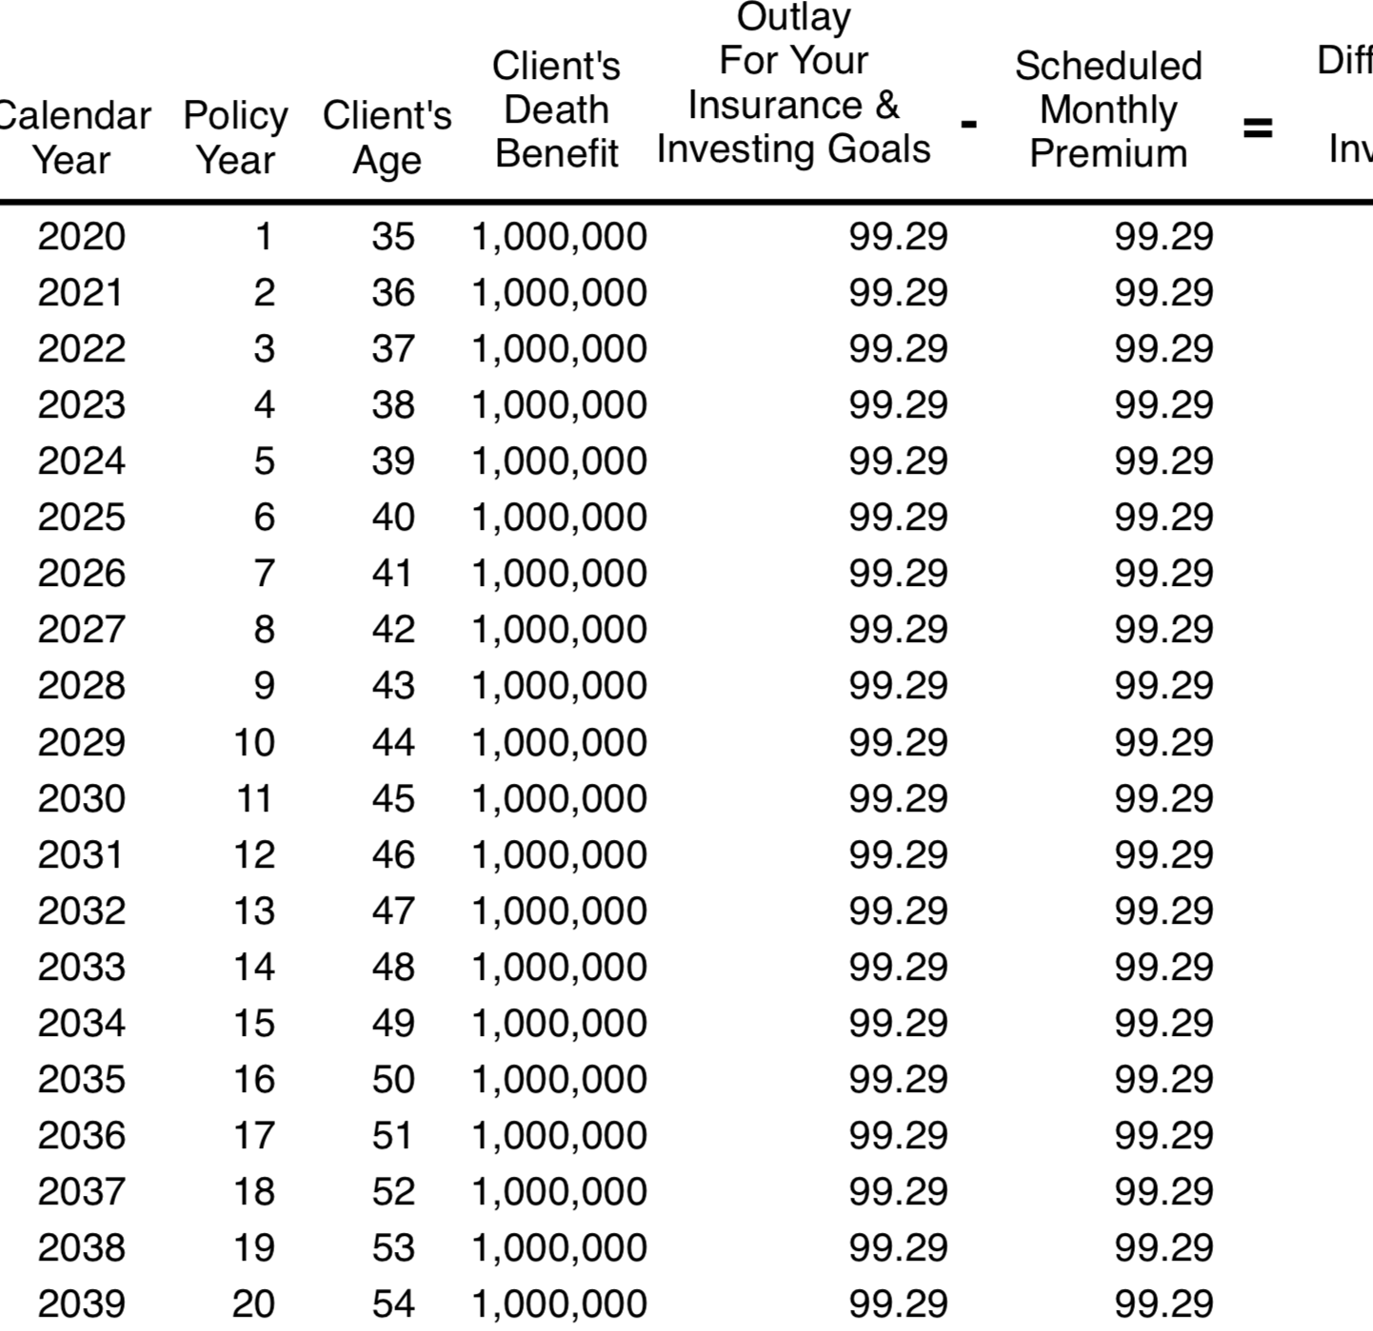
Term Life Insurance Compensation
Age 35
30 Year level premium
$1,000,000 Death Benefit
Monthly Cost $99.29

Slide 46
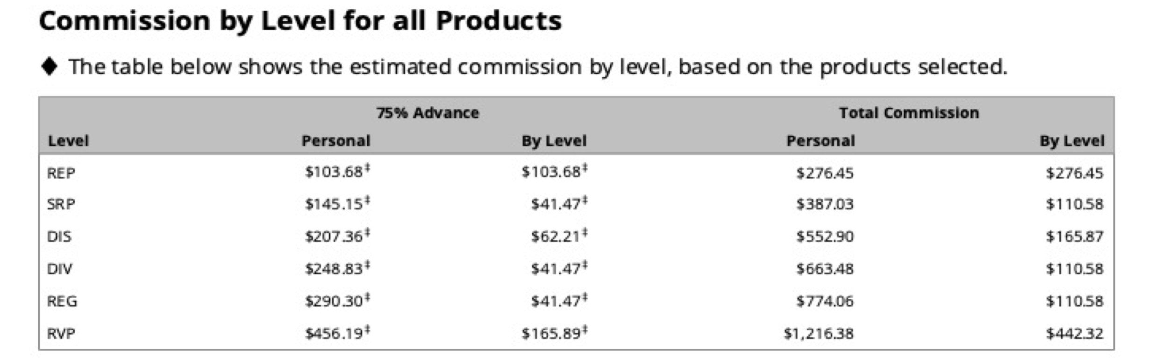
Term Life Insurance Earnings
Starting at $276.45 Per Transaction to $1,216.38 as an RVP
The Entire Application is done online through Zoom

Slide 47
Term Life Insurance and Investing in Mutual Funds
Approximate Monthly Spend Per Client $500-$1,000 Per Month
$99 Per Month Term Policy Pays a One Time Commission of $276-$1.216
$500 Per Month Investment Pays a Recurring Commission of $7-$15 per month
From January 1 through December 31, 2017, Primerica paid cash flow to its North American sales force at an average of $6,030, which includes commissions paid on all lines of business to licensed representatives. Figures include U.S. and Canadian dollars remaining in the local currency earned by the representative, not adjusted for exchange rates.

Slide 48
Term Life and Mutual Fund Compensation
Assumes 1 Client Per Week- Done Online
1-Term Life Policy Per Week - Personal Income Equals $26,000 Annual Income
1- $500 per month Investment Per Week -Personal Income Equals $520 per month in Recurring Income
Total First Year Personal Income $29,000
From January 1 through December 31, 2017, Primerica paid cash flow to its North American sales force at an average of $6,030, which includes commissions paid on all lines of business to licensed representatives. Figures include U.S. and Canadian dollars remaining in the local currency earned by the representative, not adjusted for exchange rates.

Slide 49
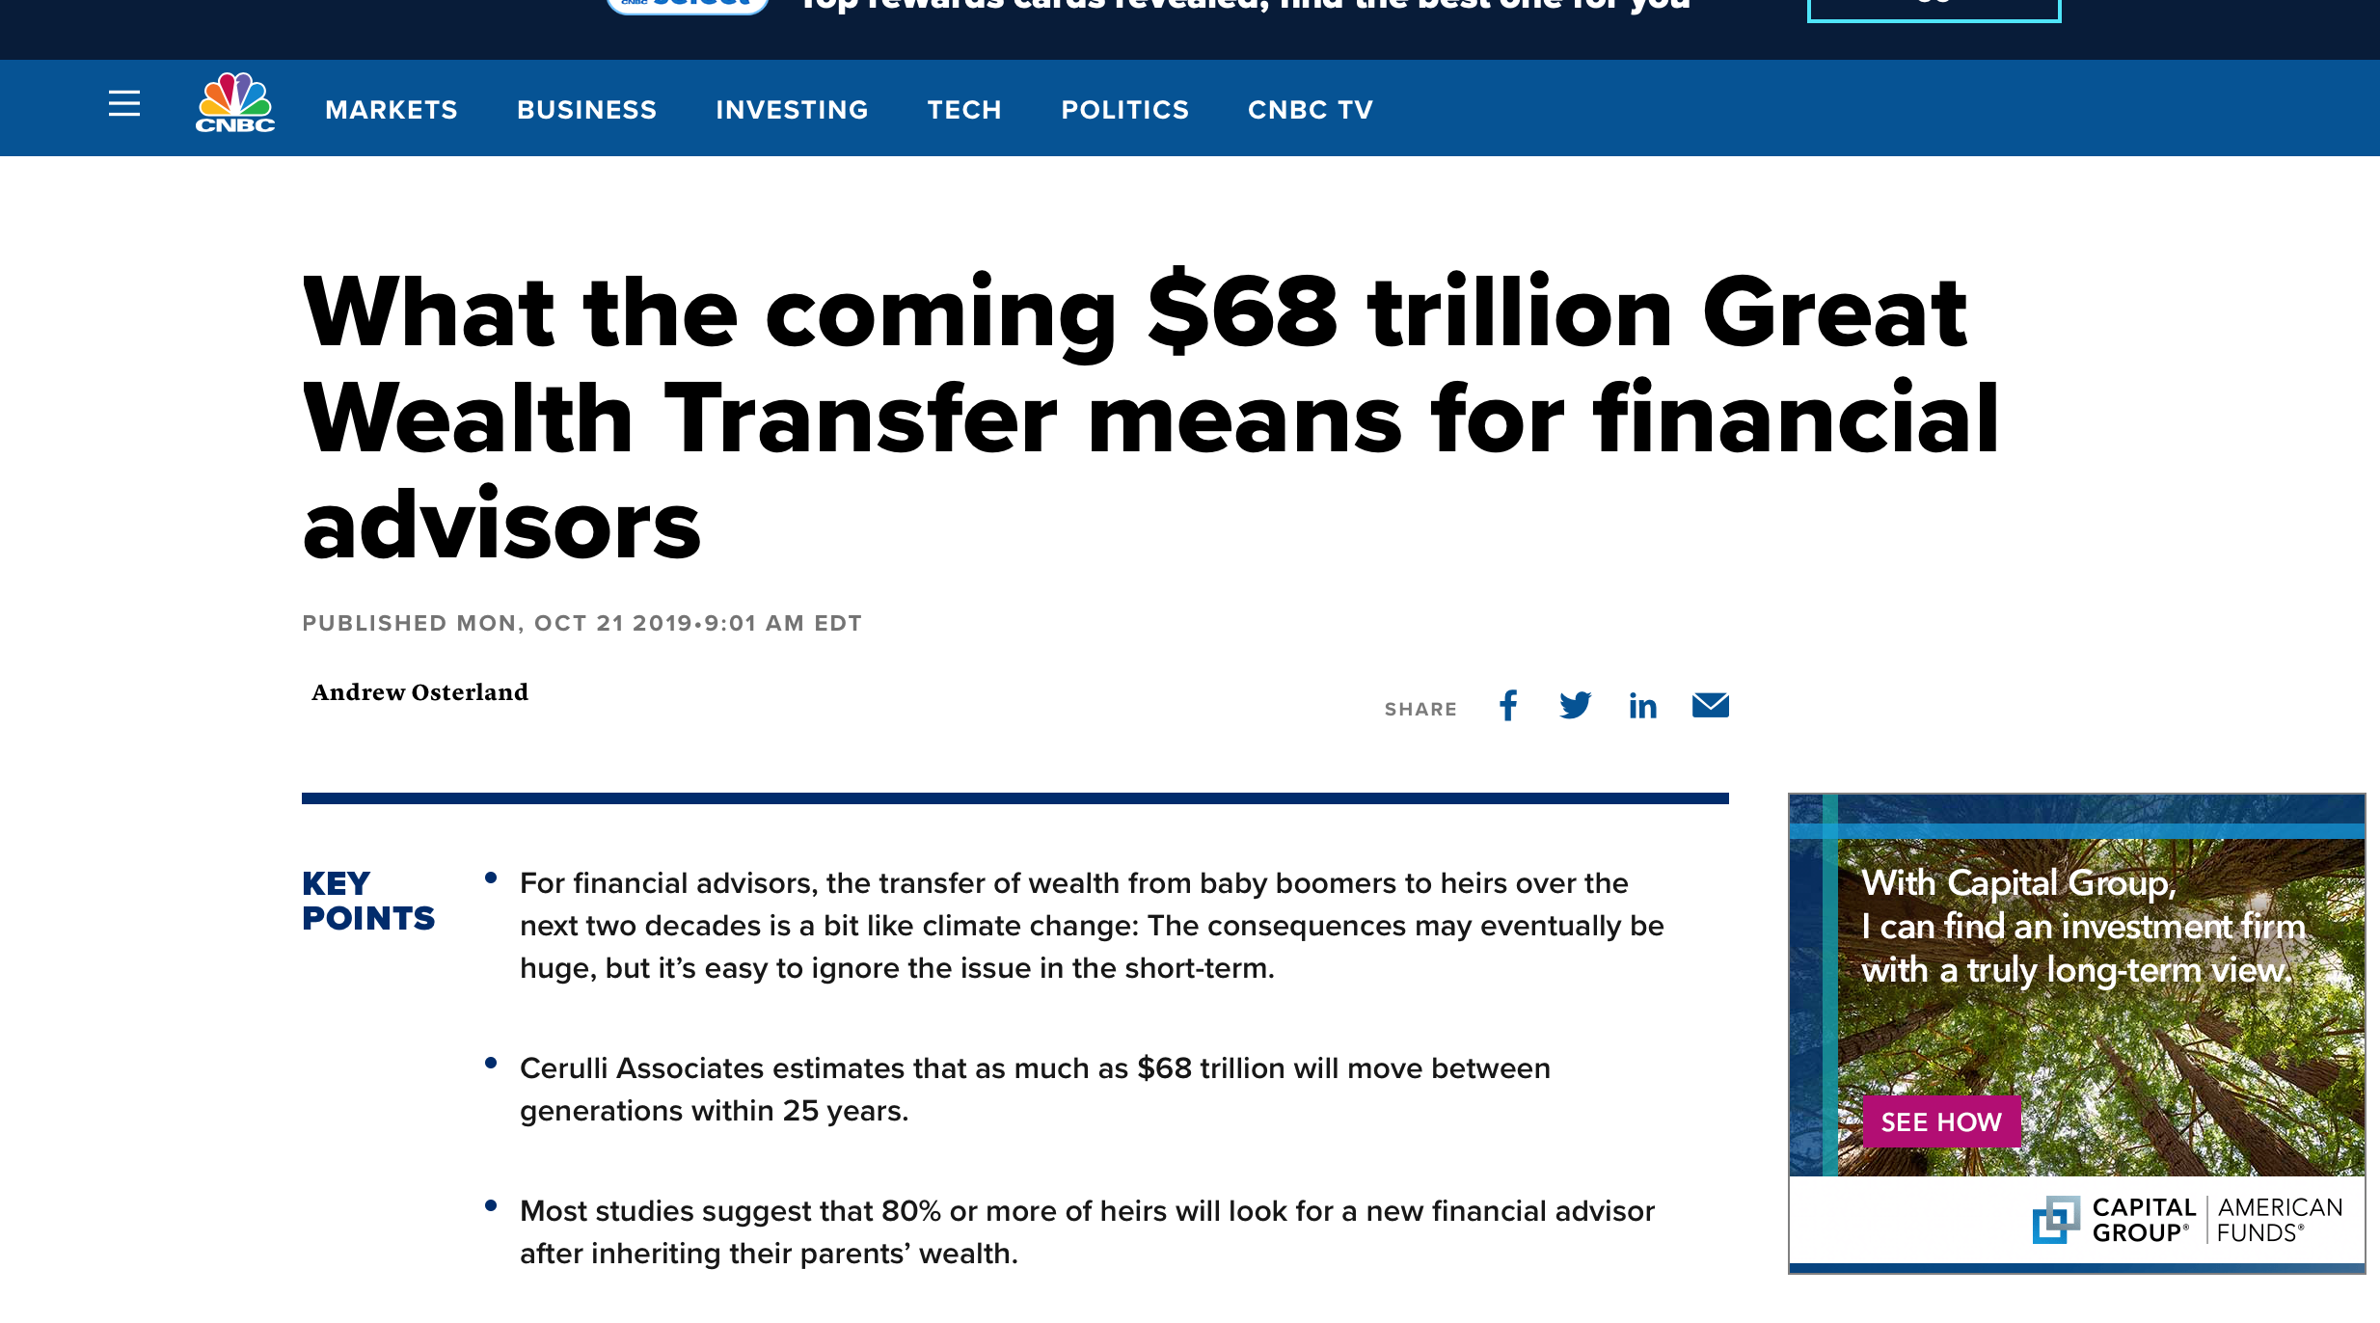
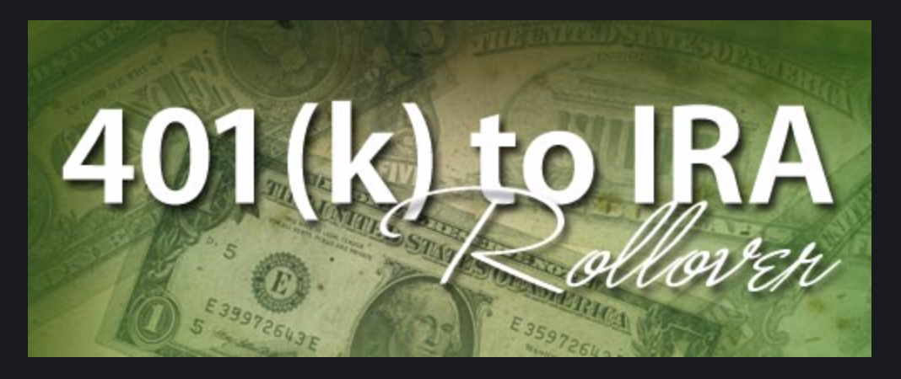
Investment Compensation

Slide 50

The Rollover Market-Nov 2019

Slide 51
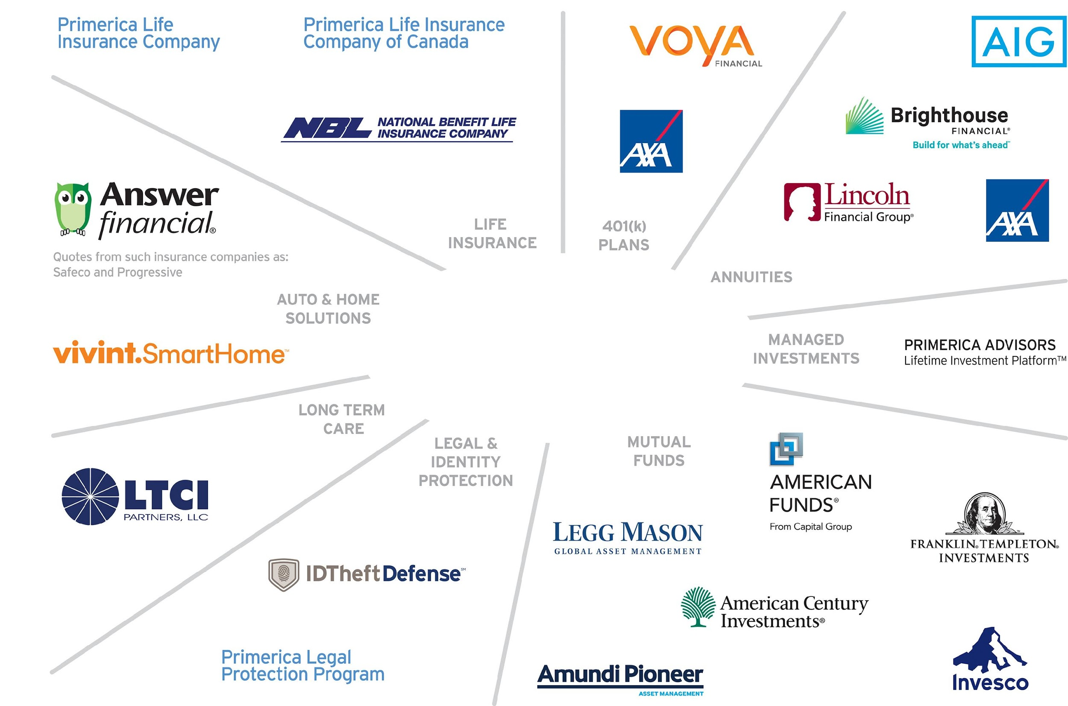
Representing Products offered thru Primerica (PRI) NYSE
Not all products and services are available in all states, territories, or the District of Columbia. A representative's ability to offer products from the companies listed is subject to state and federal licensing and certification requirements. Please refer to the Important End Notes for additional details about the contractual arrangements and company affiliations detailed above.

Slide 52
Investment Compensation
We Represent The Largest Mutual Fund and Annuity Companies is North America
$68 Trillion Market
Recurring and Repeat Compensation
No Limit to the Size of the Investment
Applications through Zoom and Online Applications

Slide 53
Investment Compensation
We Represent The Largest Mutual Fund and Annuity Companies is North America
Based on a $300,000 Rollover as a Regional Leader
Produce One Rollover Per Month Earn Annual Income $53,550
Does Not Include Residual, Recurring or Repeat Investments
Applications through Zoom and Online Applications

Slide 54

Freedom Comes From Recurring and Residual Income
You gain Freedom when you have both “Time and Money”
Freedom Money is Recurring “Do Nothing Money”
Freedom Comes from “Money Working for You or People Working for You”
Do you have a Plan?

Slide 55
Money Working for You
$1,000,000 Saved produces $50,000 Per Year in Recurring Income
Monthly savings required @9%
5 years $13,159 month
10 years $5,129 month
20 years $1,486 month

Slide 56
As an RVP with People Working for You
Assumes 10 Producers
10 Term Life Policies Per Week Life -Override Income Equals $224,640 Annual Income
10 Rollovers Per Month Investment -Override Income Equals $258,360 Annual Income
Total Override Income $483,000
Does Not Include Personal Production, Residual, Recurring or Repeat Investments

Slide 57
In Summary for Clients
Here’s what makes us different.
1. We can deliver and present Online directly to their home
2. We have all the Financial Products
3. We provide Ongoing Financial Education and Follow Up
Ownership refers to the conditional right of an eligible RVP to transfer his or her code number to another eligible RVP, subject to the consent of Primerica and subject to terms, conditions and regulatory requirements. The Ownership Program Document and policies located on POL control in all respects.

Slide 58
In Summary for Reps
Here’s what makes us different.
1. The Spare -Time Online Opportunity
2. Low Cost $124 Upfront and $25 per month
3. We pay for Insurance and Securities License $1,200 Value
4. Licensed – Regulated – Professional
5. Technology that Supports your entire business
Ownership refers to the conditional right of an eligible RVP to transfer his or her code number to another eligible RVP, subject to the consent of Primerica and subject to terms, conditions and regulatory requirements. The Ownership Program Document and policies located on POL control in all respects.

Slide 59
What You’ll Get
An Opportunity to:
Receive an education on personal finance
Have flexibility to earn additional spare-time income
Build a spare-time business as a Plan B or bridge to a full-time business

Slide 60
How To Get Started
We Represent The Largest Mutual Fund and Annuity Companies is North America
Complete an Independent Business Application
Submit $99 for Background Check and $25 First Month
Implement Your Financial Plan
Plug in to The System

Slide 61
Your Next Step
Interested
Not Interested
Schedule a follow-up one-on-one Zoom meeting with the person who invited in the next 24-48 hours while this is still fresh in your mind.
Run your complimentary Financial Needs Analysis.
Fill out an Independent Business Application.
Get Started.
Schedule a 1-1 Zoom Follow up and get your complimentary
Financial Needs Analysis.
Become a Client
Attend our Educational Workshops and get Financially Independent
*See company brochure for details.

