Slide 1

Fix Your Finances 2020
Quick Review
Class 3- How to Determine Your FIN Number

Slide 2
Step 1- Would you like to know your Financial Independence Number?
Your FIN is the amount of money you’ll need to accumulate, so that someday you can live off that money for the rest of your life and never have to go back to work.
Example: You want to retire in 30 years, with $100,000 a year in todays dollars
30 years from now, after 3% inflation… $243,000 spends like $100,000 does today.
Your FIN is $2,624,000
To get there, invest $1,421 per month for 30 years at 9% = $2,624,400
Lets Find Out What Your FIN Number Is…..
This hypothetical example assumes 20 years of retirement income needed, at a 6% post-retirement rate of return and 3% inflation. Hypothetical investment rates assume a nominal 9% rate of return, compounded monthly, and are not indicative of any specific investment. Any actual investment may be subject to taxes and fees, which would lower performance. This example shows a constant rate of return, unlike actual investments which may fluctuate in value.

Slide 3
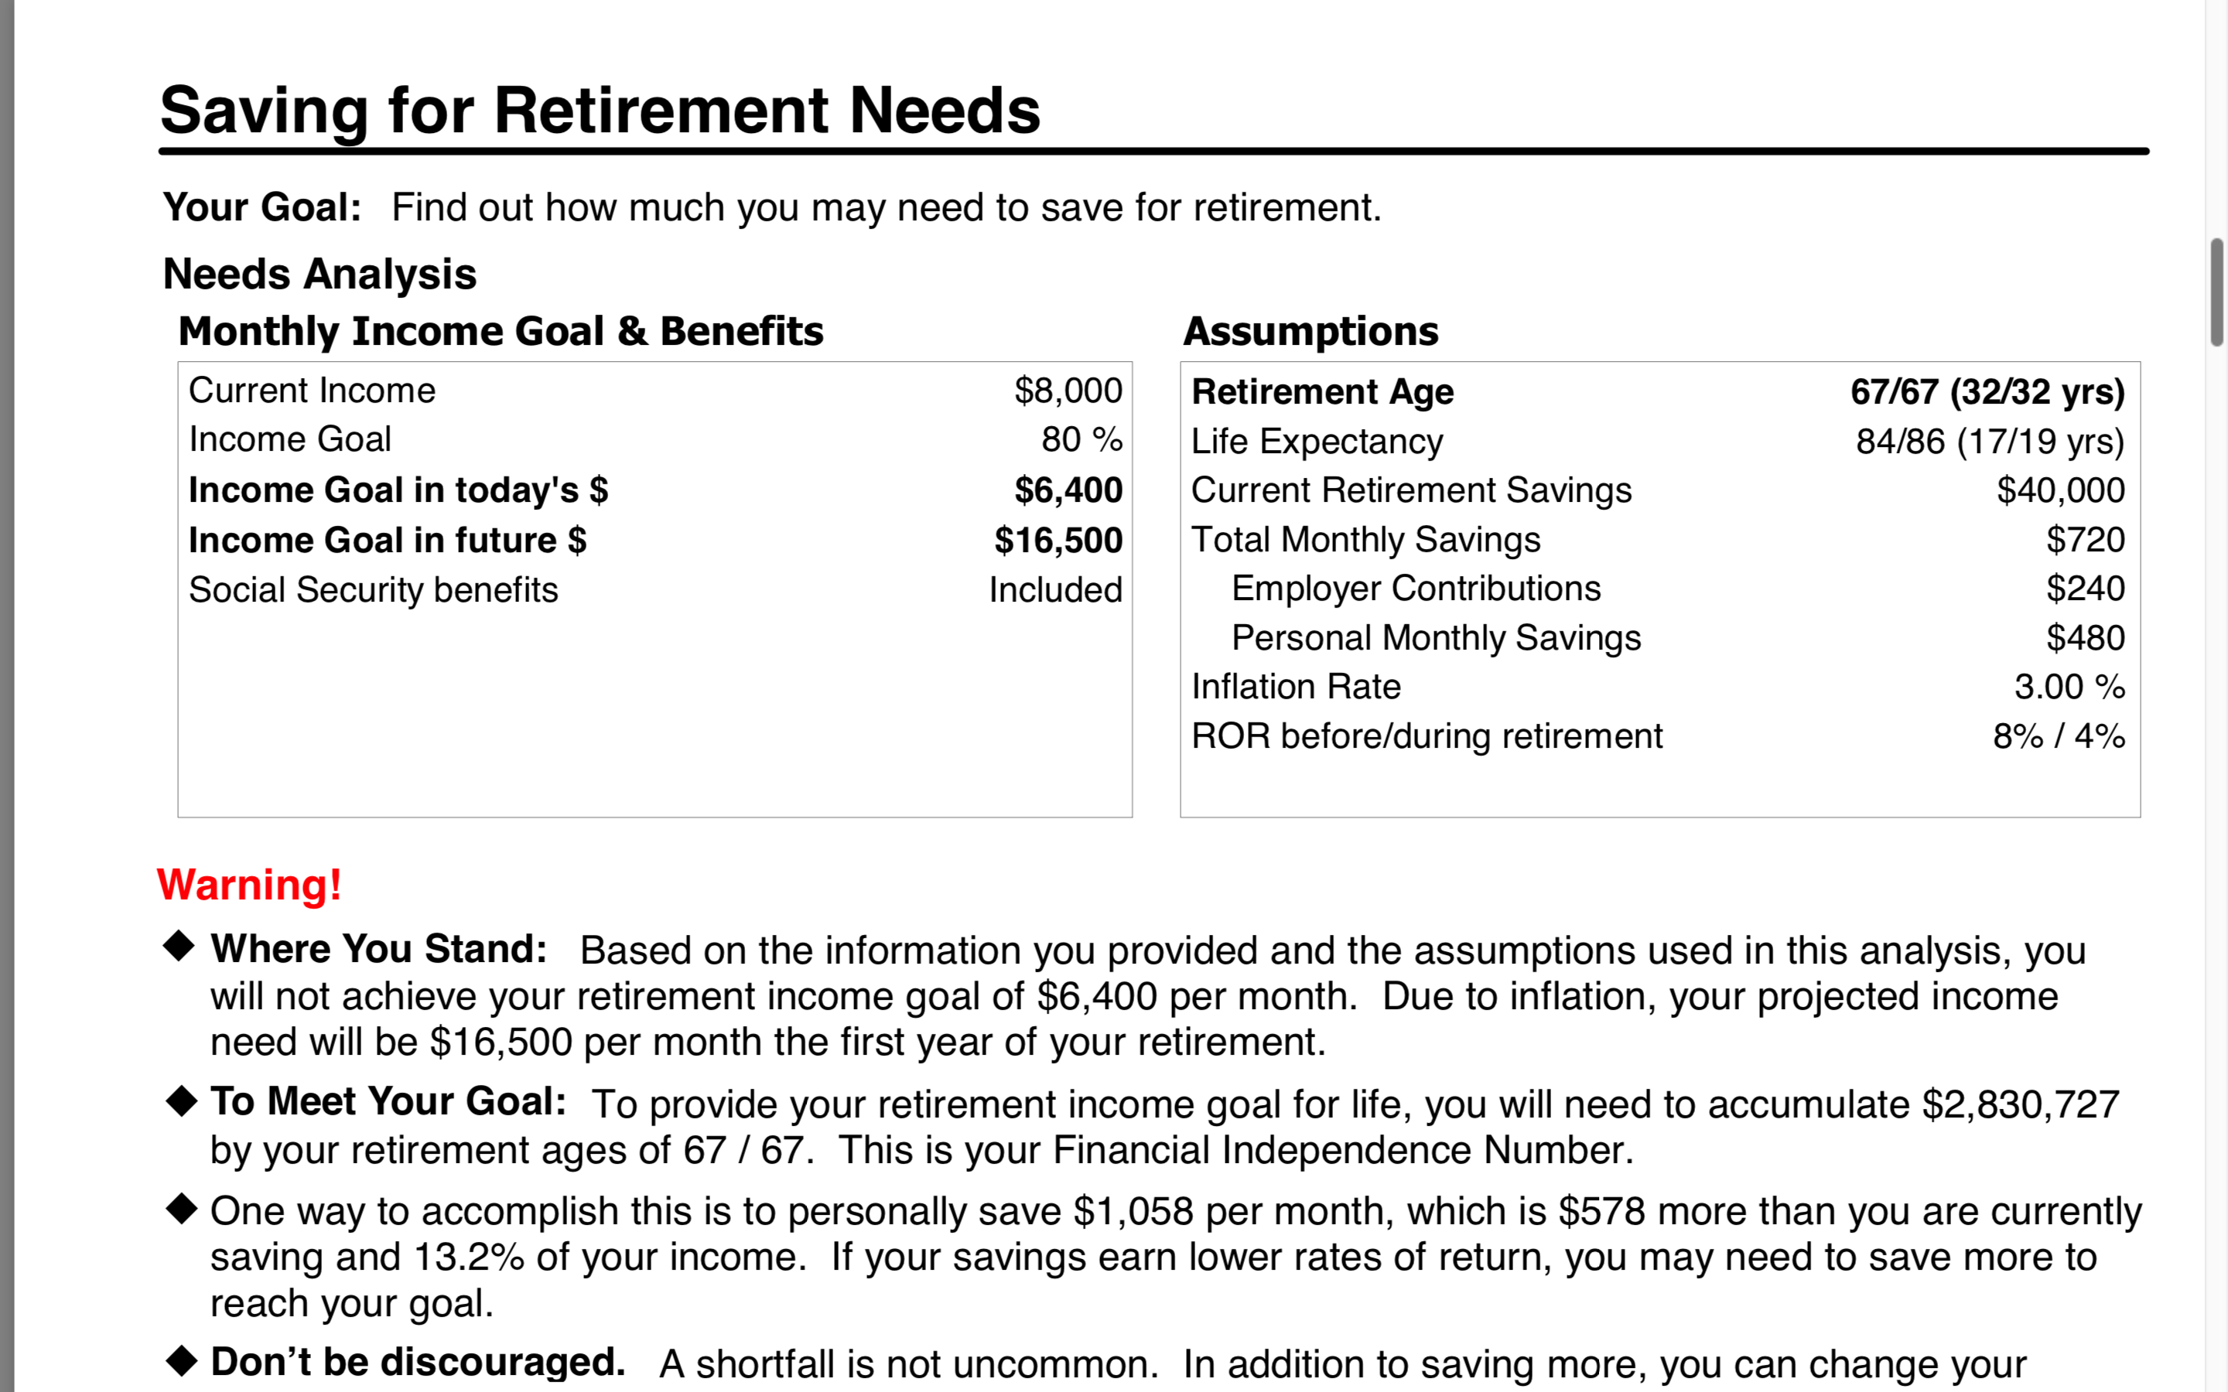
Determine Your FIN- Do Nothing Money

Slide 4
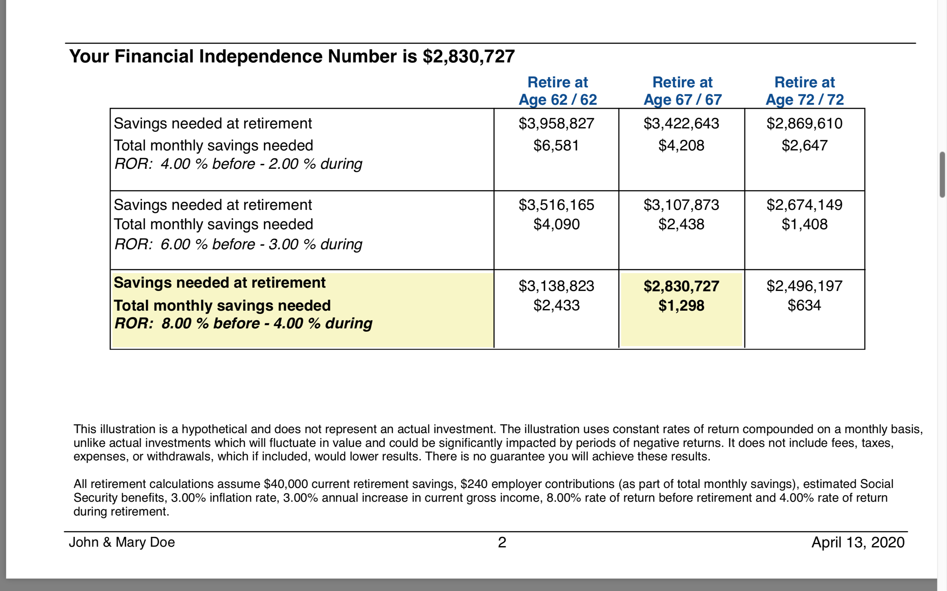
Here are the Numbers

Slide 5


The seeds you sow today will be your Harvest tomorrow…
Fix Your Finances 2020

Slide 6
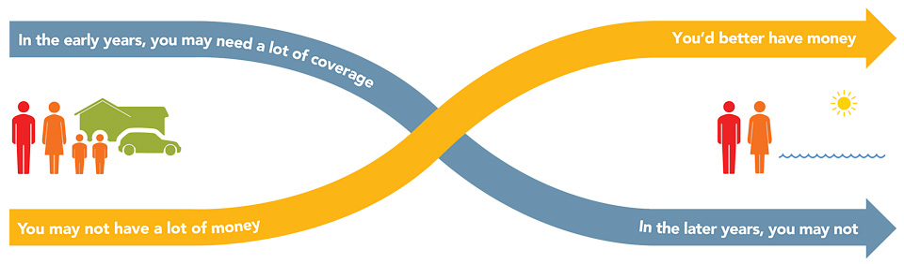
The Theory of Decreasing Responsibility
F I N #
Age 65
Age 30
Today
1. Young children
2. High debt
3. House mortgage
Loss of income
would be devastating
At Retirement
1. Grown children
2. Lower debt
3. Mortgage paid
Retirement income needed
Age 85
Fix Your Finances 2020
Notes:
According to the Theory of Decreasing Responsibility, your need for life insurance peaks along with your family responsibilities. When you’re young, you buy low-cost death protection, term insurance, enough to protect the loss of your earning power, and put the maximum amount you can afford into a promising investment program. When you’re older, you may have much less need for insurance coverage. If you’ve saved and invested wisely you should have a significant amount of accumulated cash. You’ve become “self-insured” and eliminated your need for life insurance.

Slide 7
Inflation
$155,550
$12,962/mo
$94,928
$7,910/mo
Withdrawal
AGE 85
Inflation = 2.5%
AGE 65
Income = $40,000
($3,333/mo)
Accumulation
FIN #
Financial
Independence #
Age 30
Fix Your Finances 2020
Notes:
According to the Theory of Decreasing Responsibility, your need for life insurance peaks along with your family responsibilities. When you’re young, you buy low-cost death protection, term insurance, enough to protect the loss of your earning power, and put the maximum amount you can afford into a promising investment program. When you’re older, you may have much less need for insurance coverage. If you’ve saved and invested wisely you should have a significant amount of accumulated cash. You’ve become “self-insured” and eliminated your need for life insurance.

Slide 8
Setting Your FIN#
$155,550
$12,962/mo
$94,928
$7,910/mo
Withdrawl
AGE 85
Inflation = 2.5%
AGE 65
Income = $40,000
($3,333/mo)
Accumulation
$1,239,137
7%
Financial
Independence #
Age 30
Fix Your Finances 2020
Notes:
According to the Theory of Decreasing Responsibility, your need for life insurance peaks along with your family responsibilities. When you’re young, you buy low-cost death protection, term insurance, enough to protect the loss of your earning power, and put the maximum amount you can afford into a promising investment program. When you’re older, you may have much less need for insurance coverage. If you’ve saved and invested wisely you should have a significant amount of accumulated cash. You’ve become “self-insured” and eliminated your need for life insurance.

Slide 9
You need three things to become
Financially independent…….
1. Time. If you have Lots of time!
2.Money. You need A little money!
3.Rate of return. Small Rate of return!
Shortage of time!
A lot of Money!
Highy rate of return
These are the facts of life!

Slide 10
Accumulating Your FIN#
AGE 65
$1,239,137
Accumulation
Financial
Independence #
Age 30
Add no more Money
For 35 Years
3 %
6 %
9 %
$28,138
$76,860
$204,140
$10,000
$1,669/mo
$ 869/mo
$400/mo
Additional $/mo needed to reach FIN#
Fix Your Finances 2020
Notes:
According to the Theory of Decreasing Responsibility, your need for life insurance peaks along with your family responsibilities. When you’re young, you buy low-cost death protection, term insurance, enough to protect the loss of your earning power, and put the maximum amount you can afford into a promising investment program. When you’re older, you may have much less need for insurance coverage. If you’ve saved and invested wisely you should have a significant amount of accumulated cash. You’ve become “self-insured” and eliminated your need for life insurance.

Slide 11
Spending Phase
9 %
In 20 yrs = $1,854,000
$1,239,137
7 %
In 20 yrs = $757,757
5 %
In 20 yrs = $64,808
$94,928
$7,910/mo
For Illustrative Purposes Only!!!...No Inflation Factored into above Numbers
Fix Your Finances 2020
Notes:
According to the Theory of Decreasing Responsibility, your need for life insurance peaks along with your family responsibilities. When you’re young, you buy low-cost death protection, term insurance, enough to protect the loss of your earning power, and put the maximum amount you can afford into a promising investment program. When you’re older, you may have much less need for insurance coverage. If you’ve saved and invested wisely you should have a significant amount of accumulated cash. You’ve become “self-insured” and eliminated your need for life insurance.

Slide 12
Ask Your Rep for a Complimentary Financial Needs Analysis
A Financial Plan that is Personalized to You
Free of Charge
Calculate your Net Worth
Find out your FIN Number
Debt Elimination Plan
Calculate Insurance Needs
And More…….

Slide 13
Fix Your Finances 2020
Class 4- Buy the Right Insurance

Slide 14
2 Types of Insurance
Income Protection
Asset Protection

Slide 15

Insurance for Income Protection
Life Insurance provides a lump sum that can be converted into an income stream to replace the income your family would have received from your work efforts. Employers generally provide 1 year of income as a benefit, so you purchase your own individual policy.
Disability Insurance provides a monthly income along with Social Security Disability to replace your income due to a particular disability or accident. Most disability insurance is purchased though an individual policy.

Slide 16

Asset or Liability Protection Insurance
Health Insurance provides reimbursements for medical expenses that you as an individual will incur from any type of illness or accident. You as an individual are responsible for these costs. You trade a premium in return for the insurance company to take on a portion of that liability.
Long Term Care Insurance provides reimbursements to you directly should you be confined in a nursing home or certain other care facilities. You as an individual are responsible for these costs. You trade a premium in return for the insurance company to take on a portion of that reimbursement.

Slide 17
Asset or Liability Protection Insurance
Auto Insurance provides reimbursements for damage to your car or a claim against you should someone be hurt by your car. You as an individual are responsible for these costs. You trade a premium in return for the insurance company to take on a portion of that reimbursement or liability.
Homeowners or Renters Insurance provides reimbursements for damage to your residence or a claim against you should someone be hurt at your residence. You as an individual are responsible for these costs. You trade a premium in return for the insurance company to take on a portion of that reimbursement or liability.

Slide 18


Income Protection

Slide 19
Two Problems- Dying too Soon and Living too Long
DYING
TOO SOON
LIVING TOO LONG
Today
Young children
High debt
House mortgage
Loss of income would be devastating
At Retirement
Grown children
Lower debt
Mortgage Paid
Retirement income needed

Slide 20

What is Life Insurance For?
Life Insurance is the Foundation of your Financial Plan
Life Insurance is income protection
Your income provides for expenses of your family
Life Insurance provides a lump sum to replace the future earnings that someone would earn
The goal is to one day be self insured with savings and investments at which time you can drop your coverage

Slide 21
Should You have Life Insurance Outside of Work?
Employer Sponsored Group Life Insurance generally will provide 1- 2 years of earnings and in many cases only $20,000 as a final expenses plan
Group Life Insurance does not transfer with you if you change jobs and puts you at risk of being uninsurable based on your health conditions
50% of families are either without life insurance or are under insured
Level Term insurance which is protection only provides the most affordable coverage

Slide 22
2 Types of Life Insurance
Term
Level Premium up to 35 Years
Low Cost Protection Only
No Cash Build Up
Age 35
$1,000,000 Death Benefit
$99 Per Month
Cash Value
Level Premium to Age 100
Builds Up Cash Value
High Cost
Age 35
$1,000,000 Death Benefit
$1,125 Per Month

Slide 23
Term vs. Cash Value
Cash Value Life Insurance
Whole Life, Universal Life, Variable Life
Buy Term and Invest the Difference
30-year Level Term
................
$800,000
$400,000
SAME
$450
SAVINGS
$699,841
......................... ....
$200,000
$200,000
$261 @ 9%
$153,760
.........................
...............
........
$450
$189
Primary
age 35
Spouse
age 35
Monthly
Premium
Cash Value
at age 65
Primary
age 35
Spouse
age 35
Monthly
Premium
Investmentat age 65
Which program would you want?
Monthly premium and accumulated cash value for cash value policies is an average of whole life policies from three major North American life insurance companies for male and female, both age 35 and standard risk. Cash value life insurance can be universal life, whole life, etc., and may contain features in addition to death protection, such as dividends, interest or cash value available for a loan or upon surrender of the policy. Cash value insurance usually has level premiums for the life of the policy. Term insurance provides a death benefit and its premiums increase after initial premium periods and at certain ages. Primerica monthly premium for 30-year Custom Advantage Policy: primary (17CJ0(30)) and spouse rider (17CK0(30)), both age 35, non-tobacco use, underwritten by Primerica Life Insurance Company, Executive Offices: Duluth, GA. The accumulation figure reflects continued investment at the same rate over 30 years at a 9% nominal rate of return compounded monthly and does not take into consideration taxes, fees or other factors, which would lower results. This example uses a constant rate of return, unlike actual investments, which will fluctuate in value. This is hypothetical and does not represent an actual investment.
Not for use in New York.

Slide 24
How Much Coverage Do I Need?
Age 35
Primary earning $5,000 per month
Spouse earning $3,300 per month
Over the next 30 years without a raise:
Primary will earn $1,800,000
Spouse will earn $1,200,000

Slide 25
How Much Coverage Do I Need?
Total Family Income $3,000,000
If something happened to either of the earners how much of the income do you think they would want to have for their family?

Slide 26
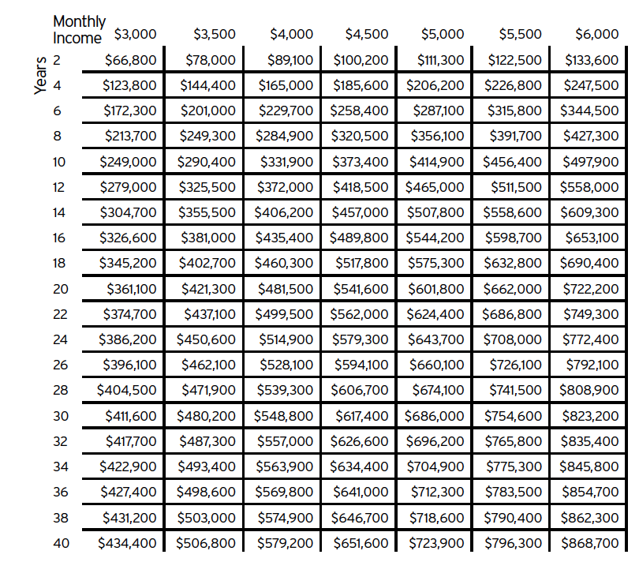
Coverage Needed Invested at 8% for 30 Years
$5,000 Per Month
Coverage Needed $686,000
$3,300 Per Month
Coverage Needed $314,000
Total Premium $112 per month

Slide 27
How much does Term Life Income Protection Cost?
Total Premium $112 per month
Represents 1.3% of Total monthly Income
Insures 100% of the $3,000,000 in future earnings
Doesn’t it make sense to set aside 1.3% of your monthly income to insure 100% of your Lifetime Earnings?

Slide 28
Smart Tips on Buying Insurance
Become more Self-Insured as your Assets Grow by raising your deductibles. You can raise deductibles on Home, Auto, Health Insurance and Increase the waiting period on Long Term care and Disability Income Payments
Buy Term Life Insurance enough to replace your income and you can drop the Term Insurance once you reach your FIN
Always have enough personal liability coverage to protect you against potential lawsuits. A personal Umbrella Policy is a cheap way to have an insurance company's law firm protect you

Slide 29

Thank You for Attending
If you need help with anything that we covered tonight or if you have questions be sure and reach out to the person that invited, you through the private link. Text or email and they will follow up with you. Take Action for Your Family
Do you have a friend or family member that would benefit from this information? Forward your private link that you received and encourage them to register for next week.
Lastly Do you need a work from home “Side Hustle” to earn extra Income? Ask the person who invited you to send you a link to “Join Our Team Webinar”

