Slide 1

Fix Your Finances 2020
Quick Review
Class 2- Budget and Emergency Fund

Slide 2


7 Areas to Free Up Money to Save
Pay yourself first
Adjust your lifestyle
Establish a cash flow plan
Adjust your priorities
Earn extra income
Realign your assets-Sell something
Avoid the credit trap

Slide 3
Gather the Information
You Need to Get Started
Now that you’ve gathered all of the necessary info, it’s time to build a budget! Use this worksheet to help you get started.
Monthly Expense | Amount | Date Due
HOME
Mortgage/Debt | $
Second Mortgage | $
Taxes & Insurance | $
Repairs | $
Homeowner Association Fees | $
UTILITIES
Electric | $
Gas or Oil | $
Water & Sewer | $
Phone (Landline) | $
Phone (Cellular) | $
Cable/Satellite | $
Internet | $
TRANSPORTATION
Car Payment 1 | $
Car Payment 2 | $
Gas | $
Car Insurance | $
Repairs/Maintenance | $
Other (tolls, taxis, parking, subway, bus) | $
INSURANCE
Life Insurance | $
Disability | $
Health Insurance | $
DEBT PAYMENTS (minimums only)
Credit Card 1 | $
Credit Card 2 | $
Credit Card 3 | $
Credit Card 4 | $
Student Loans | $
Other Loans | $
SUBTOTAL: | $
Monthly Expense | Amount | Date Due
SUBTOTAL (from page 1): | $
FOOD
Groceries | $
Dining Out | $
FAMILY PURCHASES
Child Care | $
Child Support | $
Alimony | $
School Tuition Fees | $
PERSONAL CARE
Hair Cuts | $
Prescription Medication | $
Toiletries/Makeup | $
Clothing | $
PETS
Food | $
Care vet bills, grooming, etc. | $
ENTERTAINMENT
Books & Magazines | $
Movies & Concerts | $
Music, Videos & Apps | $
Hobbies | $
Other | $
OTHER
Cleaning Supplies | $
Tithes/Donations | $
Other | $
Other | $
TOTAL: | $
Monthly Expense | Amount | Date Due
HOME
Mortgage/Debt | $
Second Mortgage | $
Taxes & Insurance | $
Repairs | $
Homeowner Association Fees | $
UTILITIES
Electric | $
Gas or Oil | $
Water & Sewer | $
Phone (Landline) | $
Phone (Cellular) | $
Cable/Satellite | $
Internet | $
TRANSPORTATION
Car Payment 1 | $
Car Payment 2 | $
Gas | $
Car Insurance | $
Repairs/Maintenance | $
Other (tolls, taxis, parking, subway, bus) | $
INSURANCE
Life Insurance | $
Disability | $
Health Insurance | $
DEBT PAYMENTS (minimums only)
Credit Card 1 | $
Credit Card 2 | $
Credit Card 3 | $
Credit Card 4 | $
Student Loans | $
Other Loans | $
SUBTOTAL: | $
Monthly Expense | Amount | Date Due
SUBTOTAL (from page 1): | $
FOOD
Groceries | $
Dining Out | $
FAMILY PURCHASES
Child Care | $
Child Support | $
Alimony | $
School Tuition Fees | $
PERSONAL CARE
Hair Cuts | $
Prescription Medication | $
Toiletries/Makeup | $
Clothing | $
PETS
Food | $
Care vet bills, grooming, etc. | $
ENTERTAINMENT
Books & Magazines | $
Movies & Concerts | $
Music, Videos & Apps | $
Hobbies | $
Other | $
OTHER
Cleaning Supplies | $
Tithes/Donations | $
Other | $
Other | $
TOTAL: | $
3

Slide 4
Accounts that Need to be Opened
Emergency Fund- Savings or Money Market
Draft Account- Checking
Personal Weekly Spending Account- Checking

Slide 5

Defense #2 The Emergency Fund

Slide 6

Benefits of an Emergency Fund
Keeps you from Borrowing and going deeper in debt
Provides security and reduces stress and worry
Allows you to cut insurance cost by raising deductibles
It is part of the foundation of your financial house

Slide 7
Fix Your Finances 2020
Class 3- How to Determine Your FIN Number

Slide 8
Step 1- Would you like to know your Financial Independence Number?
Your FIN is the amount of money you’ll need to accumulate, so that someday you can live off that money for the rest of your life and never have to go back to work.
Example: You want to retire in 30 years, with $100,000 a year in todays dollars
30 years from now, after 3% inflation… $243,000 spends like $100,000 does today.
Your FIN is $2,624,000
To get there, invest $1,421 per month for 30 years at 9% = $2,624,400
Lets Find Out What Your FIN Number Is…..
This hypothetical example assumes 20 years of retirement income needed, at a 6% post-retirement rate of return and 3% inflation. Hypothetical investment rates assume a nominal 9% rate of return, compounded monthly, and are not indicative of any specific investment. Any actual investment may be subject to taxes and fees, which would lower performance. This example shows a constant rate of return, unlike actual investments which may fluctuate in value.

Slide 9
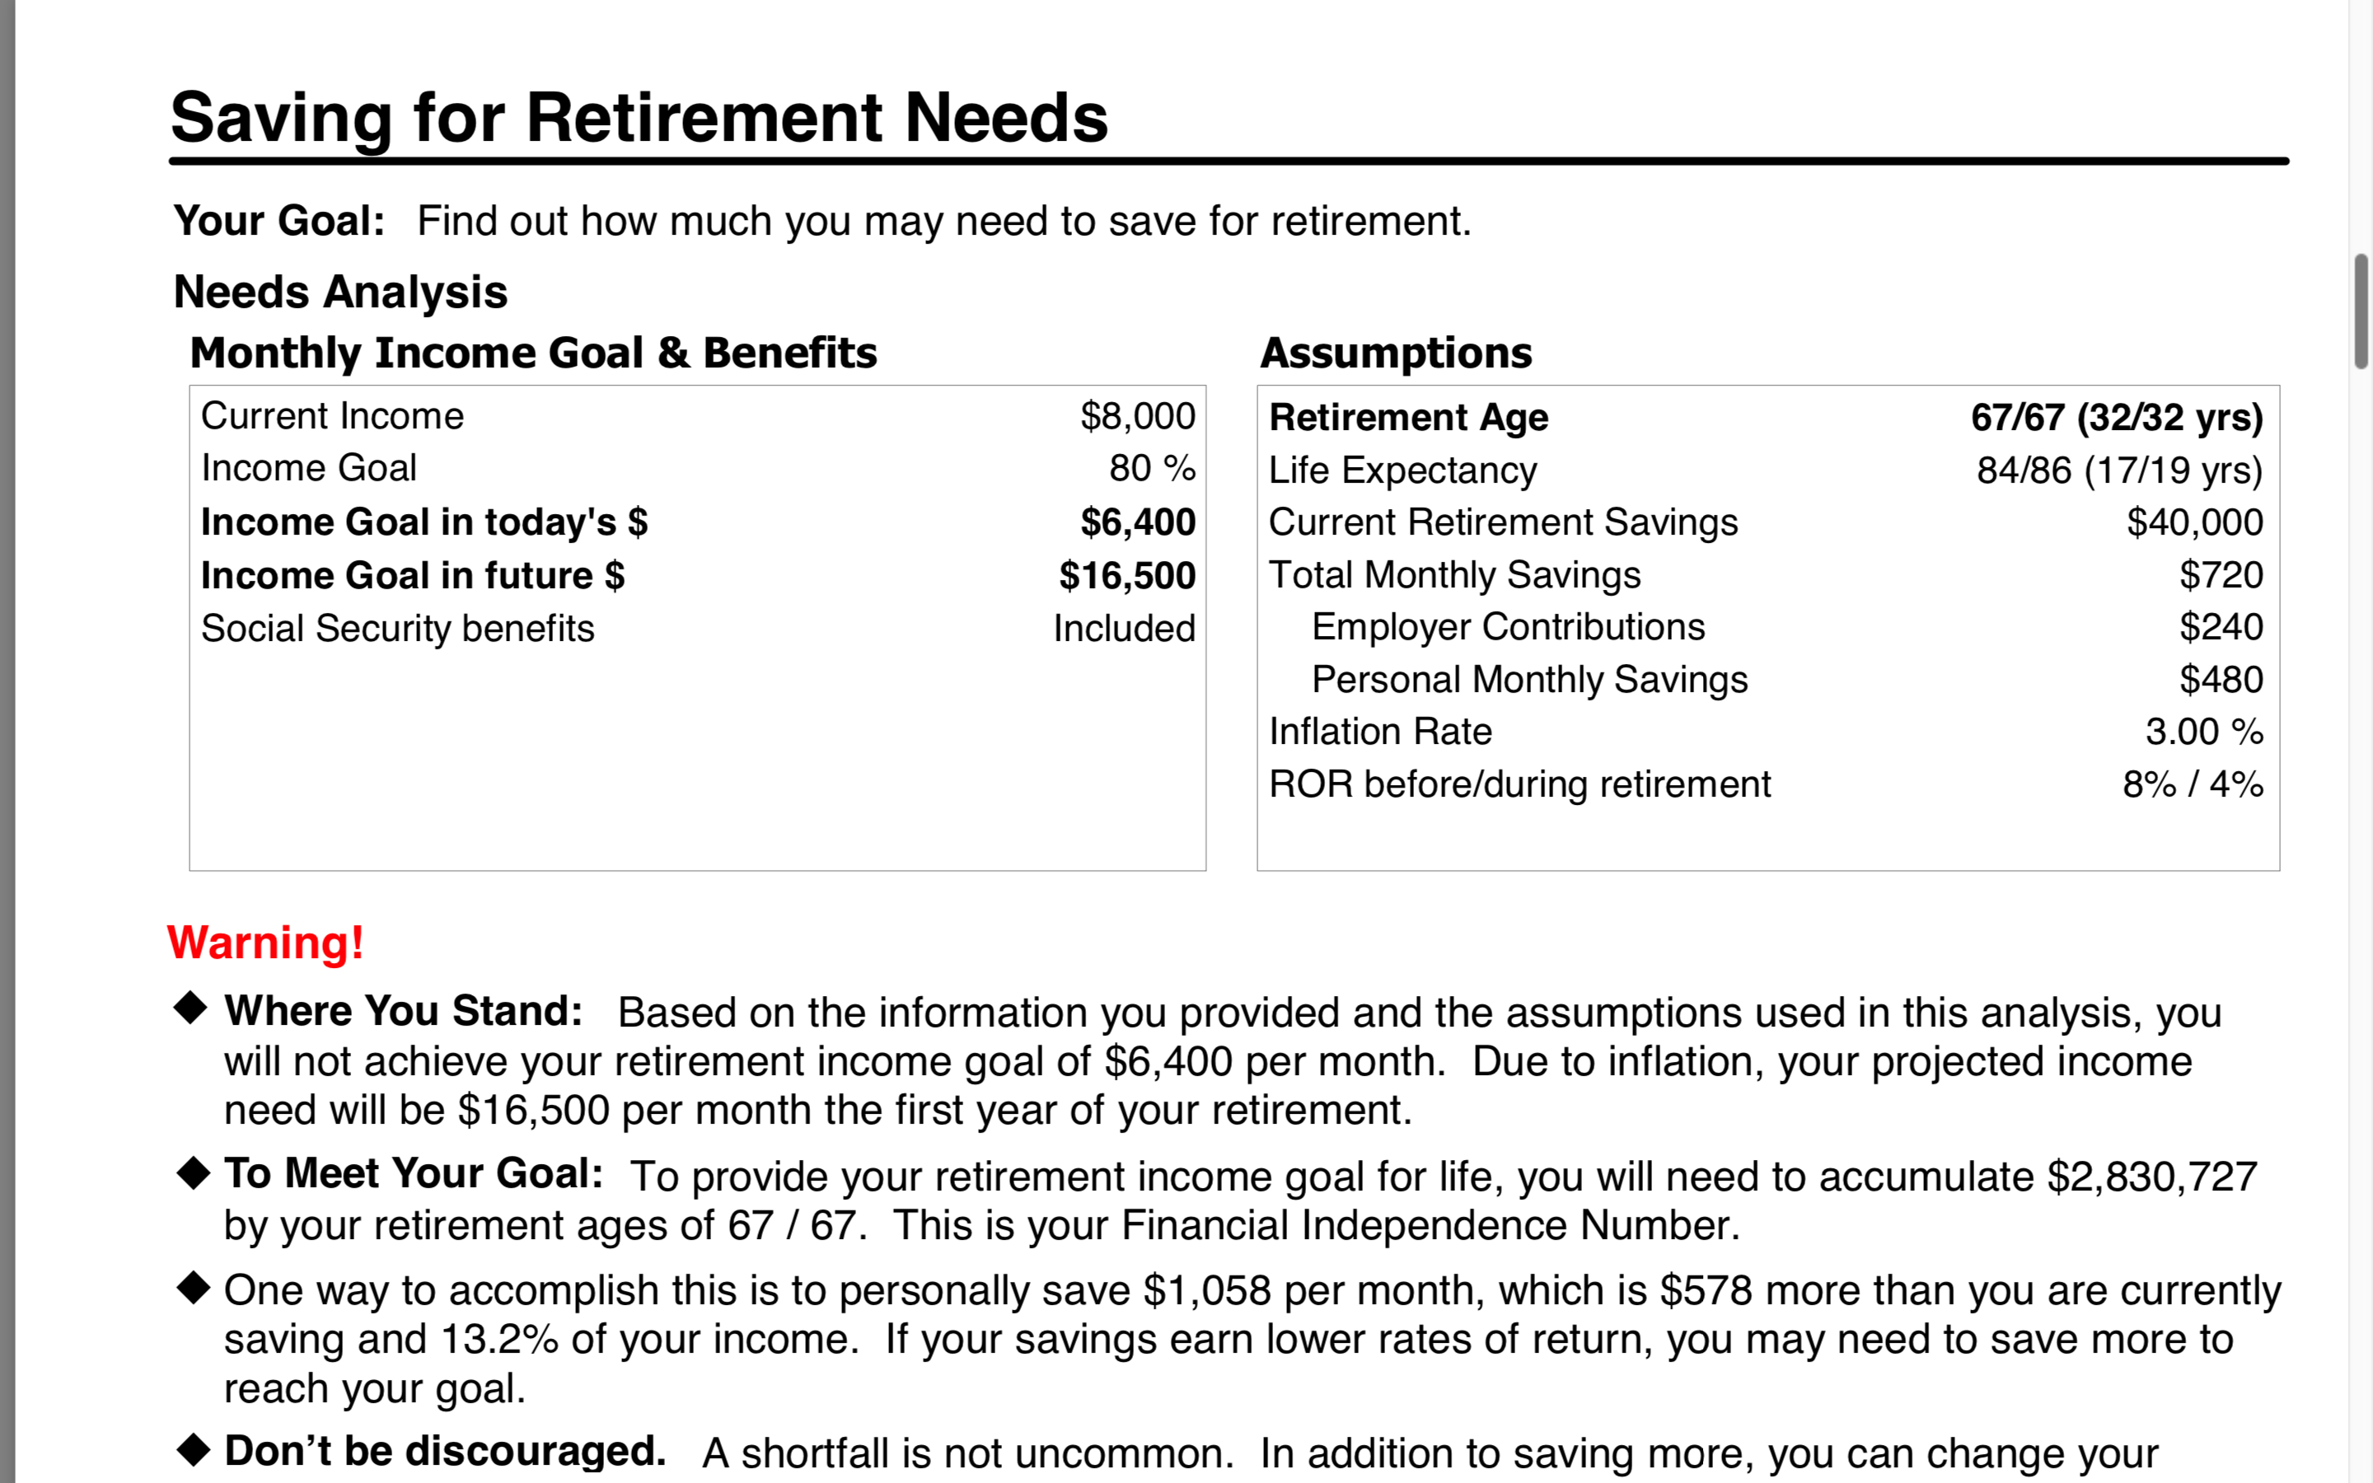
Determine Your FIN- Do Nothing Money

Slide 10
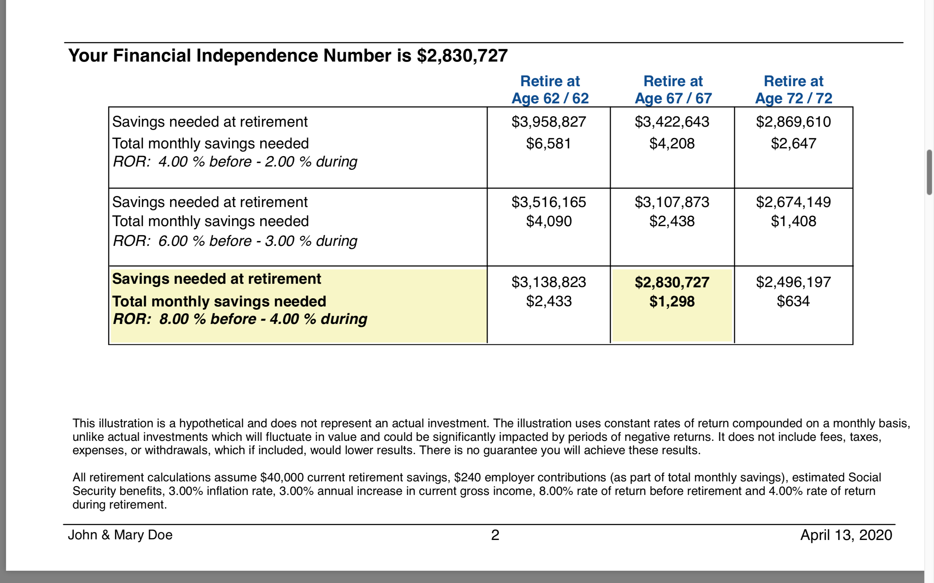
Here are the Numbers

Slide 11


The seeds you sow today will be your Harvest tomorrow…
Fix Your Finances 2020

Slide 12
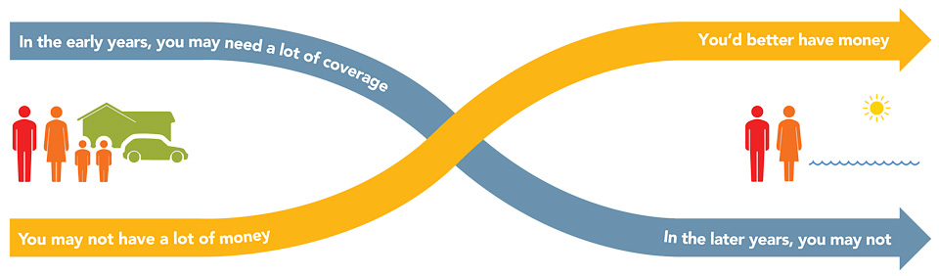
The Theory of Decreasing Responsibility
F I N #
Age 65
Age 30
Today
1. Young children
2. High debt
3. House mortgage
Loss of income
would be devastating
At Retirement
1. Grown children
2. Lower debt
3. Mortgage paid
Retirement income needed
Age 85
Fix Your Finances 2020
Notes:
According to the Theory of Decreasing Responsibility, your need for life insurance peaks along with your family responsibilities. When you’re young, you buy low-cost death protection, term insurance, enough to protect the loss of your earning power, and put the maximum amount you can afford into a promising investment program. When you’re older, you may have much less need for insurance coverage. If you’ve saved and invested wisely you should have a significant amount of accumulated cash. You’ve become “self-insured” and eliminated your need for life insurance.

Slide 13
Inflation
$155,550
$12,962/mo
$94,928
$7,910/mo
Withdrawal
AGE 85
Inflation = 2.5%
AGE 65
Income = $40,000
($3,333/mo)
Accumulation
FIN #
Financial
Independence #
Age 30
Fix Your Finances 2020
Notes:
According to the Theory of Decreasing Responsibility, your need for life insurance peaks along with your family responsibilities. When you’re young, you buy low-cost death protection, term insurance, enough to protect the loss of your earning power, and put the maximum amount you can afford into a promising investment program. When you’re older, you may have much less need for insurance coverage. If you’ve saved and invested wisely you should have a significant amount of accumulated cash. You’ve become “self-insured” and eliminated your need for life insurance.

Slide 14
Setting Your FIN#
$155,550
$12,962/mo
$94,928
$7,910/mo
Withdrawl
AGE 85
Inflation = 2.5%
AGE 65
Income = $40,000
($3,333/mo)
Accumulation
$1,239,137
7%
Financial
Independence #
Age 30
Fix Your Finances 2020
Notes:
According to the Theory of Decreasing Responsibility, your need for life insurance peaks along with your family responsibilities. When you’re young, you buy low-cost death protection, term insurance, enough to protect the loss of your earning power, and put the maximum amount you can afford into a promising investment program. When you’re older, you may have much less need for insurance coverage. If you’ve saved and invested wisely you should have a significant amount of accumulated cash. You’ve become “self-insured” and eliminated your need for life insurance.

Slide 15
You need three things to become
Financially independent…….
1. Time. If you have Lots of time!
2.Money. You need A little money!
3.Rate of return. Small Rate of return!
Shortage of time!
A lot of Money!
Highy rate of return
These are the facts of life!

Slide 16
Accumulating Your FIN#
AGE 65
$1,239,137
Accumulation
Financial
Independence #
Age 30
Add no more Money
For 35 Years
3 %
6 %
9 %
$28,138
$76,860
$204,140
$10,000
$1,669/mo
$ 869/mo
$400/mo
Additional $/mo needed to reach FIN#
Fix Your Finances 2020
Notes:
According to the Theory of Decreasing Responsibility, your need for life insurance peaks along with your family responsibilities. When you’re young, you buy low-cost death protection, term insurance, enough to protect the loss of your earning power, and put the maximum amount you can afford into a promising investment program. When you’re older, you may have much less need for insurance coverage. If you’ve saved and invested wisely you should have a significant amount of accumulated cash. You’ve become “self-insured” and eliminated your need for life insurance.

Slide 17
Spending Phase
9 %
In 20 yrs = $1,854,000
$1,239,137
7 %
In 20 yrs = $757,757
5 %
In 20 yrs = $64,808
$94,928
$7,910/mo
For Illustrative Purposes Only!!!...No Inflation Factored into above Numbers
Fix Your Finances 2020
Notes:
According to the Theory of Decreasing Responsibility, your need for life insurance peaks along with your family responsibilities. When you’re young, you buy low-cost death protection, term insurance, enough to protect the loss of your earning power, and put the maximum amount you can afford into a promising investment program. When you’re older, you may have much less need for insurance coverage. If you’ve saved and invested wisely you should have a significant amount of accumulated cash. You’ve become “self-insured” and eliminated your need for life insurance.

Slide 18
Ask Your Rep for a Complimentary Financial Needs Analysis
A Financial Plan that is Personalized to You
Free of Charge
Calculate your Net Worth
Find out your FIN Number
Debt Elimination Plan
Calculate Insurance Needs
And More…….

Slide 19
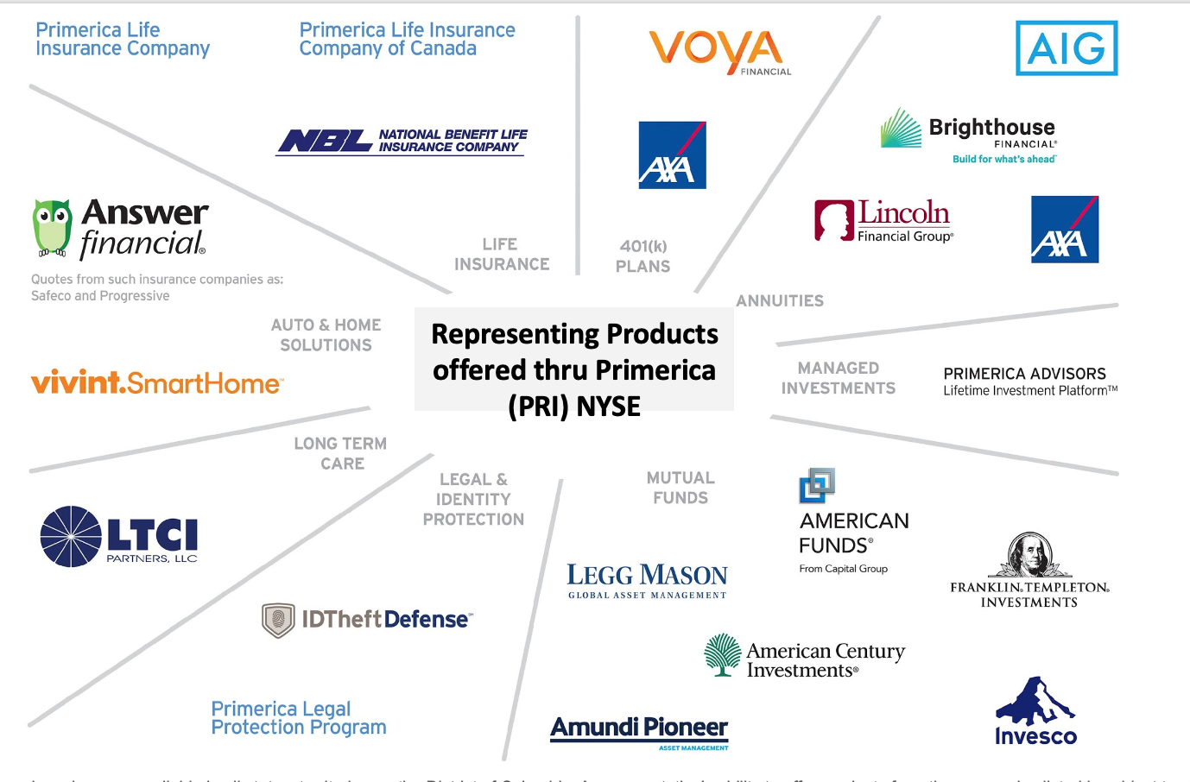
Thank You for Attending
In One Place We have all the “Education and Products” to Help You Reach Your Goals
If you need help with anything that we covered tonight or if you have questions be sure and reach out to the person that invited, you through the private link. Text or email and they will follow up with you. Take Action for Your Family
Do you have a friend or family member that would benefit from this information? Forward your private link that you received and encourage them to register for next week.
Lastly Do you need a work from home “Side Hustle” to earn extra Income? Ask the person who invited you to send you a link to “Join Our Team Webinar”

