Slide 1

Fix your Finances 2020
Quick Review
Class 1- Fundamentals of the Financial House

Slide 2
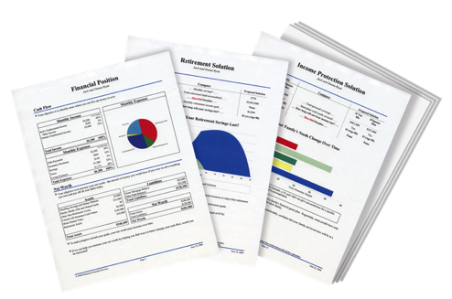
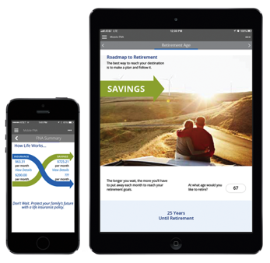
People Don’t Plan to Fail, They Fail to Plan
The Problem:
Traditional financial institutions sell you products. They don’t provide you with a total solution.
The Solution:
A Financial Needs Analysis. A customized, confidential and complimentary program that helps you achieve your goals and dreams.
A Financial GPS: It helps you find answers to important questions.

Slide 3
Step 1- Would you like to know your Financial Independence Number?
Your FIN is the amount of money you’ll need to accumulate, so that someday you can live off that money for the rest of your life and never have to go back to work.
Example: You want to retire in 30 years, with $100,000 a year in todays dollars
30 years from now, after 3% inflation… $243,000 spends like $100,000 does today.
Your FIN is $2,624,000
To get there, invest $1,421 per month for 30 years at 9% = $2,624,400
Lets Find Out What Your FIN Number Is…..
This hypothetical example assumes 20 years of retirement income needed, at a 6% post-retirement rate of return and 3% inflation. Hypothetical investment rates assume a nominal 9% rate of return, compounded monthly, and are not indicative of any specific investment. Any actual investment may be subject to taxes and fees, which would lower performance. This example shows a constant rate of return, unlike actual investments which may fluctuate in value.

Slide 4
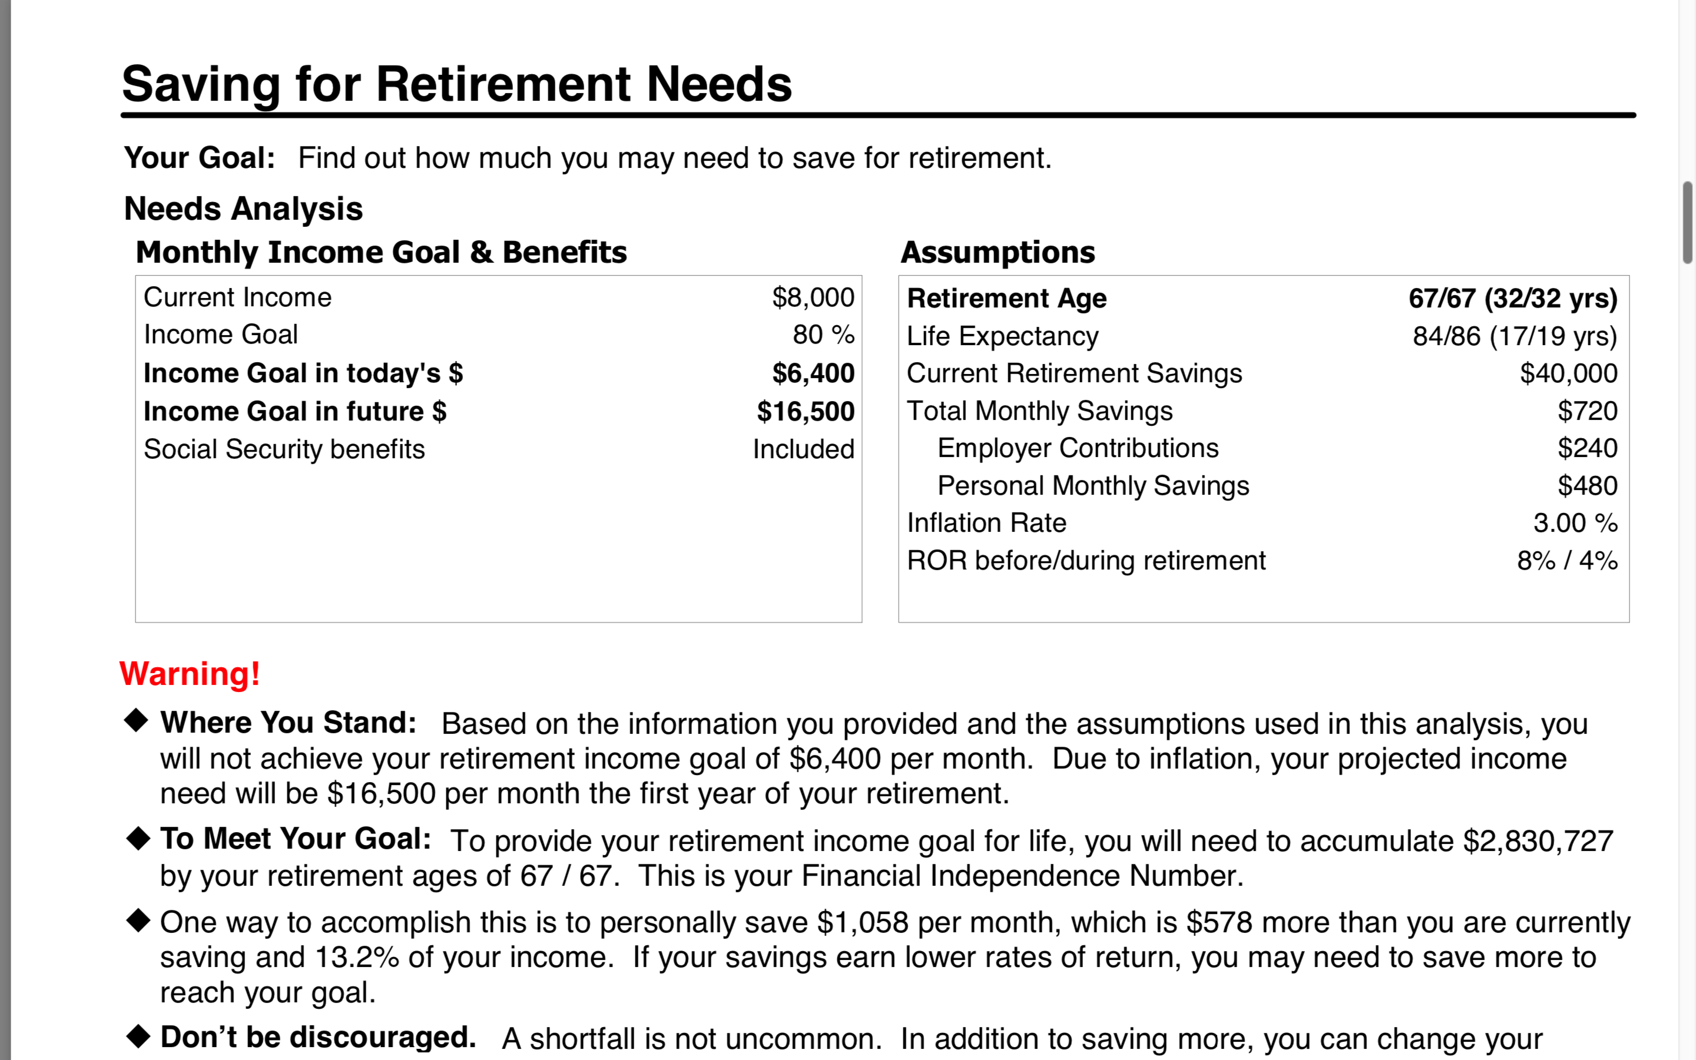
Determine Your FIN- Do Nothing Money

Slide 5
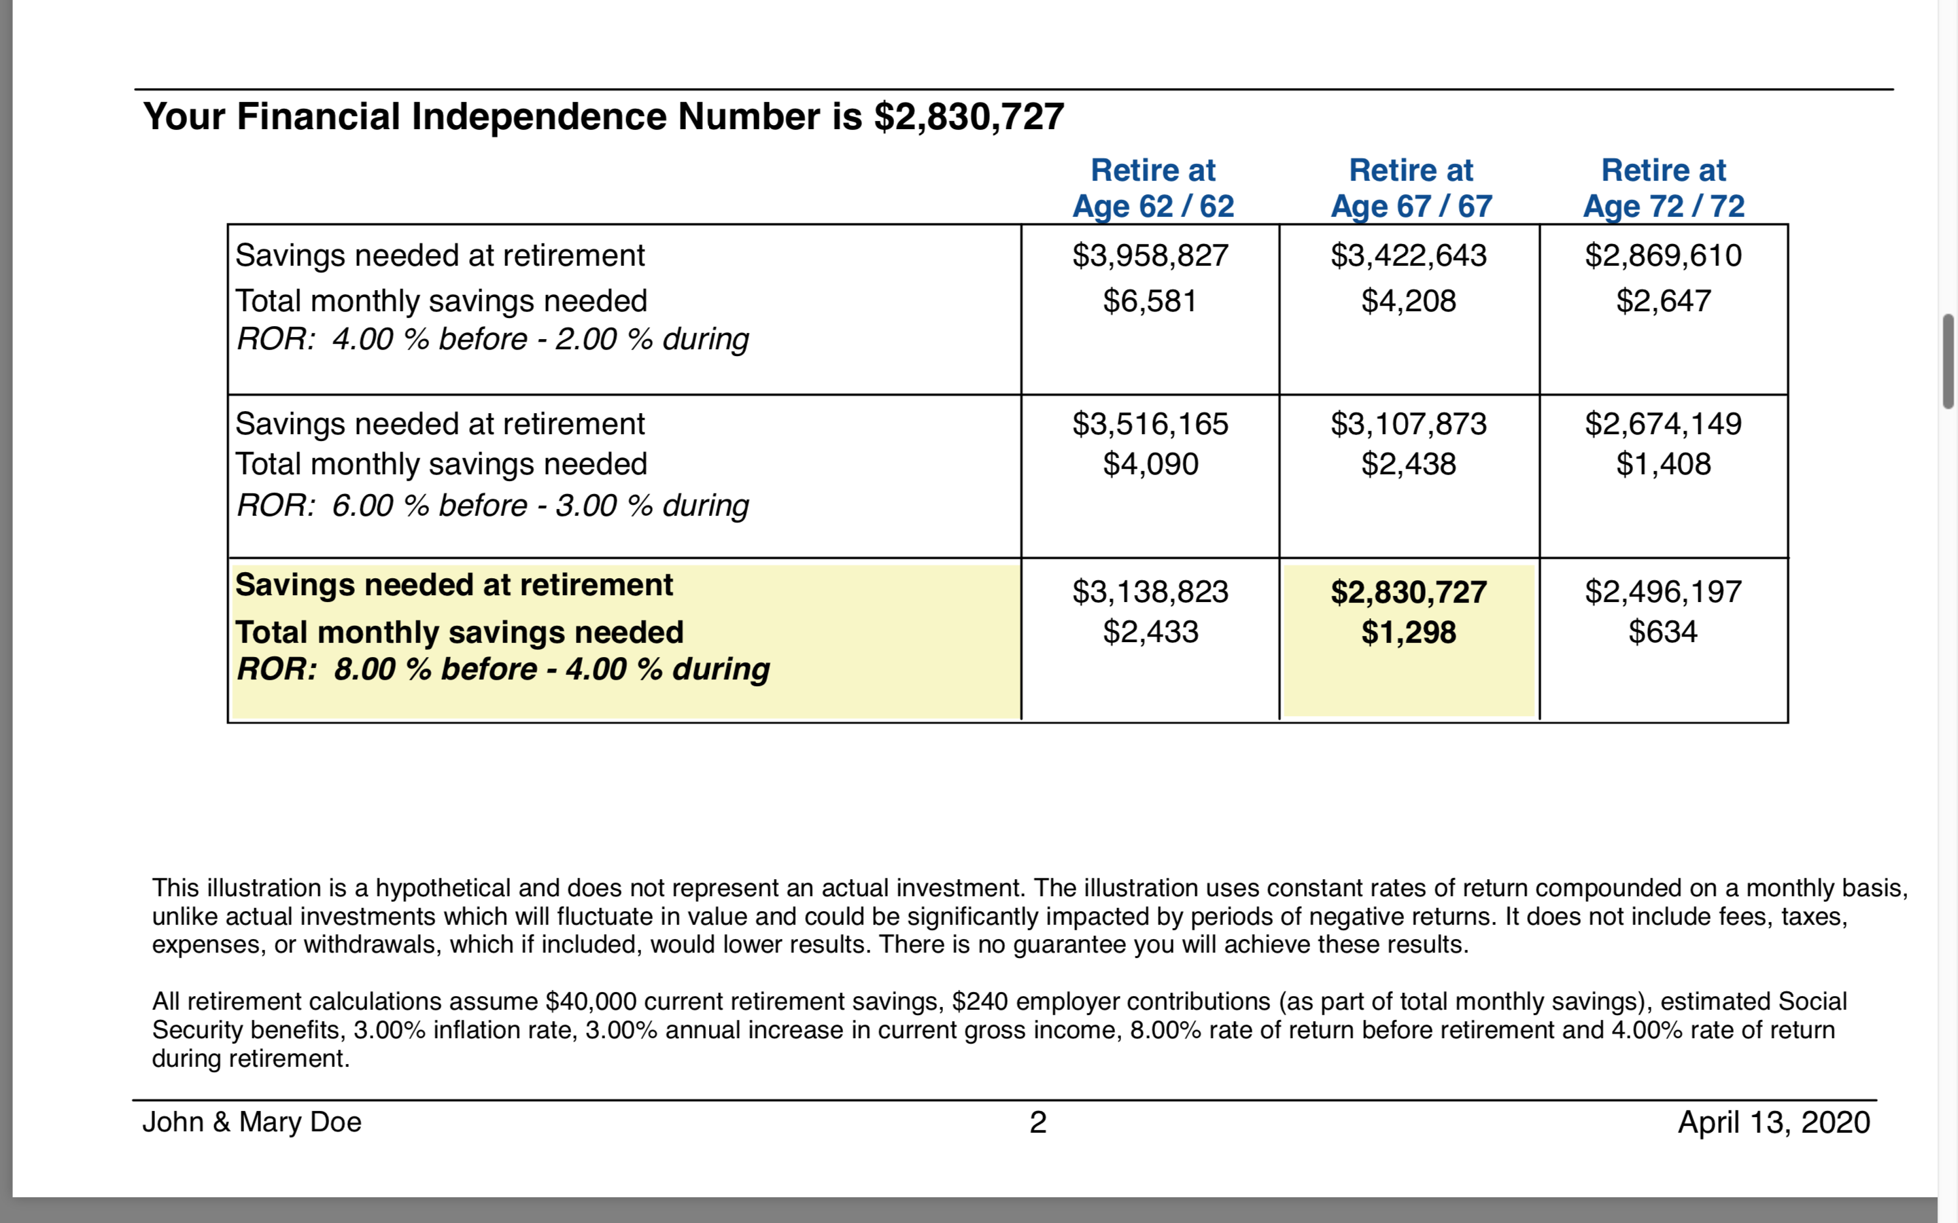
Here are the Numbers

Slide 6
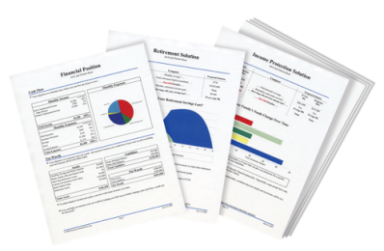
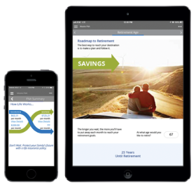
Build Your Financial House
Other Goals and Dreams
Retirement-College Savings
Understanding Investments
Pay Off Bad Debt- Home Ownership
On a scale of 1-10,
10 being the highest,
how would you rate your
confidence level that you will become debt free and financially independent?
Protect Your Income and Liabilities
Budget - Emergency Fund

Slide 7


Last Weeks Homework

Slide 8
GPS: Build Your Financial House
Plan Schedule/Completion
__________________________________________________
__________________________________________________
__________________________________________________
__________________________________________________
__________________________________________________
__________________________________________________
__________________________________________________
__________________________________________________
Other Goals and Dreams
Retirement-College Savings
Understanding Investments
Pay Off Bad Debt- Home Ownership
Protect Your Income and Liabilities
Budget - Emergency Fund

Slide 9
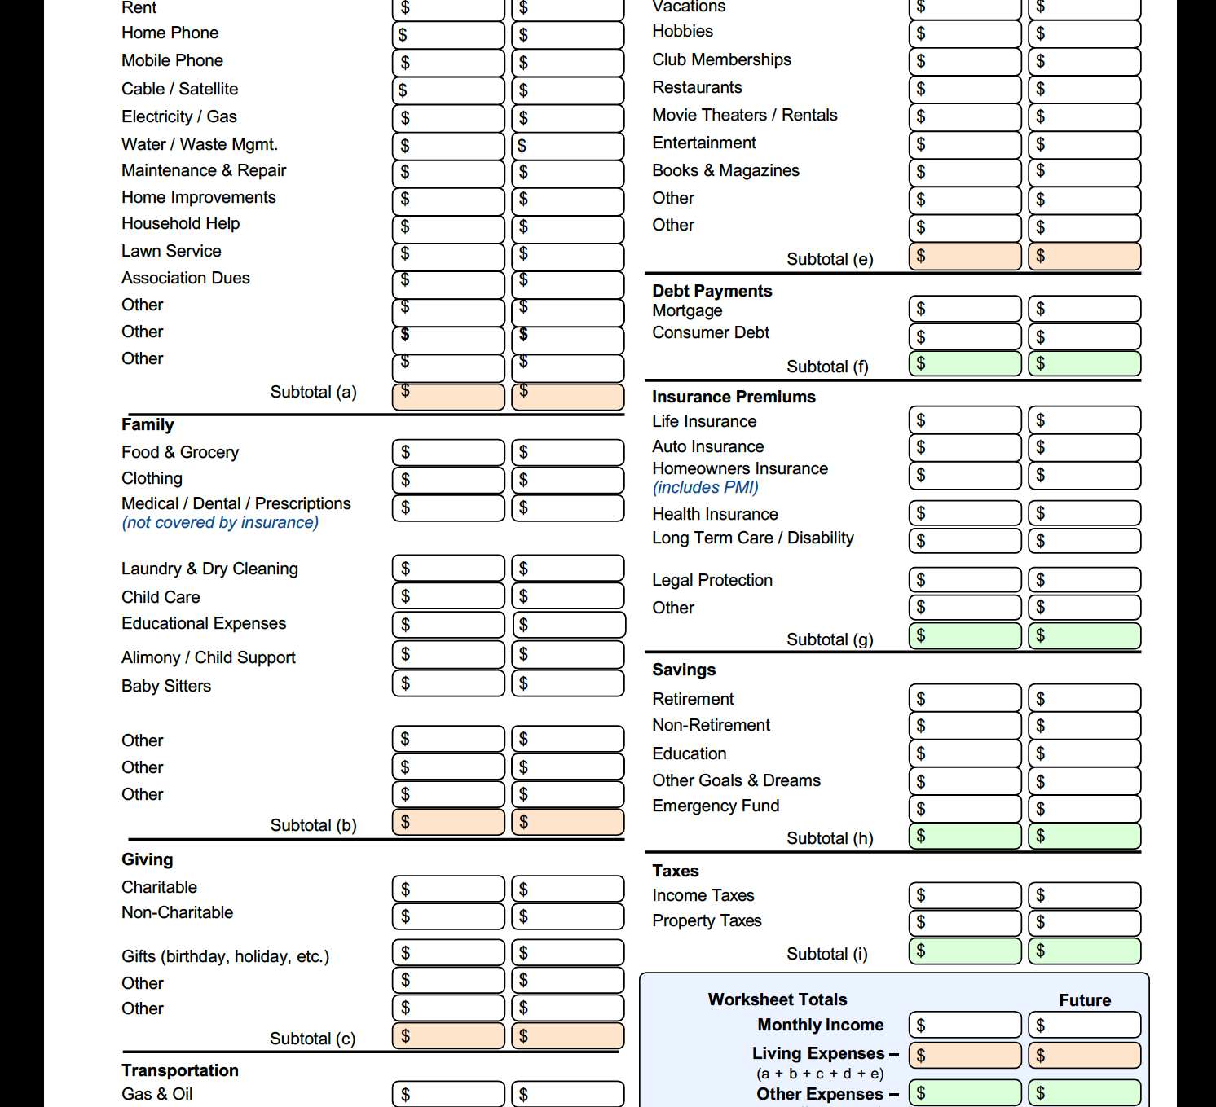
Budget Worksheet

Slide 10
Fix Your Finances 2020
Class 2- How to Set Up a Working Budget and Establishing an Emergency Fund

Slide 11
Financial Defense-Build Your Financial House
Offense
Home Ownership
Pay Off Bad Debt
On a scale of 1-10,
10 being the highest,
how would you rate your
confidence level that you will become debt free and financially independent?
Protect Your Income and Liabilities
Budget - Emergency Fund

Slide 12

Defense #1 The Cash Flow Plan or Budget

Slide 13
Did You Know?
“One in four people have almost nothing saved for retirement.”
– Money.CNN.com, March 22, 2019
“More than 80 percent of people making less than $50,000 a year say it is hard to keep up with bills and save for retirement at the same time, and half say it is very hard.”
CBSNews.com, viewed May 25, 2018
“Nearly half of Americans would have trouble finding $400 to pay for an emergency.”
– TheAtlantic.com, May 2019
“Millions of Americans have no savings set aside for a rainy day, leaving them in serious jeopardy if financial calamity strikes…”
– USAToday.com, March 31, 2019

Slide 14

Getting Started
Principle # 1 Where will I get the money to get started?
Problem: Most people have too much month left at the end of the money.
Solution: No matter what your income you can find money to save.

Slide 15


7 Areas to Free Up Money to Save
Pay yourself first
Adjust your lifestyle
Establish a cash flow plan
Adjust your priorities
Earn extra income
Realign your assets-Sell something
Avoid the credit trap

Slide 16
Find Out Where the Money Should Go
Housing and Debt
30%
25% Taxes*
Living Expenses 26%
4% Insurance
15%
Savings and Investments
In an ideal budget,
your monthly income
should be divided up between
five main categories of spending.
16

Slide 17

Keys to Handing your Money
Never lose money
Stop buying stupid things
Only spend money that you have
Have a Big Goal – Save 50% of your income

Slide 18
Budgeting
Tips
Take an honest appraisal of what you spend (budget sheet)
Everything is electronically itemized
Decide what you are going to adjust (not sacrifice) its just an exchange
Keep as many expenses as you can variable
Automatic Millionaire

Slide 19
Gather the Information
You Need to Get Started
Now that you’ve gathered all of the necessary info, it’s time to build a budget! Use this worksheet to help you get started.
Monthly Expense | Amount | Date Due
HOME
Mortgage/Debt | $
Second Mortgage | $
Taxes & Insurance | $
Repairs | $
Homeowner Association Fees | $
UTILITIES
Electric | $
Gas or Oil | $
Water & Sewer | $
Phone (Landline) | $
Phone (Cellular) | $
Cable/Satellite | $
Internet | $
TRANSPORTATION
Car Payment 1 | $
Car Payment 2 | $
Gas | $
Car Insurance | $
Repairs/Maintenance | $
Other (tolls, taxis, parking, subway, bus) | $
INSURANCE
Life Insurance | $
Disability | $
Health Insurance | $
DEBT PAYMENTS (minimums only)
Credit Card 1 | $
Credit Card 2 | $
Credit Card 3 | $
Credit Card 4 | $
Student Loans | $
Other Loans | $
SUBTOTAL: | $
Monthly Expense | Amount | Date Due
SUBTOTAL (from page 1): | $
FOOD
Groceries | $
Dining Out | $
FAMILY PURCHASES
Child Care | $
Child Support | $
Alimony | $
School Tuition Fees | $
PERSONAL CARE
Hair Cuts | $
Prescription Medication | $
Toiletries/Makeup | $
Clothing | $
PETS
Food | $
Care vet bills, grooming, etc. | $
ENTERTAINMENT
Books & Magazines | $
Movies & Concerts | $
Music, Videos & Apps | $
Hobbies | $
Other | $
OTHER
Cleaning Supplies | $
Tithes/Donations | $
Other | $
Other | $
TOTAL: | $
Monthly Expense | Amount | Date Due
HOME
Mortgage/Debt | $
Second Mortgage | $
Taxes & Insurance | $
Repairs | $
Homeowner Association Fees | $
UTILITIES
Electric | $
Gas or Oil | $
Water & Sewer | $
Phone (Landline) | $
Phone (Cellular) | $
Cable/Satellite | $
Internet | $
TRANSPORTATION
Car Payment 1 | $
Car Payment 2 | $
Gas | $
Car Insurance | $
Repairs/Maintenance | $
Other (tolls, taxis, parking, subway, bus) | $
INSURANCE
Life Insurance | $
Disability | $
Health Insurance | $
DEBT PAYMENTS (minimums only)
Credit Card 1 | $
Credit Card 2 | $
Credit Card 3 | $
Credit Card 4 | $
Student Loans | $
Other Loans | $
SUBTOTAL: | $
Monthly Expense | Amount | Date Due
SUBTOTAL (from page 1): | $
FOOD
Groceries | $
Dining Out | $
FAMILY PURCHASES
Child Care | $
Child Support | $
Alimony | $
School Tuition Fees | $
PERSONAL CARE
Hair Cuts | $
Prescription Medication | $
Toiletries/Makeup | $
Clothing | $
PETS
Food | $
Care vet bills, grooming, etc. | $
ENTERTAINMENT
Books & Magazines | $
Movies & Concerts | $
Music, Videos & Apps | $
Hobbies | $
Other | $
OTHER
Cleaning Supplies | $
Tithes/Donations | $
Other | $
Other | $
TOTAL: | $
19

Slide 20
Accounts that Need to be Opened
Emergency Fund- Savings or Money Market
Draft Account- Checking
Personal Weekly Spending Account- Checking

Slide 21

Account Descriptions
Draft Account- This is a checking account where your total household income comes in. If you are married, we recommend both incomes go into this account. If your company provides a retirement plan and group health insurance, then this would be the income after those costs. All recurring bills including long term investments are set on automation as well as money is set aside for future purchases
Emergency Fund- This account should have an automatic transfer from the draft account each month until it is fully funded 3-6 months of expenses. If you have Bad Debt you can transfer from this account periodically to finish off any debts while maintaining a comfortable amount of emergency cash.

Slide 22
Account Descriptions
Weekly Spending Account- This is a checking account that is used to cover any weekly miscellaneous expenses. Each spouse should have an individual account based on typical weekly expenses. You should have a debit card. If you need cash, then you can get the cash from the ATM.
Each day have the bank text or email you the balance in the account. Sunday night transfer from the draft account to the weekly spending account

Slide 23

Steps to Setting Up the Cash Flow Plan
Use the Budget worksheet to account for all previous income and expenses
All Income deposited in your Draft Account
Drafts to Investments
Money is set aside for cars,vacations,maintanance, Christmas,etc. This money will be allocated and withdrawn as needed.
Drafts and bill pay to pay recurring expenses
Make any cuts that will allow for a positive real outcome.

Slide 24
Defense #2 The Emergency Fund

Slide 25



The Three Accounts You Need to Budget
To have a complete savings program,
most people need three types of basic accounts.
Emergency Fund
Short-Term Savings
Long-Term Savings or Investments
Investing entails risk including loss of principal. Shares, when redeemed, may be worth more or less than original value.

Slide 26
Benefits of an Emergency Fund
Keeps you from Borrowing and going deeper in debt
Provides security and reduces stress and worry
Allows you to cut insurance cost by raising deductibles
It is part of the foundation of your financial house

Slide 27
How Much should you have in an Emergency Fund?
Short Term Goal of $1,000 or 1 month of expenses
Long Term Goal 3-6 months of expenses
Use a money market account or savings account

Slide 28

Building Your
Defense

Slide 29
Next Weeks Homework
Utilize the 7 ways to free up money to save and free up some cash
Take the time and work on your budget and set up your bank accounts
Set up all bill pays and drafts
Check your email

Slide 30
Thank You for Attending- We can Help You.
If you need help with anything that we covered tonight or if you have questions be sure and reach out to the person that invited you through the private link. Text or email and they will follow up with you.
Do you have a friend or family member that would benefit from this information? Forward your private link that you received and encourage them to register for next week.
Lastly Do you need a work from home “Side Hustle” to earn extra Income? Ask the person who invited you to send you a link to “Join Our Team Webinar”

