Slide 2

Fix your Finances 2020
Class 1- Fundamentals of the Financial House

Slide 3
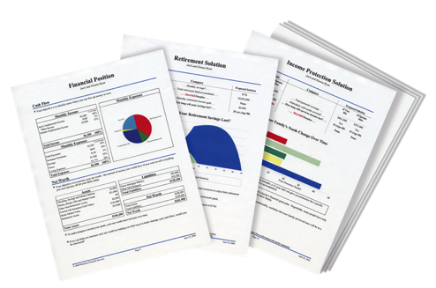

People Don’t Plan to Fail, They Fail to Plan
The Problem:
Traditional financial institutions sell you products. They don’t provide you with a total solution.
The Solution:
A Financial Needs Analysis. A customized, confidential and complimentary program that helps you achieve your goals and dreams.
A Financial GPS: It helps you find answers to important questions.

Slide 4
Step 1- Would you like to know your Financial Independence Number?
Your FIN is the amount of money you’ll need to accumulate, so that someday you can live off that money for the rest of your life and never have to go back to work.
Example: You want to retire in 30 years, with $100,000 a year in todays dollars
30 years from now, after 3% inflation… $243,000 spends like $100,000 does today.
Your FIN is $2,624,000
To get there, invest $1,421 per month for 30 years at 9% = $2,624,400
Lets Find Out What Your FIN Number Is…..
This hypothetical example assumes 20 years of retirement income needed, at a 6% post-retirement rate of return and 3% inflation. Hypothetical investment rates assume a nominal 9% rate of return, compounded monthly, and are not indicative of any specific investment. Any actual investment may be subject to taxes and fees, which would lower performance. This example shows a constant rate of return, unlike actual investments which may fluctuate in value.

Slide 5
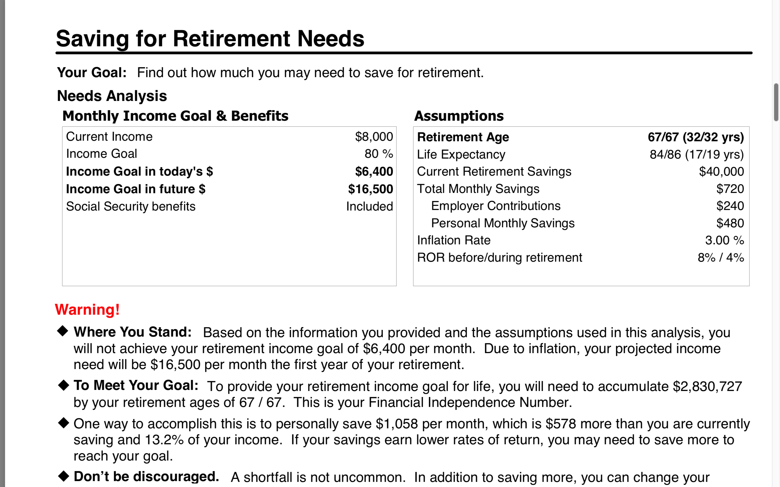
Determine Your FIN- Do Nothing Money

Slide 6
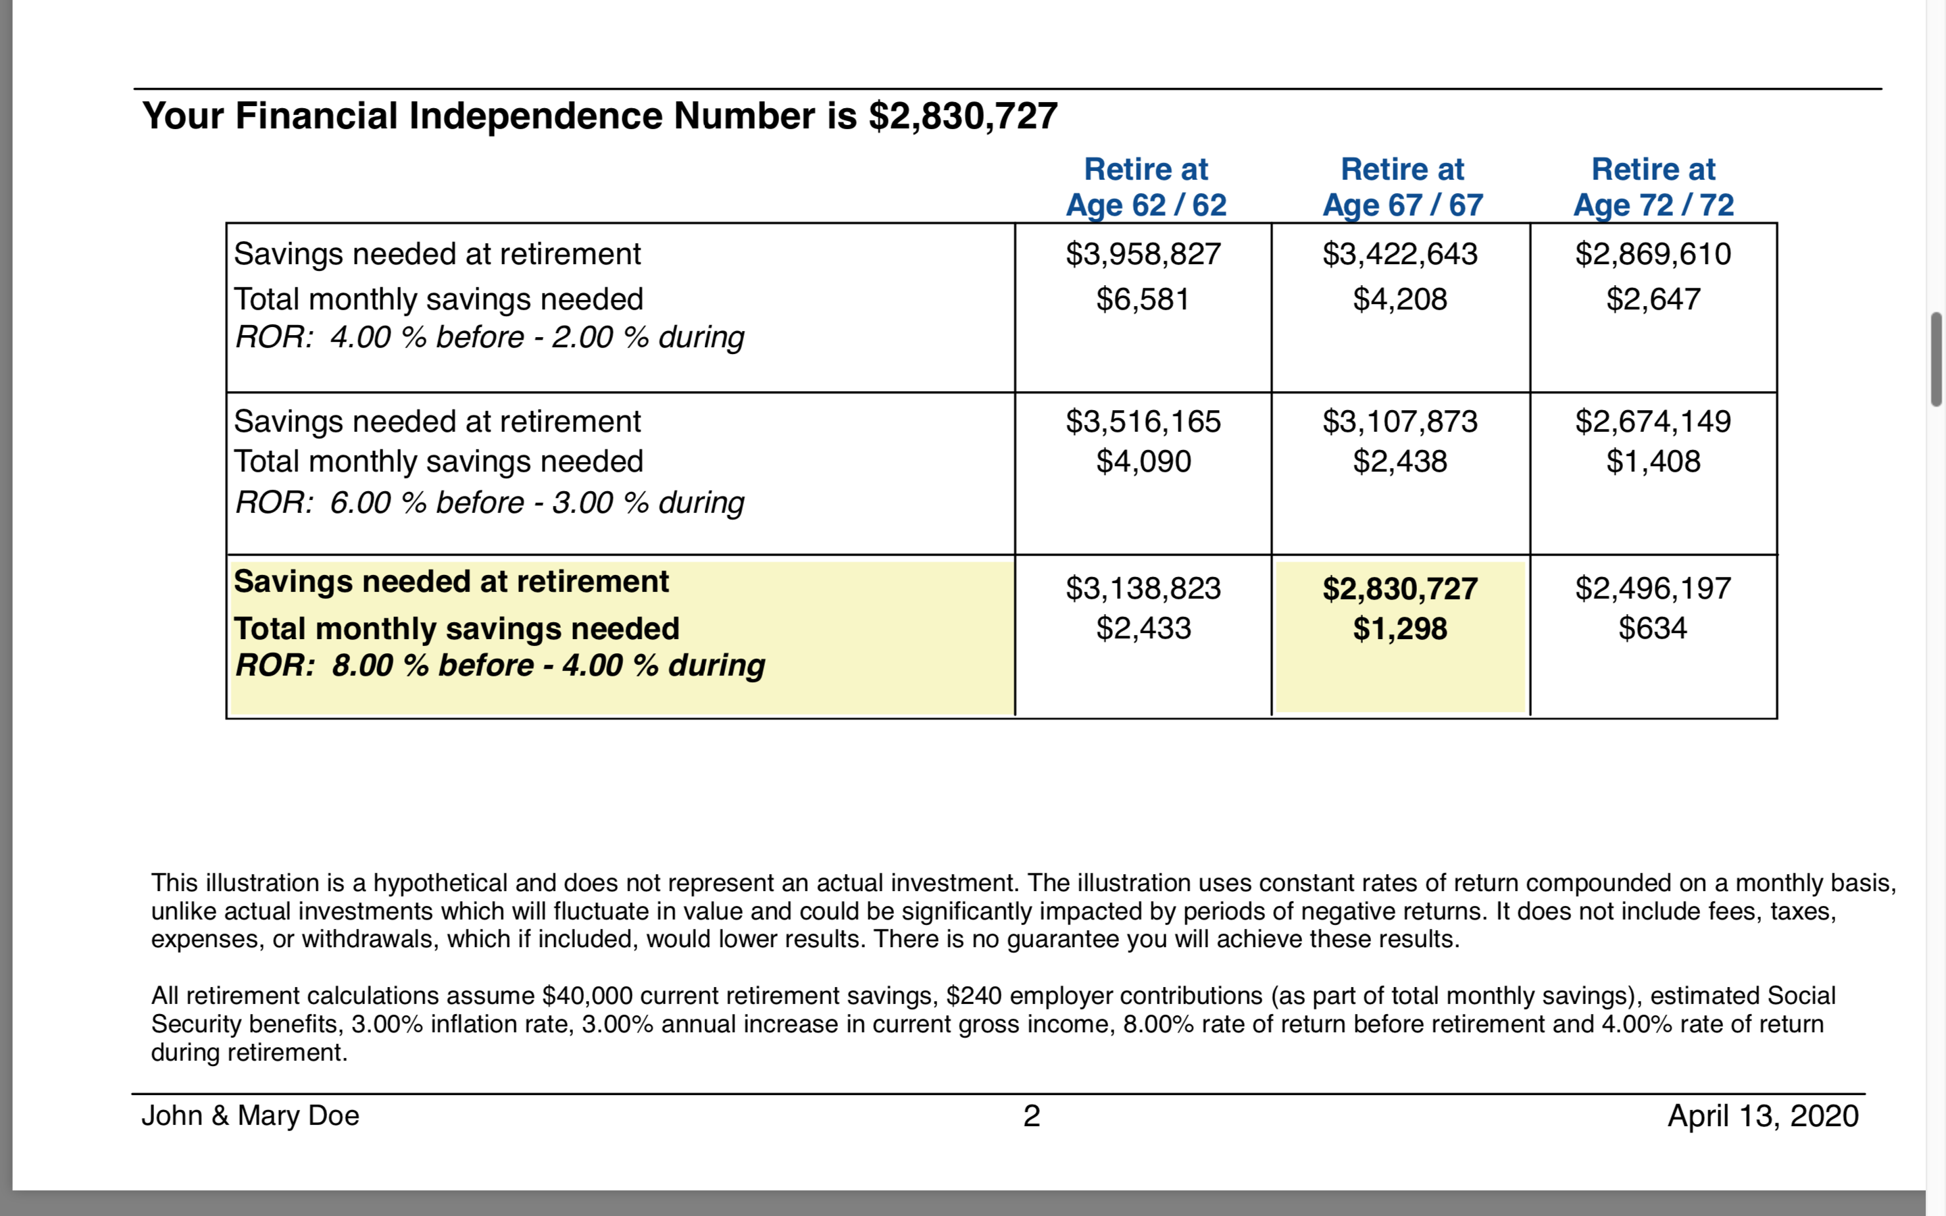
Here are the Numbers

Slide 7
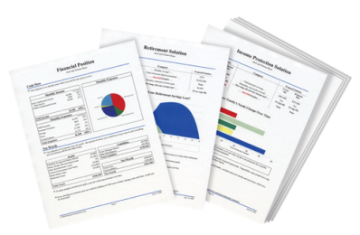

Build Your Financial House
Other Goals and Dreams
Retirement-College Savings
Understanding Investments
Pay Off Bad Debt- Home Ownership
On a scale of 1-10,
10 being the highest,
how would you rate your
confidence level that you will become debt free and financially independent?
Protect Your Income and Liabilities
Budget - Emergency Fund

Slide 8


Last Weeks Homework

Slide 9
GPS: Build Your Financial House
Plan Schedule/Completion
__________________________________________________
__________________________________________________
__________________________________________________
__________________________________________________
__________________________________________________
__________________________________________________
__________________________________________________
__________________________________________________
Other Goals and Dreams
Retirement-College Savings
Understanding Investments
Pay Off Bad Debt- Home Ownership
Protect Your Income and Liabilities
Budget - Emergency Fund

Slide 10
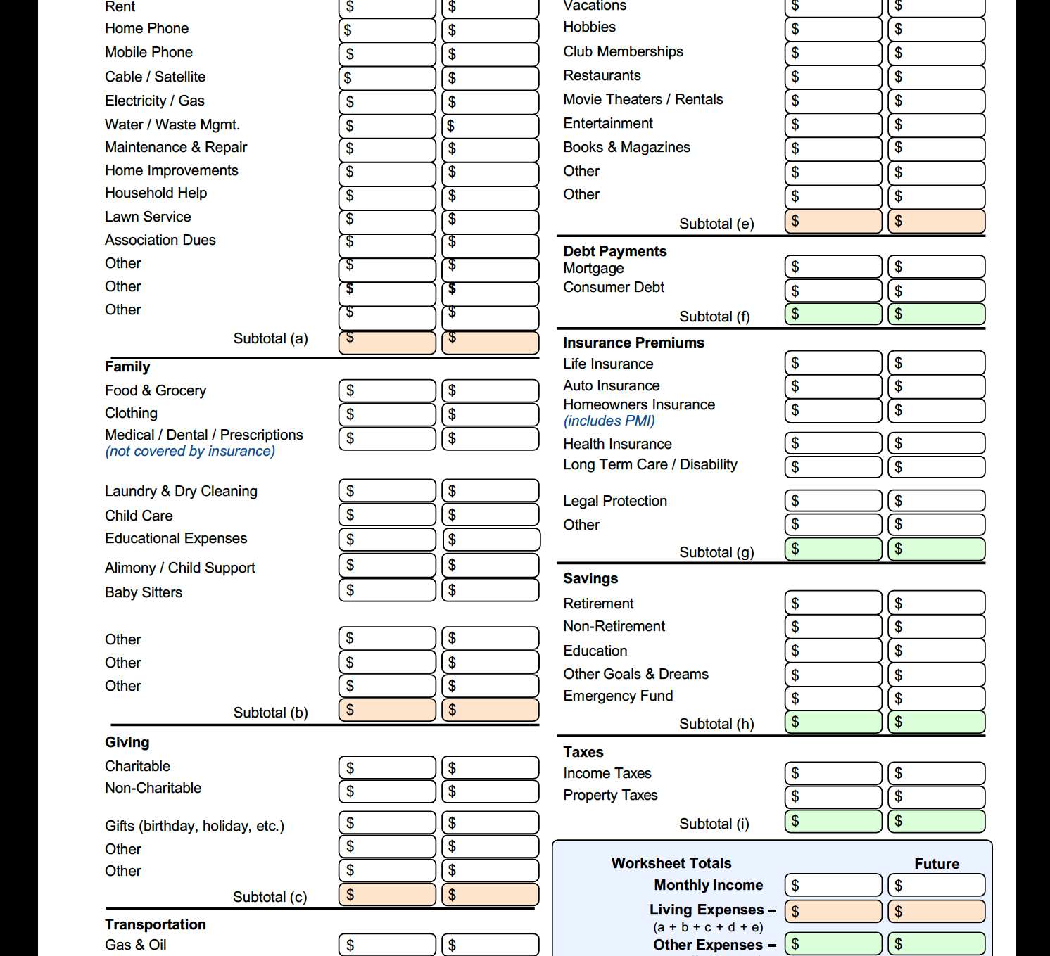
Budget Worksheet

